Slide 1
understanding STAAR 2024
getting centered – getting started

Slide 2
welcome leaders

Slide 3
Data pics

Slide 4
not just me!

Slide 5
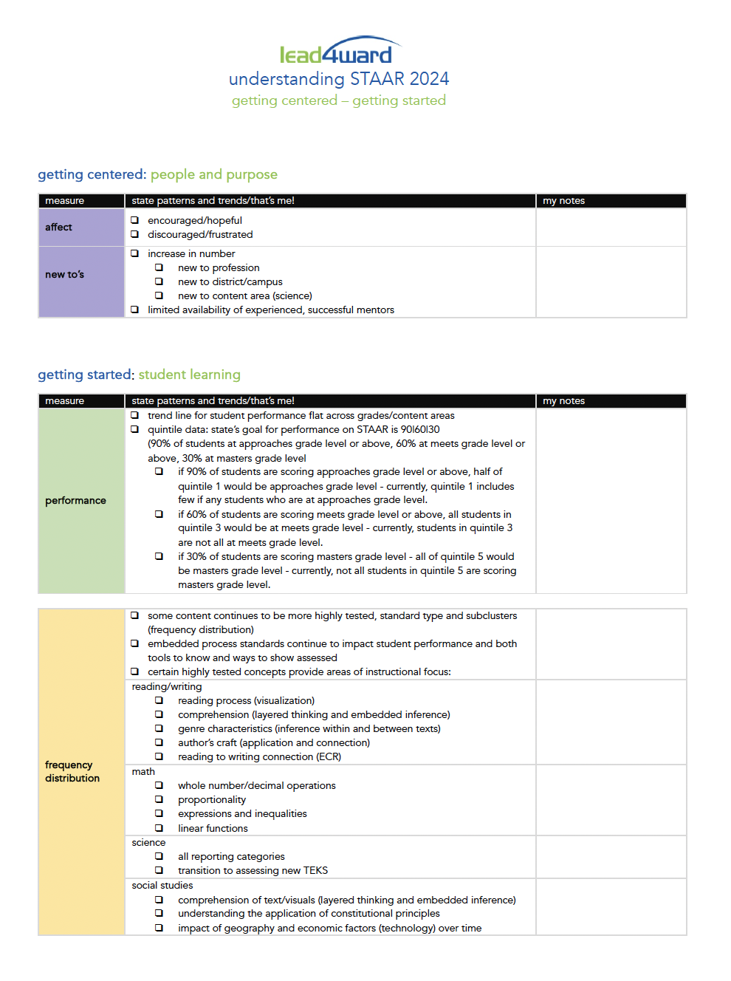

Slide 6
getting centered

Slide 8
mood matters

Slide 9
new to’s
new to profession
new to campus/district
new to content area

Slide 10
getting started

Slide 11
the story behind the numbers

Slide 12
learning ABOUT the test
learning FROM the test

Slide 13
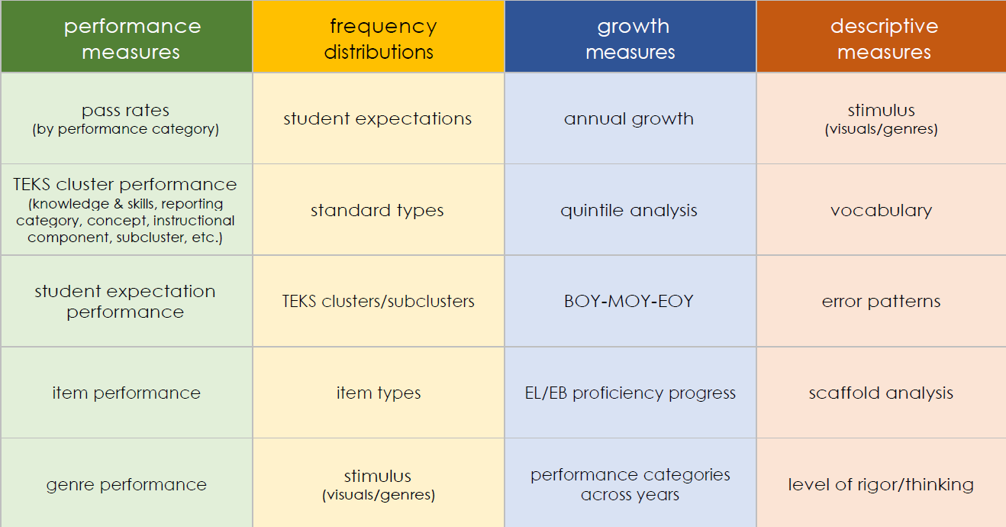
what can we learn from state data?
Prioritize
Focus
Monitor
Informs

Slide 14
getting started
systemic
most kids
most teachers
most content
specific
some kids
some teachers
some content

Slide 15
what can we learn from state data?
Prioritize

Slide 16
performance
90 | 60 |30
approaches
meets
meets
masters
masters
masters

Slide 17
the goal
Quintile 1
Quintile 2
Quintile 3
Quintile 4
Quintile 5
did not meet
approaches
meets
masters

Slide 18
the state pattern
Quintile 1
Quintile 2
Quintile 3
Quintile 4
Quintile 5
did not meet
approaches
meets
masters

Slide 19
performance
systemic
most kids
most teachers
most content

Slide 20
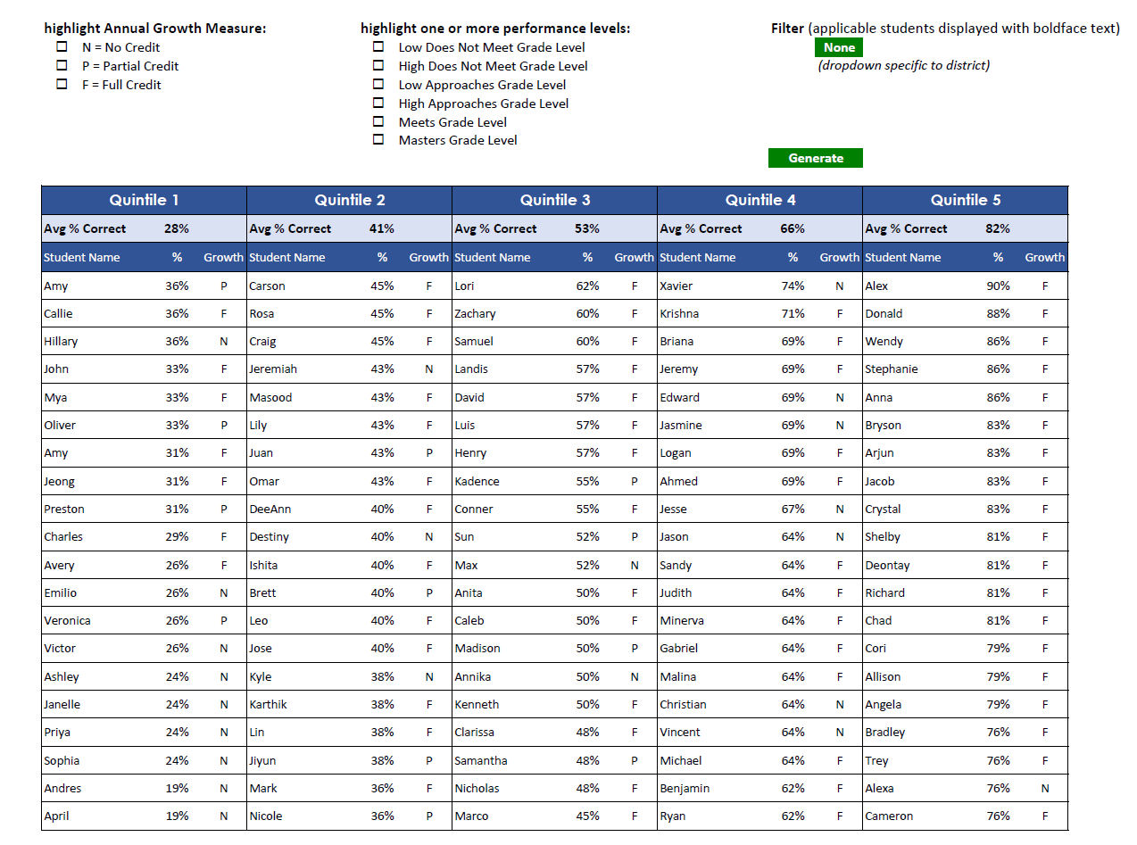

Slide 21
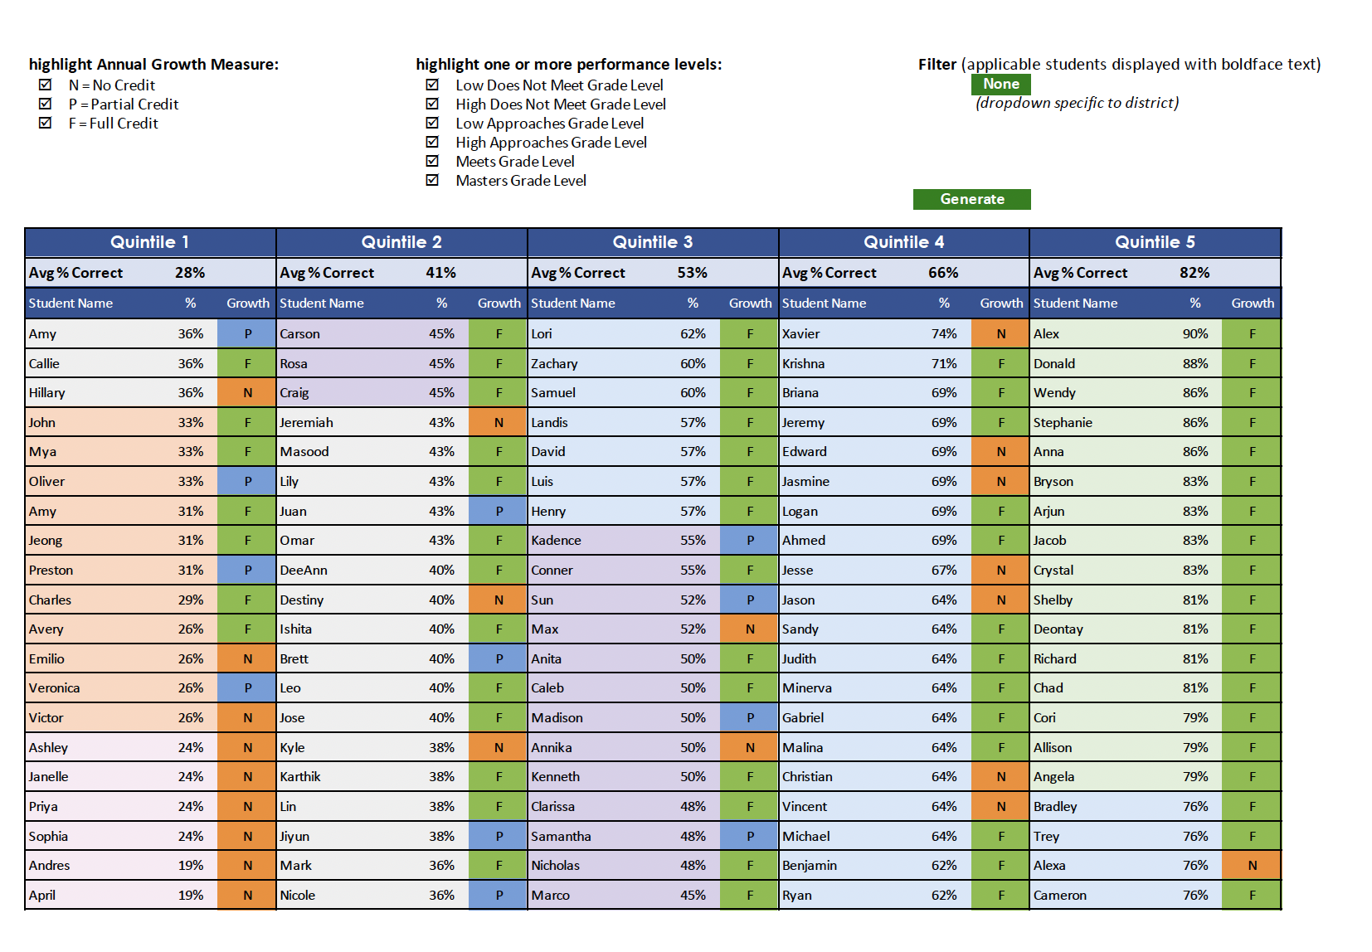

Slide 22
what can we learn from state data?
Prioritize
Focus

Slide 23
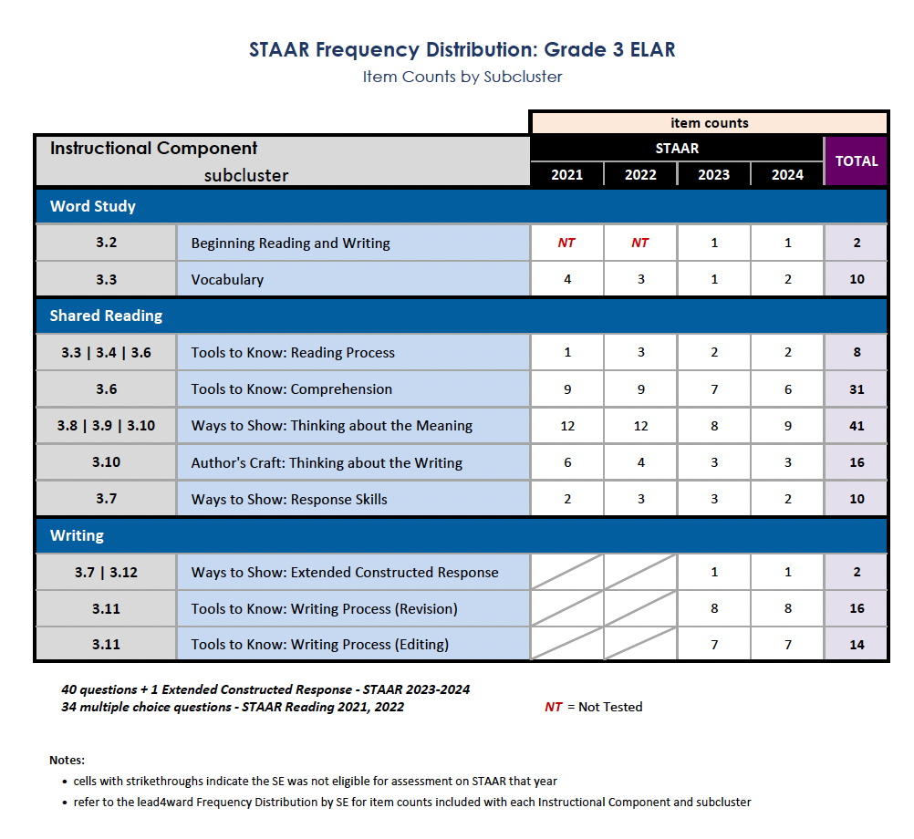
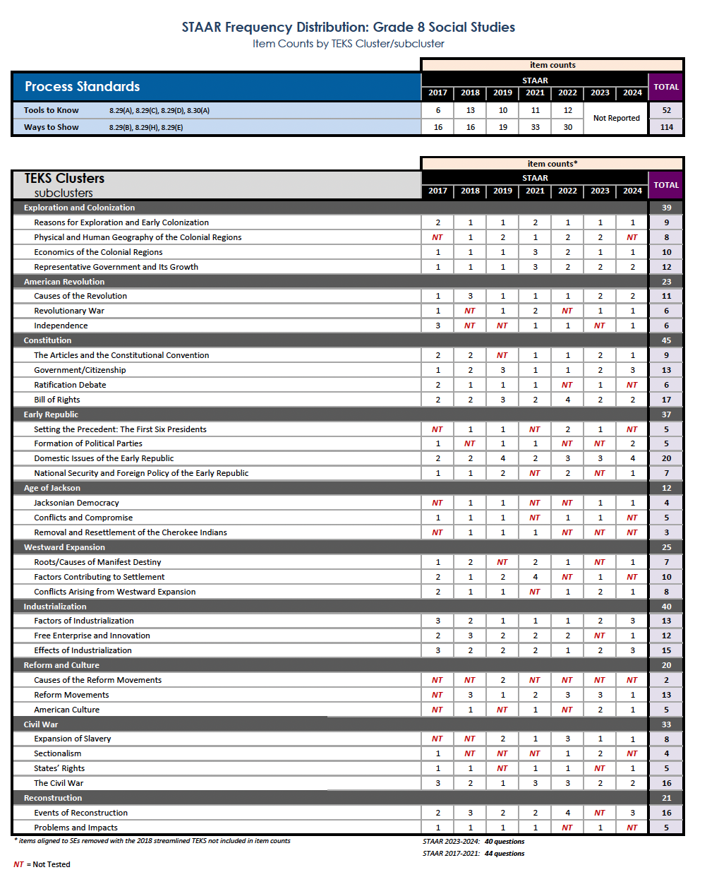
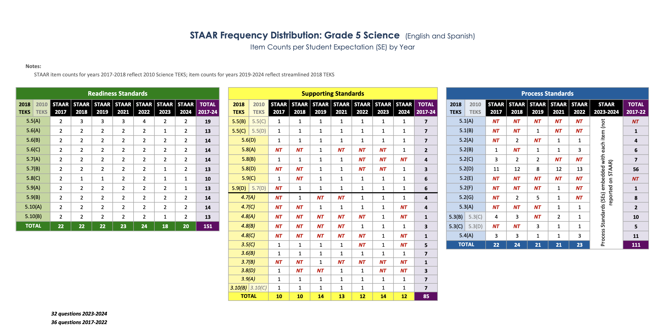
frequency distribution

Slide 24
frequency distribution
some content continues to be more highly tested
readiness standards
certain clusters >>
embedded process standards
tools to know
ways to show

Slide 26
frequency distribution - elar
comprehension (layered thinking and embedded inference)
genre (inference within and between texts)
author’s craft (application and connection)
reading process (visualization)
reading to writing connection (ECR)

Slide 27
frequency distribution - math
numeracy
whole number/decimal operations
proportionality
expressions and inequalities
linear functions

Slide 28
frequency distribution - science
all reporting categories
transition to assessing new TEKS

Slide 29
frequency distribution – social studies
comprehension of text/visuals
(layered thinking and embedded inference)
understanding the application of constitutional principles
impact of geography and economic factors and technology over time

Slide 30
frequency distribution
systemic
most kids
most teachers
most content
specific
some kids
some teachers
some content

Slide 31
what can we learn from state data?
Prioritize
Focus
Monitor

Slide 32
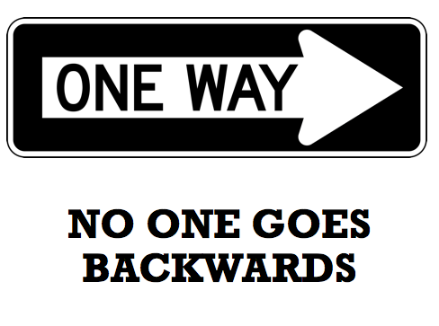
academic growth
all data are local (for now)
academic growth of all students
tier 1 instruction
tier 1 assessment
tier 1 intervention
academic growth of students who did not meet grade level in prior year
supplemental instruction/intervention

Slide 33
what can we learn from state data?
Prioritize
Focus
Monitor
Informs

Slide 34
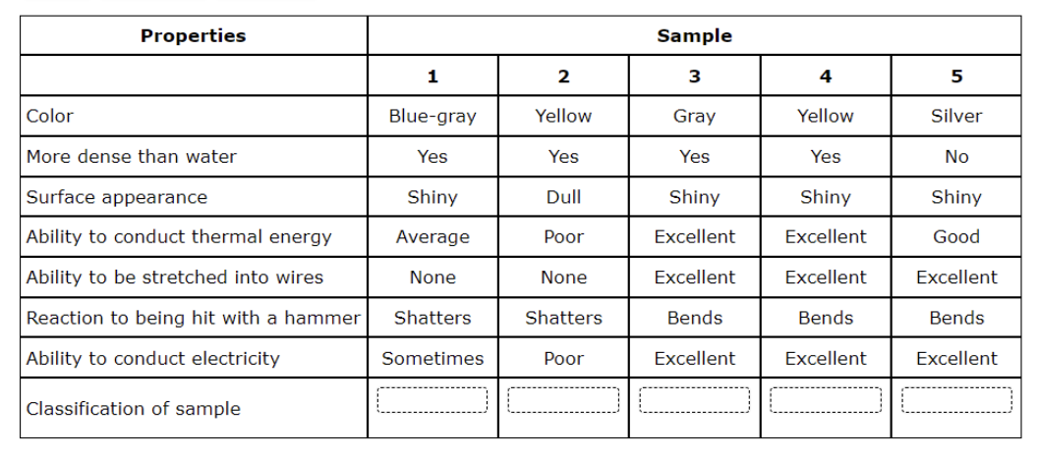
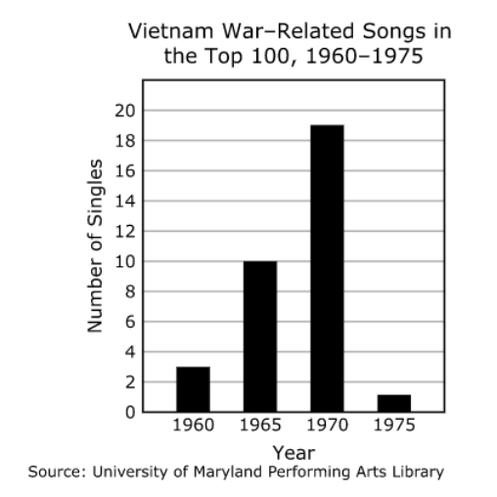
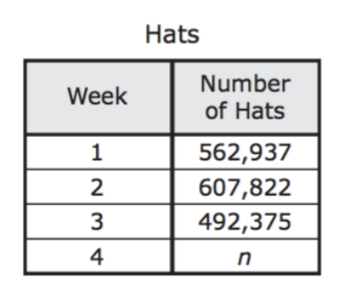
descriptive measures

Slide 35
descriptive measures
vocabulary
visuals
closed-ended items
open-ended items

Slide 36
vocabulary
beyond academic vocabulary
vocabulary as it relates to the question/context
input: comprehension issues (understanding the question)
access: using academic vocabulary to anchor concepts
output: representing/explaining the answer

Slide 37
visuals/visualization
access: understanding the visual/text
application: knowing what parts, if any, to answer the question
representation/explanation: using the information accurately

Slide 38
closed-ended items
higher levels of performance
error patterns consistent (awaiting item level data – IQ)
unexplained errors

Slide 39
open-ended items
ECR performance still low
SCR performance show partial explanation
open ended items which require layered thinking are low

Slide 40
descriptive measures
systemic
most kids
most teachers
most content
specific
some kids
some teachers
some content

Slide 41
What do we know about supporting teachers?
tier 1
layered thinking
using resources
Notes:
Justin

Slide 43
info@lead4ward.com

Slide 44
supporting you
info@lead4ward.com

Slide 45
understanding STAAR 2024
getting centered – getting started

