Slide 1
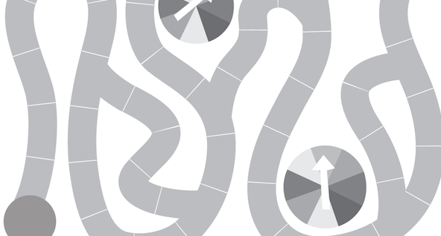
advanced
math
pathways

Slide 2
kim o’neal
kim.oneal@lead4ward.com
abby loggains
abby@lead4ward.com

Slide 3
carol gautier
mathmark
clee upchurch
clee@lead4ward.com
wade labay
wade@lead4ward.com

Slide 5
Q&A

Slide 6
name that
game

Slide 7
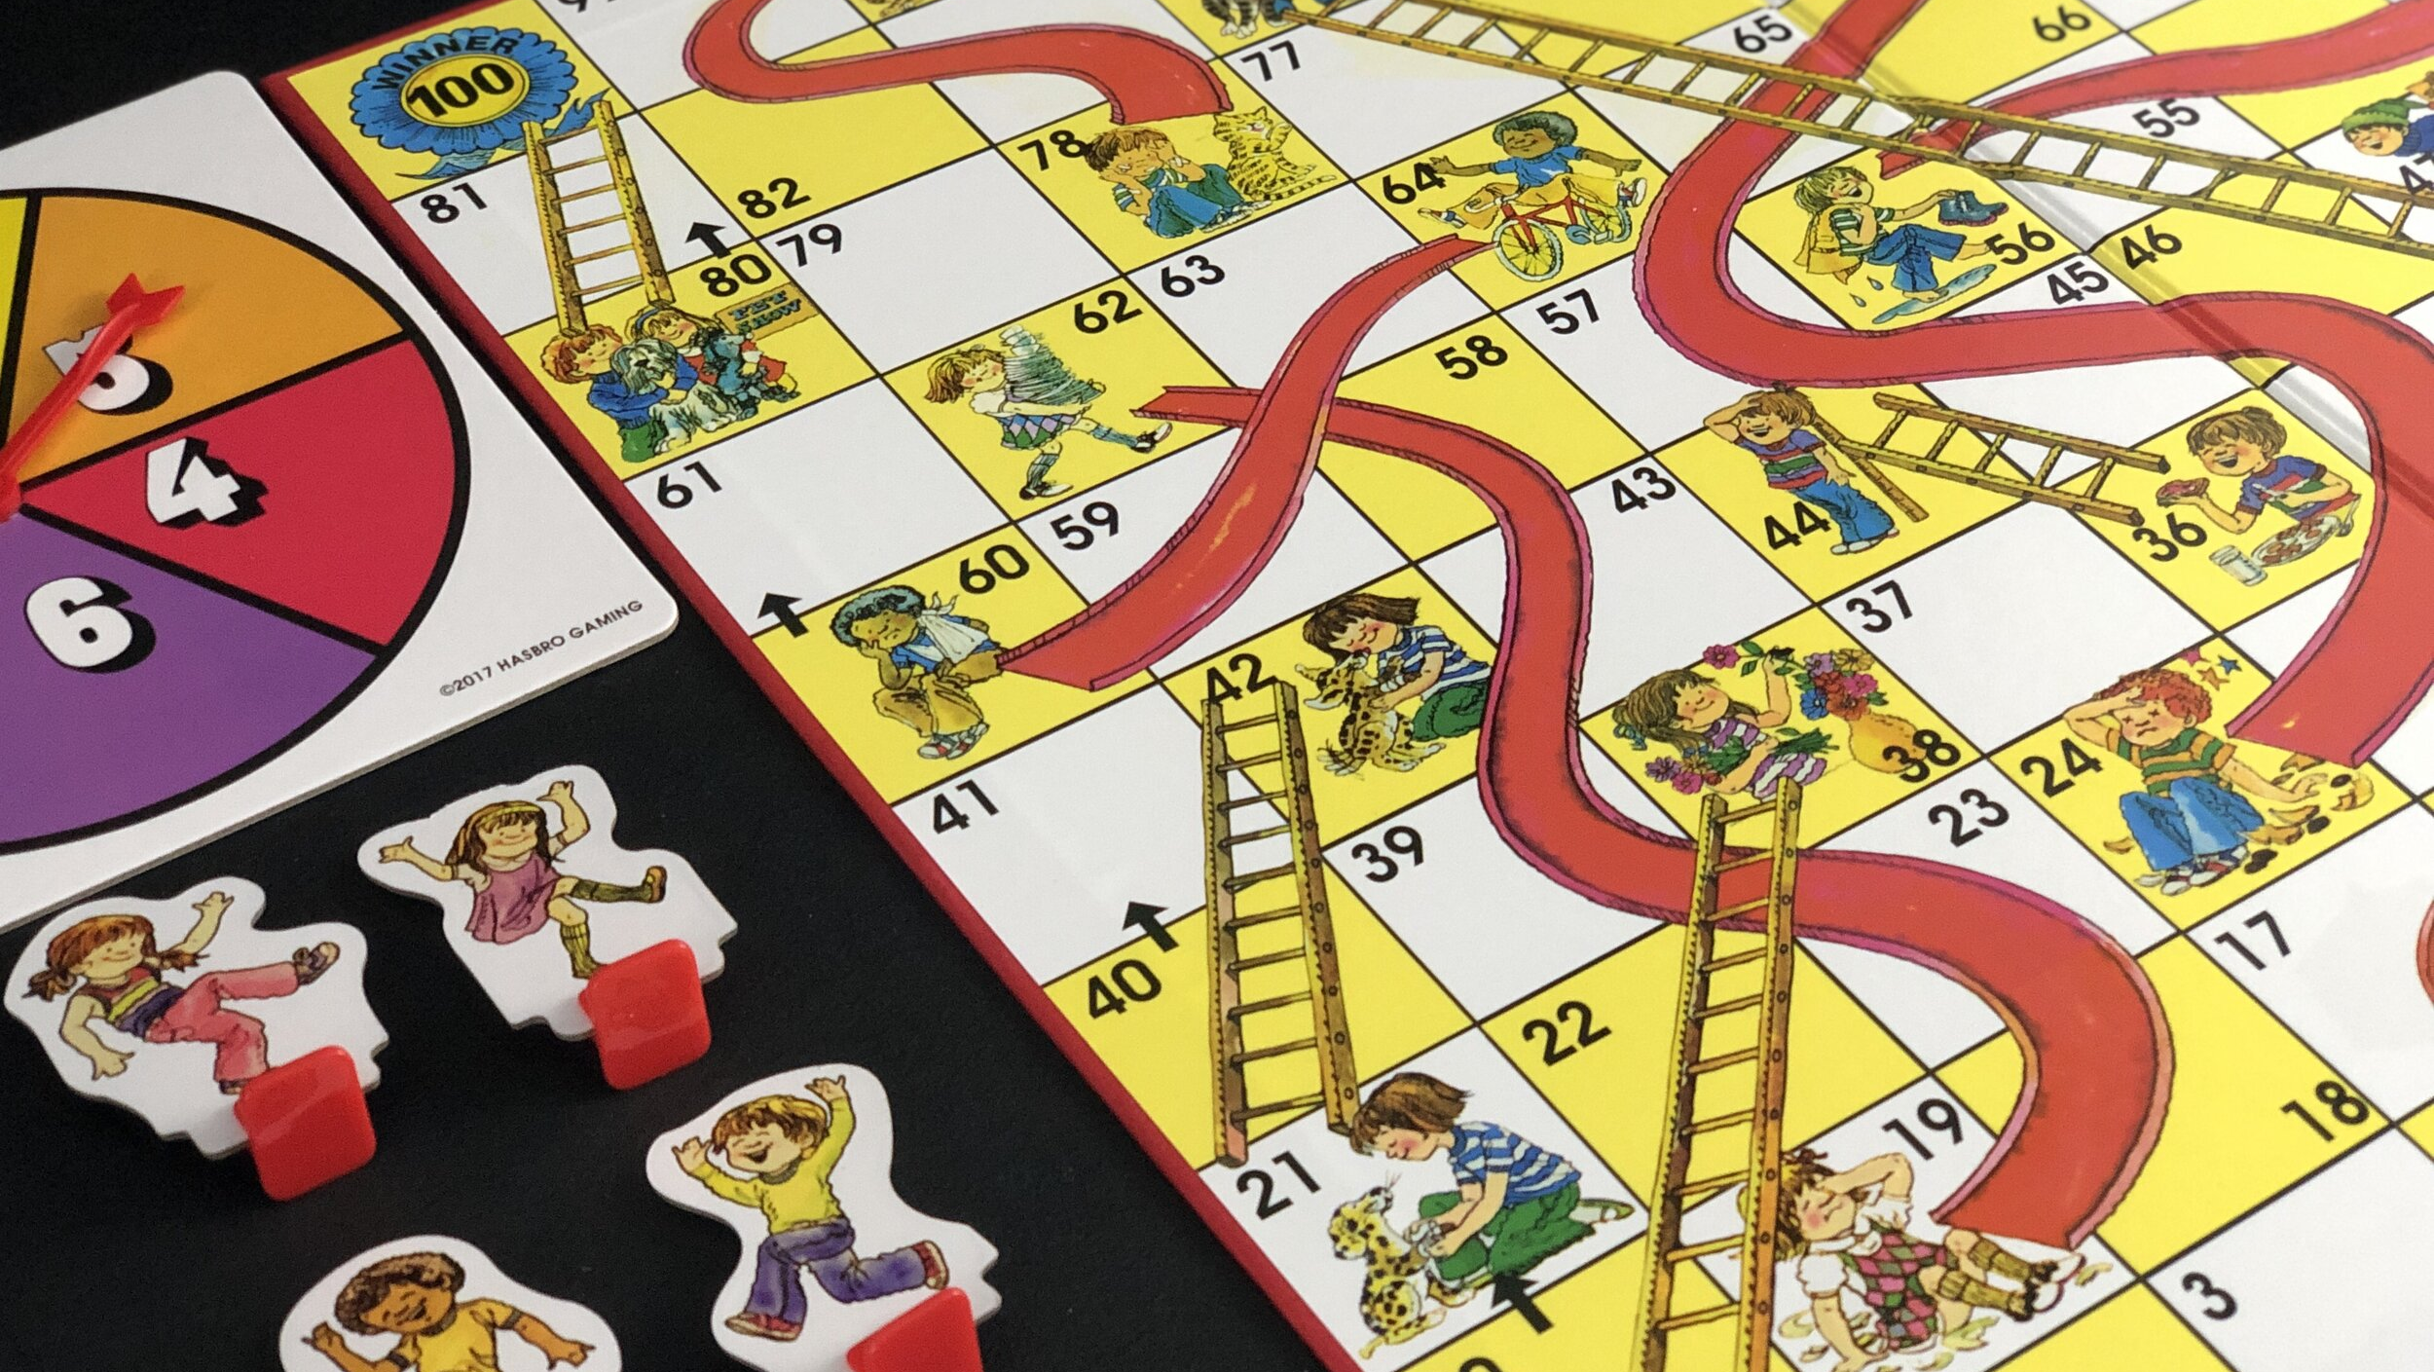

Slide 10
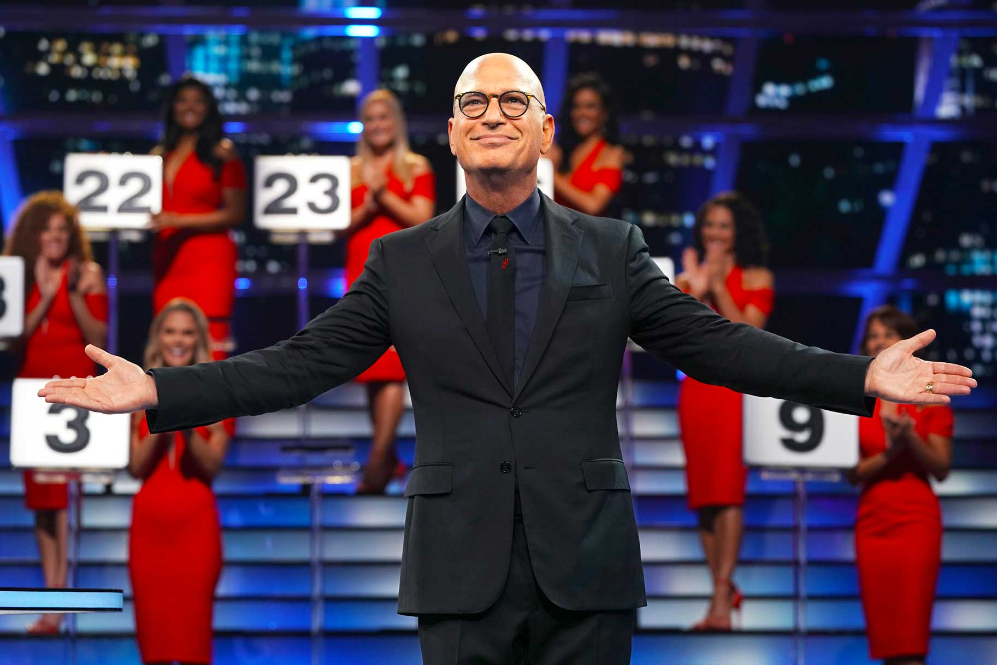

Slide 14
advanced
math
pathways
tea.texas.gov/academics/subject-areas/mathematics/middle-school-advanced-mathematics-program

Slide 15
help!!!

Slide 16
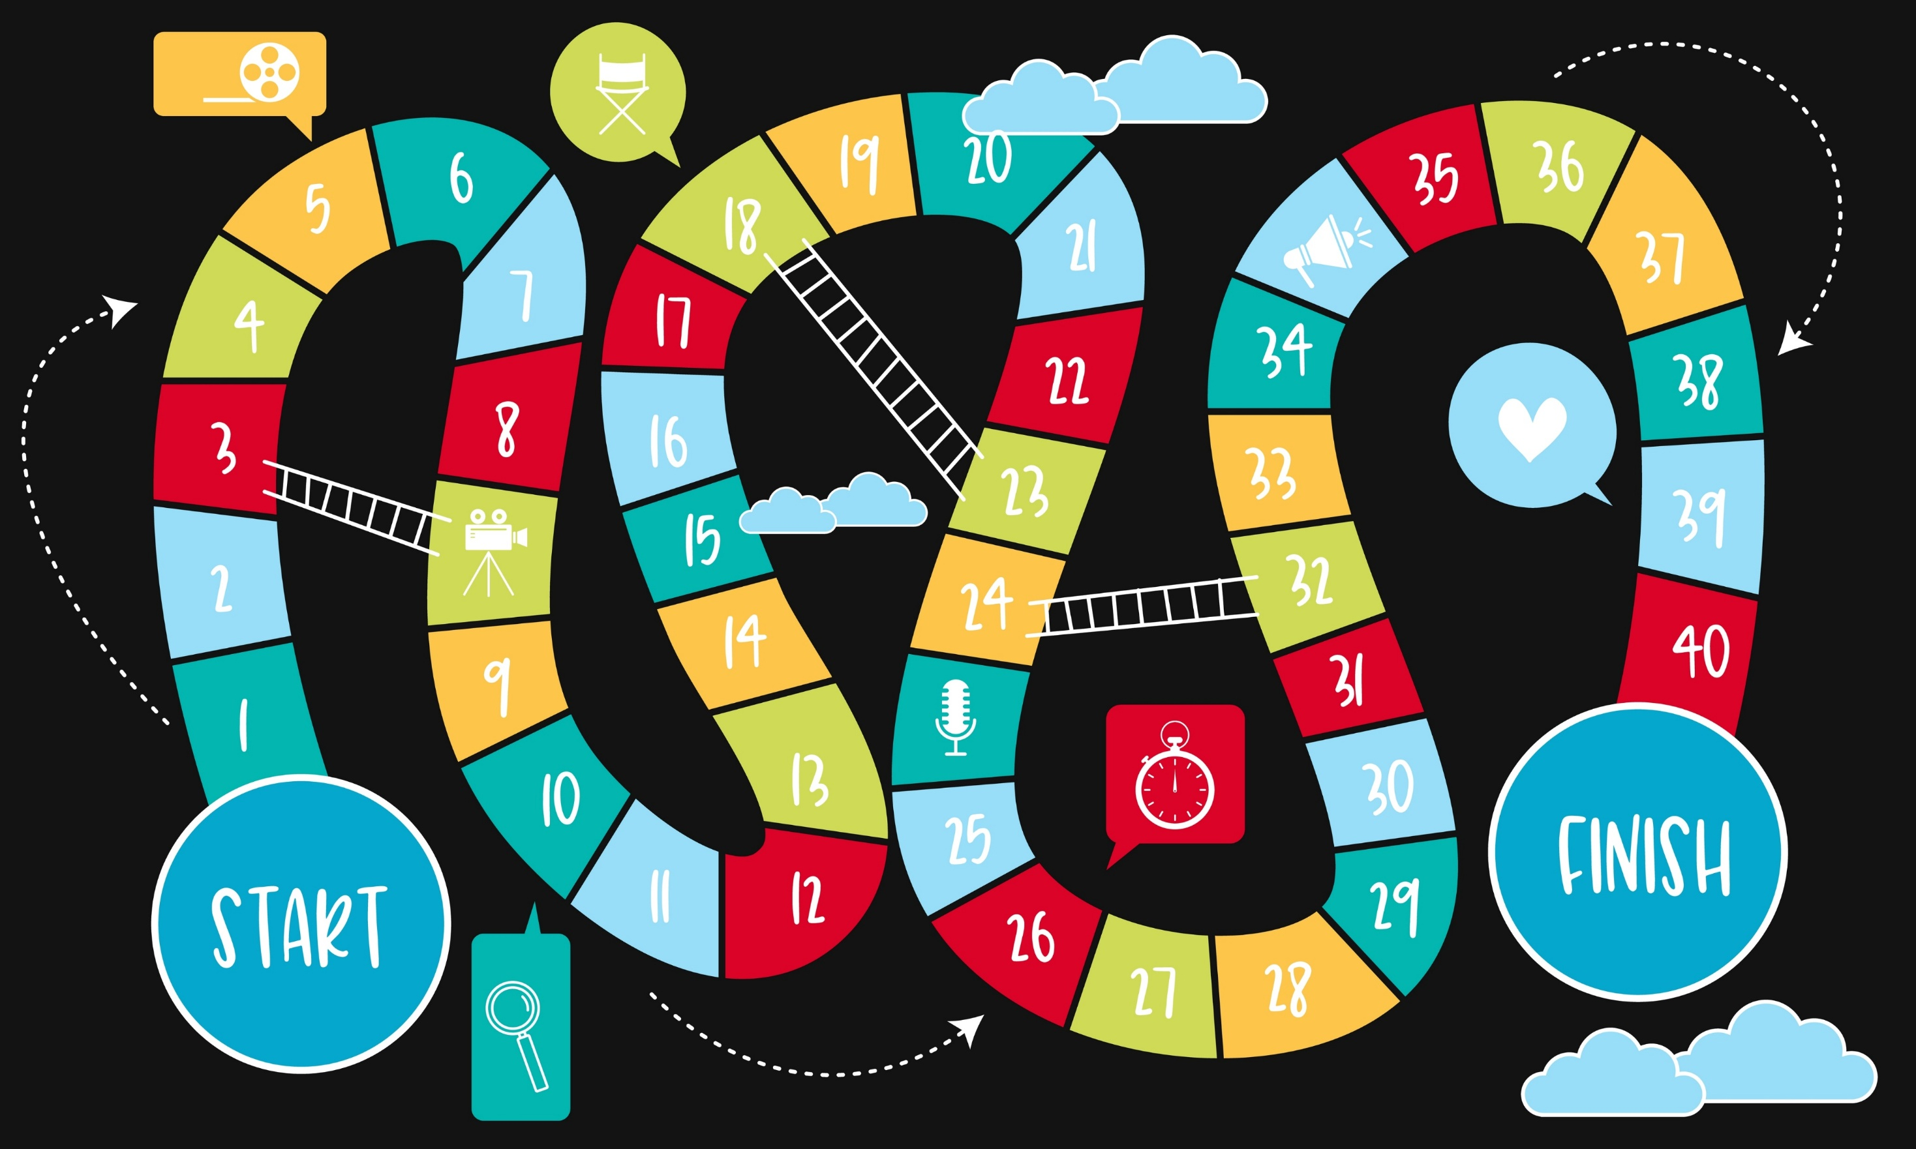

Slide 17
grade 5
60th percentile [STAAR]
or
Top 40%
Grade 6 TEKS
Grade 6 STAAR
Grade 7 TEKS
Grade 7 STAAR
Grade 8 TEKS
Grade 8 STAAR
grade 6 regular
grade 7 regular
grade 8 regular
Grade ADV6 TEKS
Grade 6 STAAR
Grade ADV7 TEKS
Grade 7 STAAR
OR
Grade 8 STAAR
GradeADV8 TEKS
Algebra 1 EOC STAAR
grade 6 advanced
grade 7 advanced
grade 8 advanced
Alg 1

Slide 18
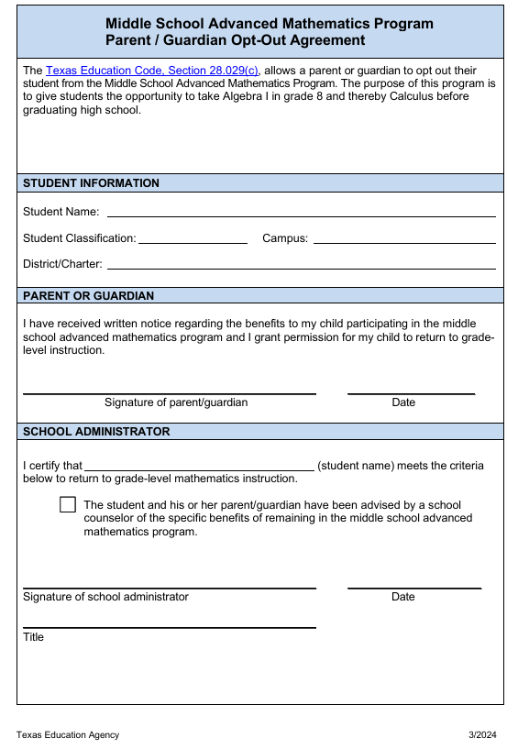
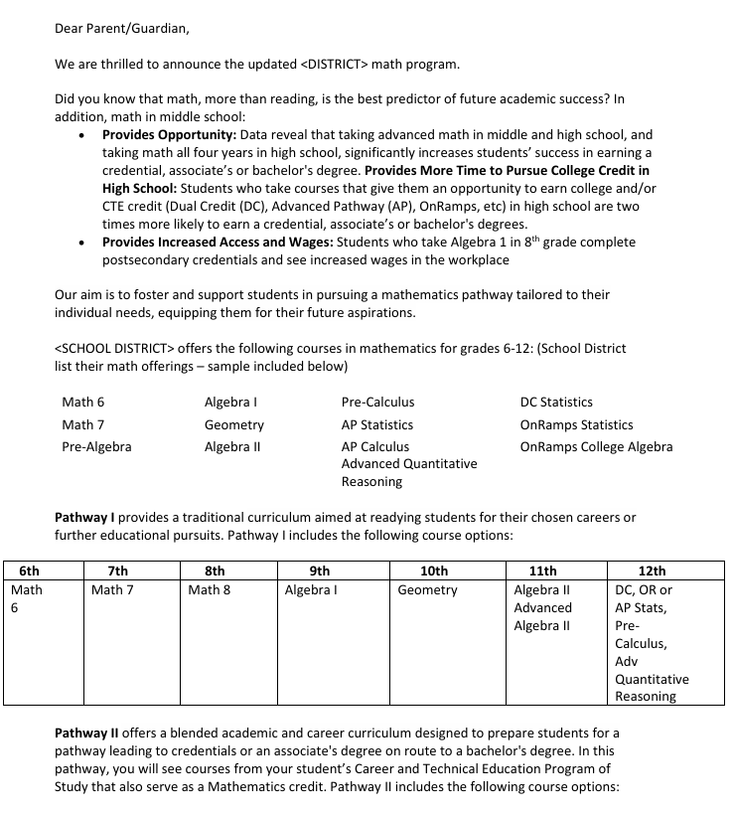
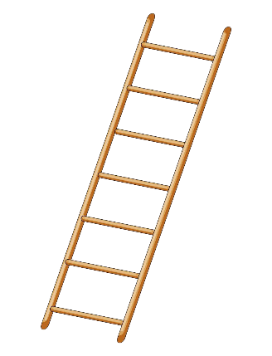
grade 5
Grade 6 TEKS
Grade 6 STAAR
Grade 7 TEKS
Grade 7 STAAR
Grade 8 TEKS
Grade 8 STAAR
grade 6 regular
grade 7 regular
grade 8 regular
Grade ADV6 TEKS
Grade 6 STAAR
Grade ADV7 TEKS
Grade 8 STAAR
GradeADV8 TEKS
EOC STAAR
grade 6 advanced
grade 7 advanced
grade 8 advanced
Alg 1
tea.texas.gov/academics/subject-areas/mathematics/middle-school-advanced-mathematics-program
This Photo by Unknown Author is licensed under CC BY-NC

Slide 19
COGNITIVE
ROLE
MODEL
grade 5
Grade 6 TEKS
Grade 6 STAAR
Grade 7 TEKS
Grade 7 STAAR
Grade 8 TEKS
Grade 8 STAAR
COGNITIVE
ROLE
MODEL
grade 6 regular
grade 7 regular
grade 8 regular
Grade ADV6 TEKS
Grade 6 STAAR
Grade ADV7 TEKS
Grade 7 STAAR
OR
Grade 8 STAAR
GradeADV8 TEKS
Algebra 1 EOC STAAR
grade 6 advanced
grade 7 advanced
grade 8 advanced
Alg 1
This Photo by Unknown Author is licensed under CC BY-NC

Slide 20
grade 5
COGNITIVE
ROLE
MODEL
Grade 6 TEKS
Grade 6 STAAR
Grade 7 TEKS
Grade 7 STAAR
Grade 8 TEKS
Grade 8 STAAR
COGNITIVE
ROLE
MODEL
grade 6 regular
grade 7 regular
grade 8 regular
Grade ADV6 TEKS
Grade 6 STAAR
Grade ADV7 TEKS
Grade 7 STAAR
OR
Grade 8 STAAR
GradeADV8 TEKS
Algebra 1 EOC STAAR
grade 6 advanced
grade 7 advanced
grade 8 advanced
Alg 1

Slide 21
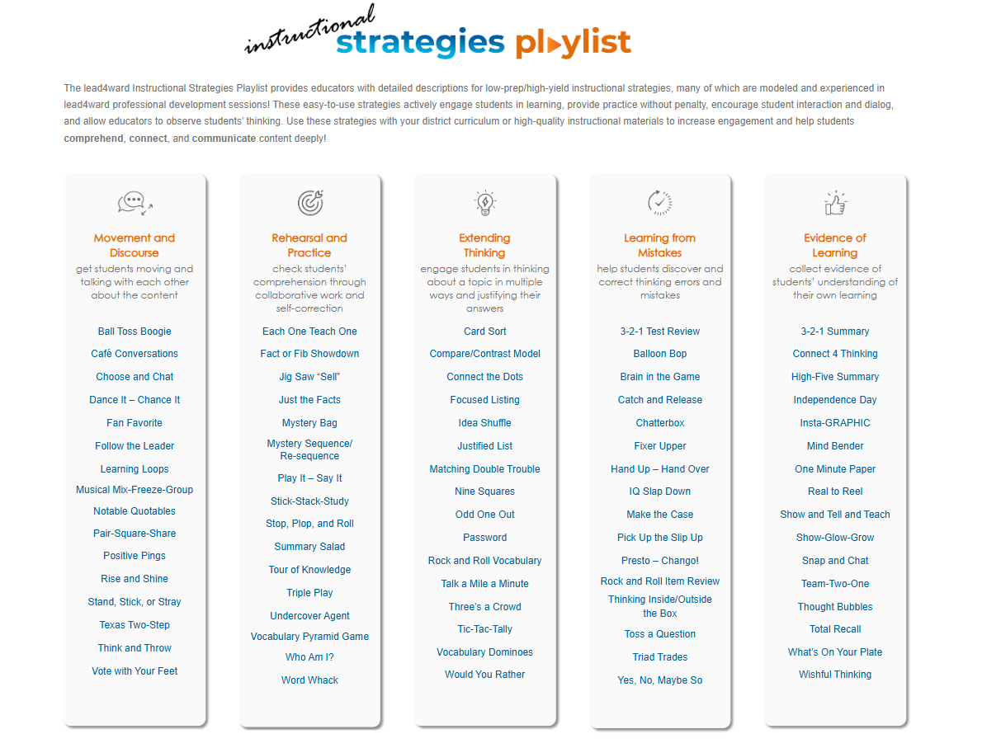
lead4ward.com/instructional-strategies/
This Photo by Unknown Author is licensed under CC BY-SA-NC

Slide 22
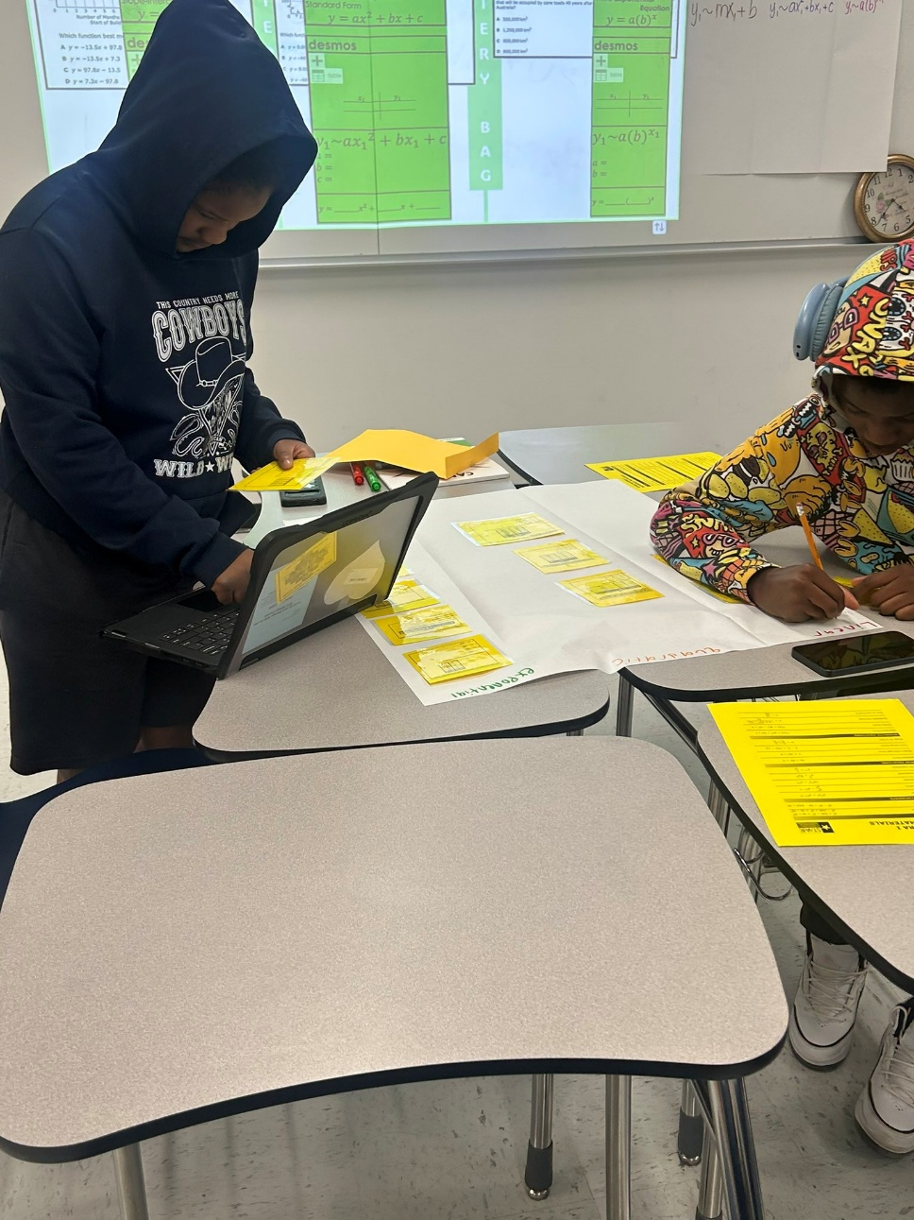
lead4ward.com/instructional-strategies/
mystery
bag

Slide 23
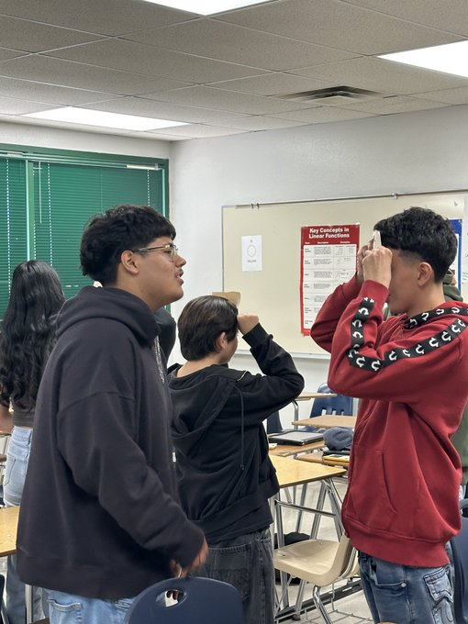
who am I?

Slide 24
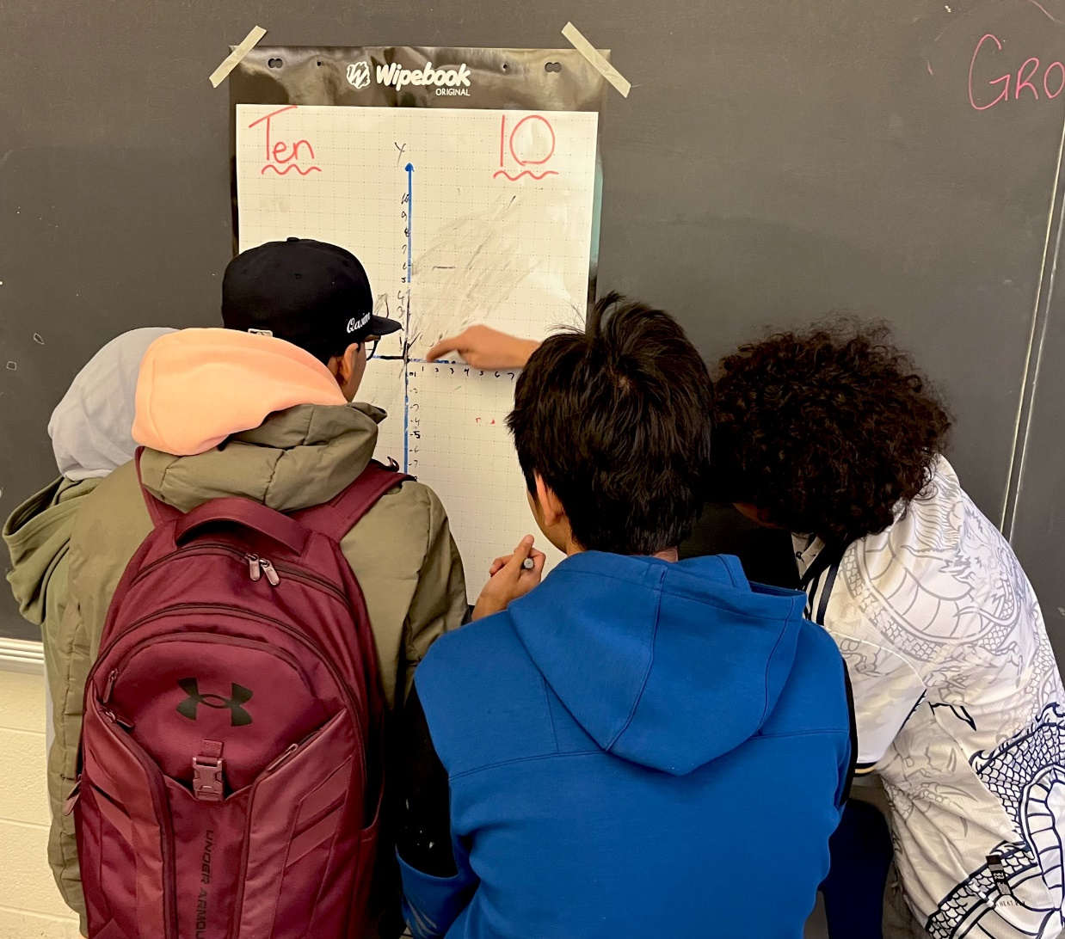

Slide 25
lead4ward.com/open-session/

Slide 26
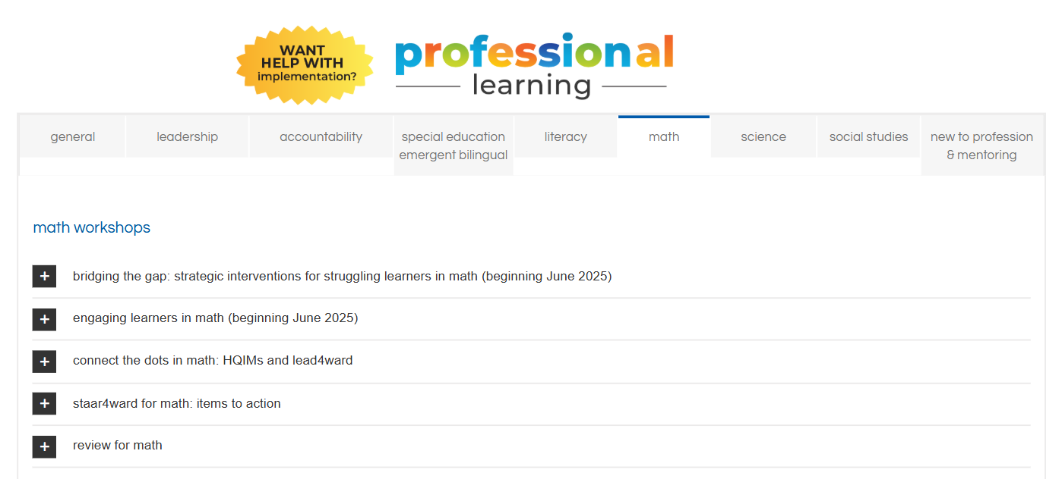
lead4ward.com/open-session/

Slide 27
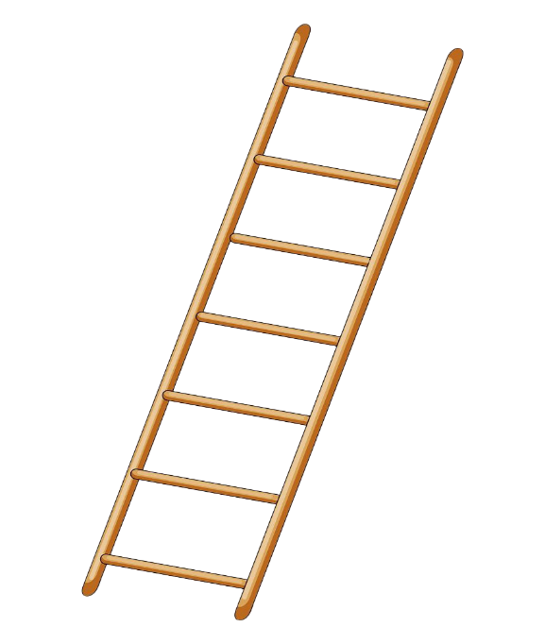
Rational number computations
grade 5
Grade 6 TEKS
Grade 6 STAAR
Grade 7 TEKS
Grade 7 STAAR
Grade 8 TEKS
Grade 8 STAAR
grade 6 regular
grade 7 regular
grade 8 regular
Geometry
Equations & Inequalities
Grade ADV6 TEKS
Grade 6 STAAR
Grade ADV7 TEKS
Grade 7 STAAR
OR
Grade 8 STAAR
GradeADV8 TEKS
Algebra 1 EOC STAAR
grade 6 advanced
grade 7 advanced
grade 8 advanced
Alg 1
This Photo by Unknown Author is licensed under CC BY-NC
This Photo by Unknown Author is licensed under CC BY-NC

Slide 28
Taught:
Use of tables with proportional situations including similarity
Solving two-step equations
Refreshed:
Graph points using rational number coordinates
Connecting tables, graphs, equations & verbal descriptions
Integer, Fraction, and Decimal Operations
Use of tables with proportional situations including percents

Slide 29
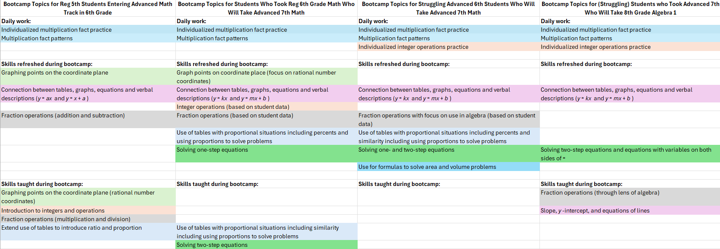

Slide 30
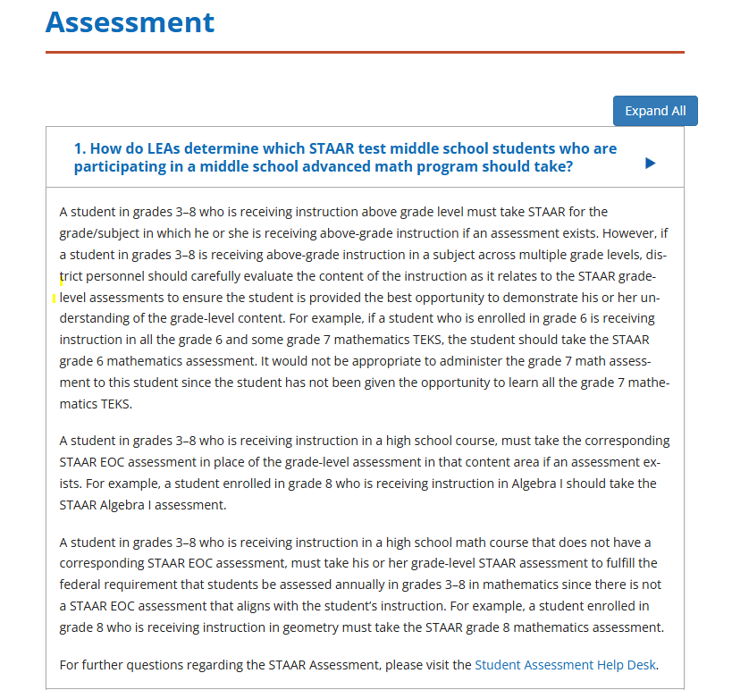
grade 5
Grade 6 TEKS
Grade 6 STAAR
Grade 7 TEKS
Grade 7 STAAR
Grade 8 TEKS
Grade 8 STAAR
grade 6 regular
grade 7 regular
grade 8 regular
Grade ADV6 TEKS
Grade 6 STAAR
Grade ADV7 TEKS
Grade 7 STAAR
OR
Grade 8 STAAR
GradeADV8 TEKS
Algebra 1 EOC STAAR
grade 6 advanced
grade 7 advanced
grade 8 advanced
Alg 1
tea.Texas.gov/academics/subject-areas/mathematics/middle-school-advanced-mathematics-program-faq

Slide 31
store.lead4ward.com/pages/mathematics

Slide 32
store.lead4ward.com/pages/mathematics

Slide 34
60th percentile [STAAR]
or
Top 40%
Grade 6 TEKS
Grade 6 STAAR
Grade 7 TEKS
Grade 7 STAAR
Grade 8 TEKS
Grade 8 STAAR
grade 5
grade 6 regular
grade 7 regular
grade 8 regular
Grade ADV6 TEKS
Grade 6 STAAR
Grade ADV7 TEKS
Grade 7 STAAR
OR
Grade 8 STAAR
GradeADV8 TEKS
Algebra 1 EOC STAAR
grade 6 advanced
grade 7 advanced
grade 8 advanced
Alg 1

Slide 35
TEKS??

Slide 36
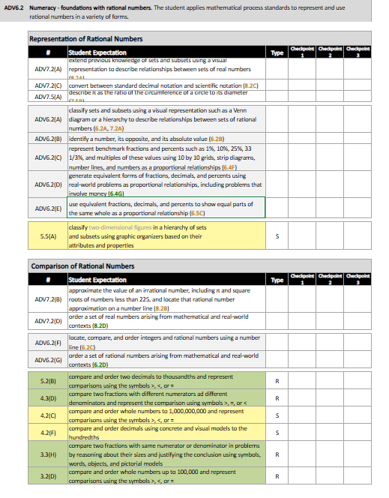
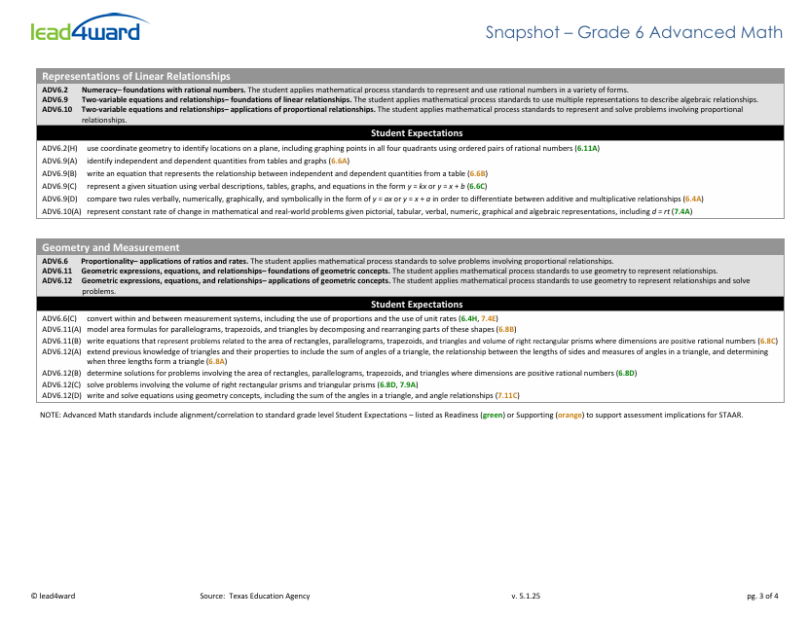
lead4ward.com/resources

Slide 37
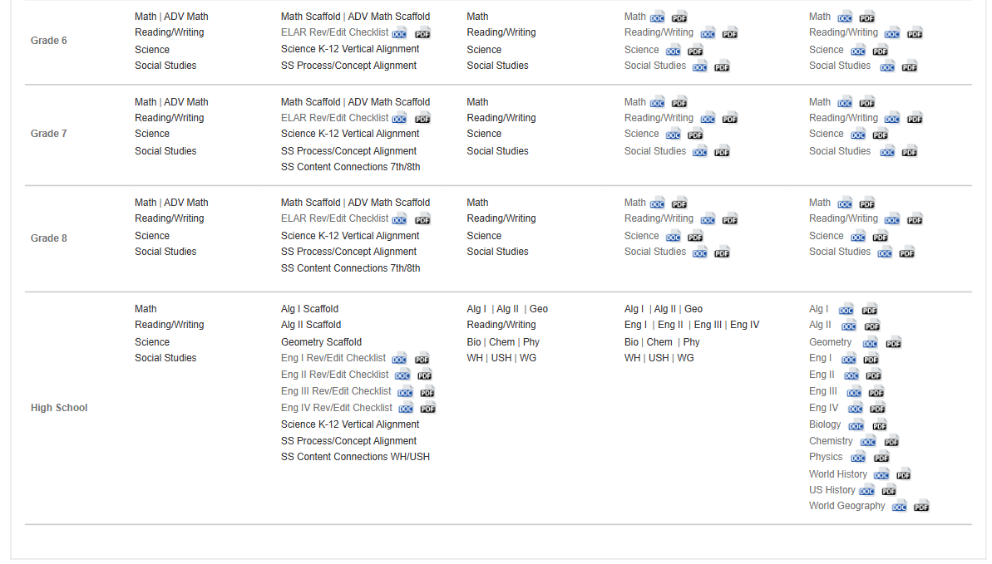
lead4ward.com/resources

Slide 38
snapshot

Slide 39
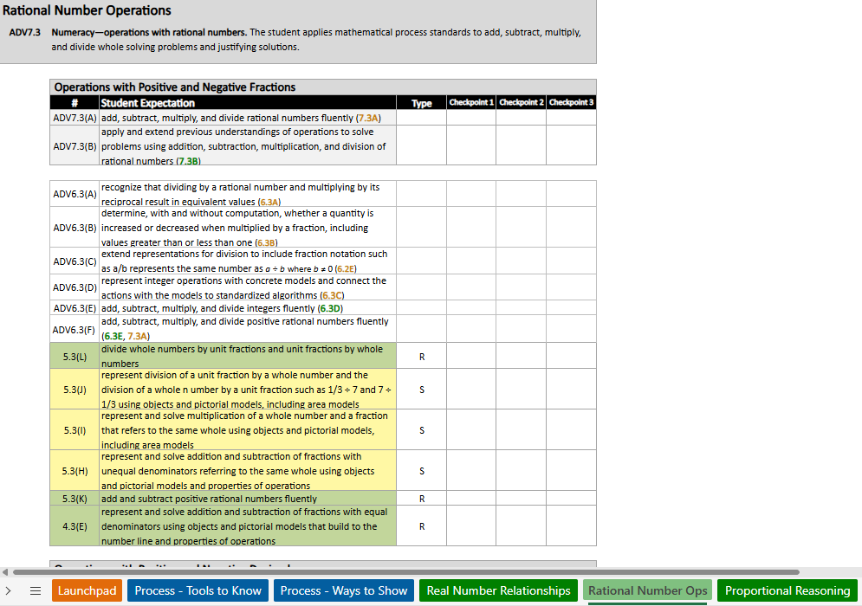
scaffold

Slide 41
Grade 6 TEKS
Grade 6 STAAR
Grade 7 TEKS
Grade 7 STAAR
Grade 8 TEKS
Grade 8 STAAR
grade 5
grade 6 regular
grade 7 regular
grade 8 regular
Grade ADV6 TEKS
Grade 6 STAAR
Grade ADV7 TEKS
Grade 7 STAAR
OR
Grade 8 STAAR
GradeADV8 TEKS
Algebra 1 EOC STAAR
grade 6 advanced
grade 7 advanced
grade 8 advanced
Alg 1

Slide 42
Grade 6 TEKS
Grade 6 STAAR
Grade 7 TEKS
Grade 7 STAAR
Grade 8 TEKS
Grade 8 STAAR
grade 5
grade 6 regular
grade 7 regular
grade 8 regular
Grade ADV6 TEKS
Grade 6 STAAR
Grade ADV7 TEKS
Grade 7 STAAR
OR
Grade 8 STAAR
GradeADV8 TEKS
Algebra 1 EOC STAAR
grade 6 advanced
grade 7 advanced
grade 8 advanced
Alg 1

Slide 43
lead4ward.com/resources

Slide 45
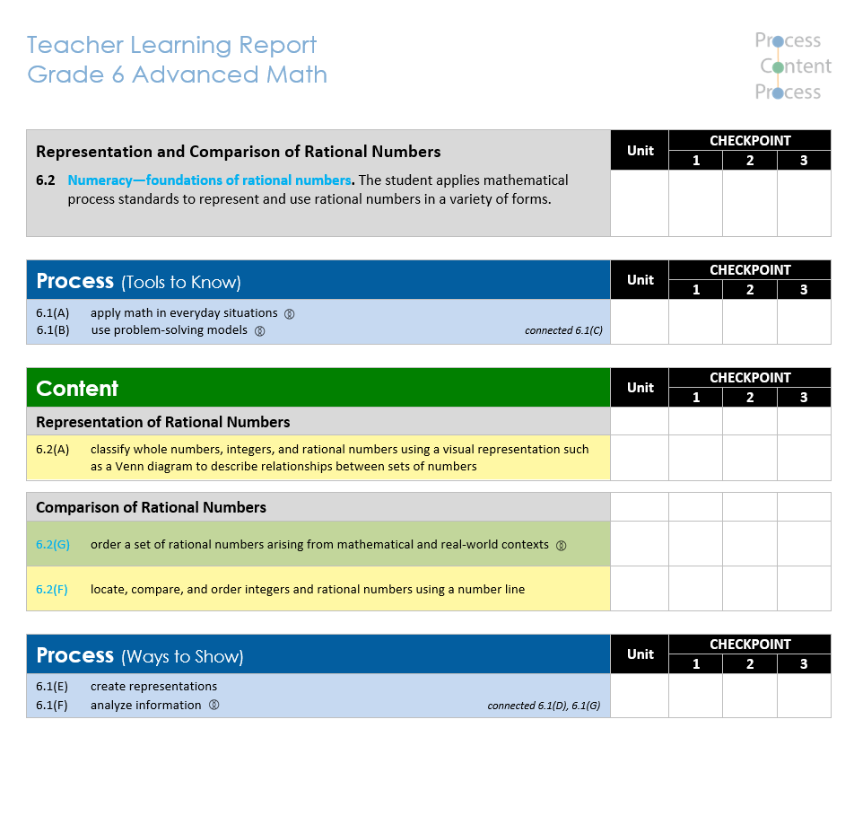
https://lead4ward.com/ms-adv-math-landing/

Slide 46
Questions?
we are here to help
info@lead4ward.com
kim o’neal
kim.oneal@lead4ward.com
abby loggains
abby@lead4ward.com

Slide 47
HELPFUL LINKS
Strategies playlist: https://lead4ward.com/instructional-strategies
Math mark: https://store.lead4ward.com/pages/mathematics
Think conference: https://lead4ward.com/think
Open sessions: https://lead4ward.com/open-sessions/#tab-205ee059817036912c3
Workshops: https://lead4ward.com/workshops/#tab-dc44e4adee00109f6a9
Free resources: https://lead4ward.com/resources
TEA advanced math page: https://tea.texas.gov/academics/subject-areas/mathematics/middle-school-advanced-mathematics-program

Slide 48
Grade 8 SEs NOT included conceptually in grade 7 advanced standards, but will be tested on grade 8 STAAR
8.3A | Definition of similarity
8.4A | Slope; moved to Adv Algebra 1
8.4B | Slope; moved to Adv Algebra 1
8.4C | Slope; moved to Adv Algebra 1
8.5C | Bivariate data – linear vs nonlinear; moved to Adv Algebra 1
8.5D | Trend lines; moved to Adv Algebra 1
8.5E | Direct variation; moved to Adv Algebra 1
8.5G | Identify functions; moved to Adv Algebra 1
8.9A | Systems of equations; moved to Adv Algebra 1
8.11A | Scatterplots- linear vs nonlinear; moved to Adv Algebra 1

