Slide 2
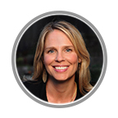
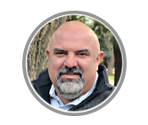
clee@lead4ward.com
justin@lead4ward.com

Slide 3
info@lead4ward.com

Slide 4
If you were to
summarize this year
using one word or phase,
it would be _________.

Slide 5
If we were to
think4ward into 2023-24
using one word or phase,
it would be _________.

Slide 6
new science TEKS
CIP
HB4545
T-TESS/T-PESS
connect
ESF
district initiatives
HQIM
STAAR 2.0
A-F accountability
new legislation

Slide 9
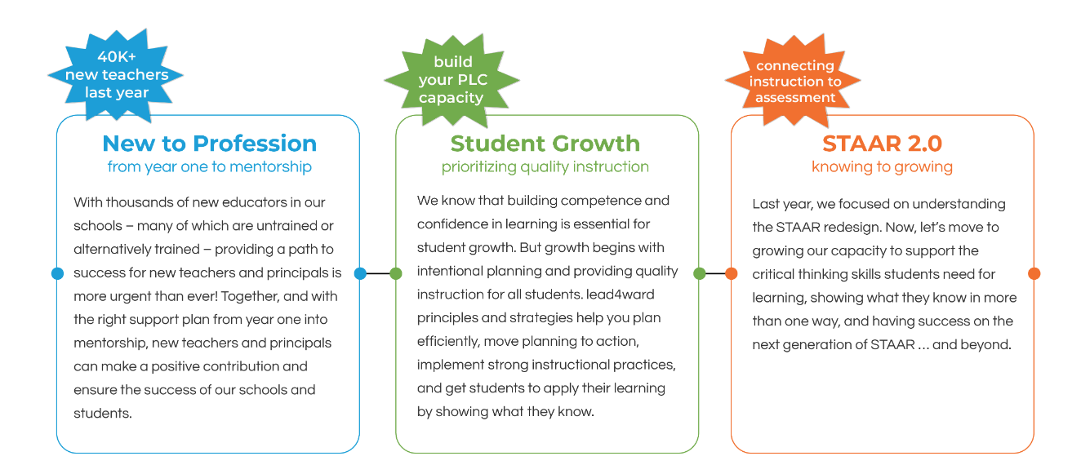

Slide 10
Teacher Induction
principals are confident in their support of new teachers
effective and well-supported mentors
year long support for FYT

Slide 11
“Kelvey Oeser, a deputy commissioner of the Texas Education Agency, told lawmakers that roughly 40% of newly hired teachers last year were either uncertified or came through an alternative certification program.“
– from The Dallas Morning News, Sept 22, 2022

Slide 12
Teacher Vacancy Task Force
February 2023
Provide training for faculty/staff on curriculum and assessment literacy best practices
Expand teacher leadership roles

Slide 13
And…we know the generation of young professionals coming into the workforce will likely change careers multiple times.

Slide 14
What connections are you making for supporting new teachers?

Slide 15
year 4 and beyond
let us help you build a plan
district initiatives
the engaged classroom
checking for understanding
rigor
subject specific support
be a mentor
first-year
teacher academy
year 1
year 2
year 3

Slide 16
When teachers grow, students grow.

Slide 18
What connections are you making between growth and STAAR 2.0?

Slide 19
plan4growth

Slide 20
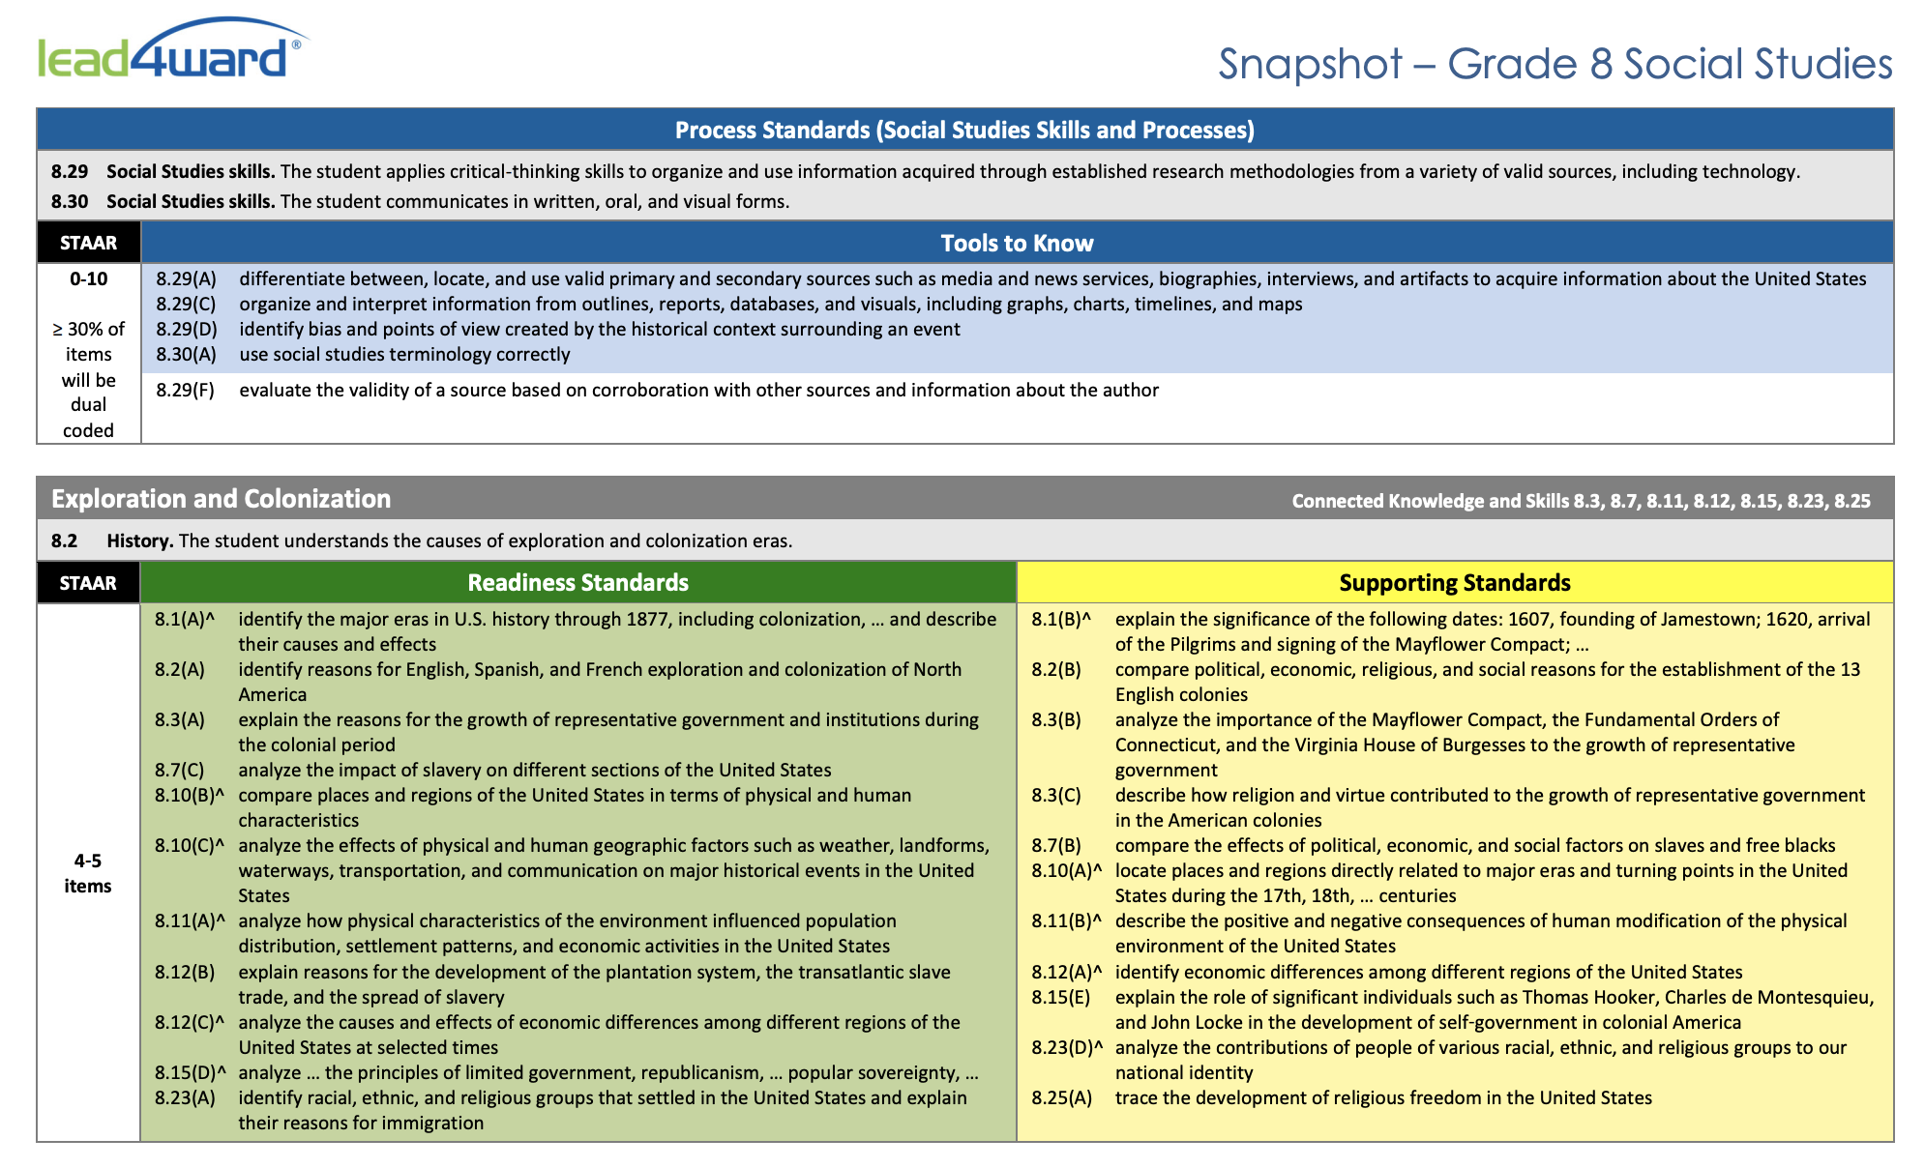
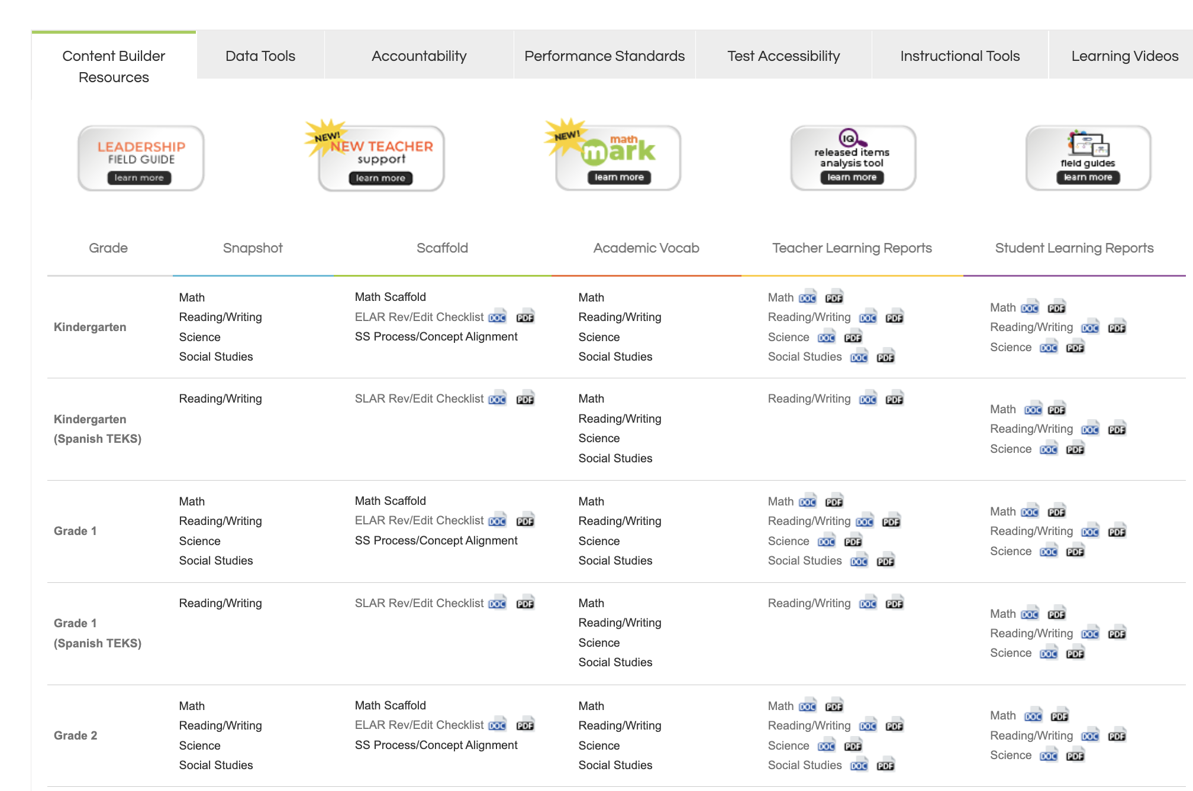
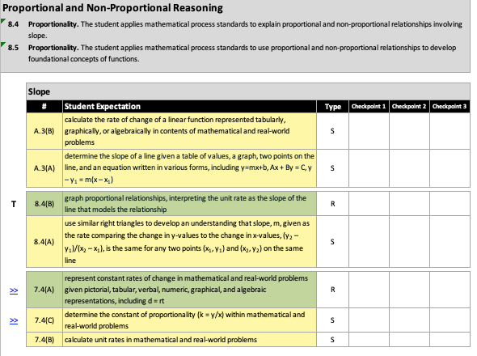
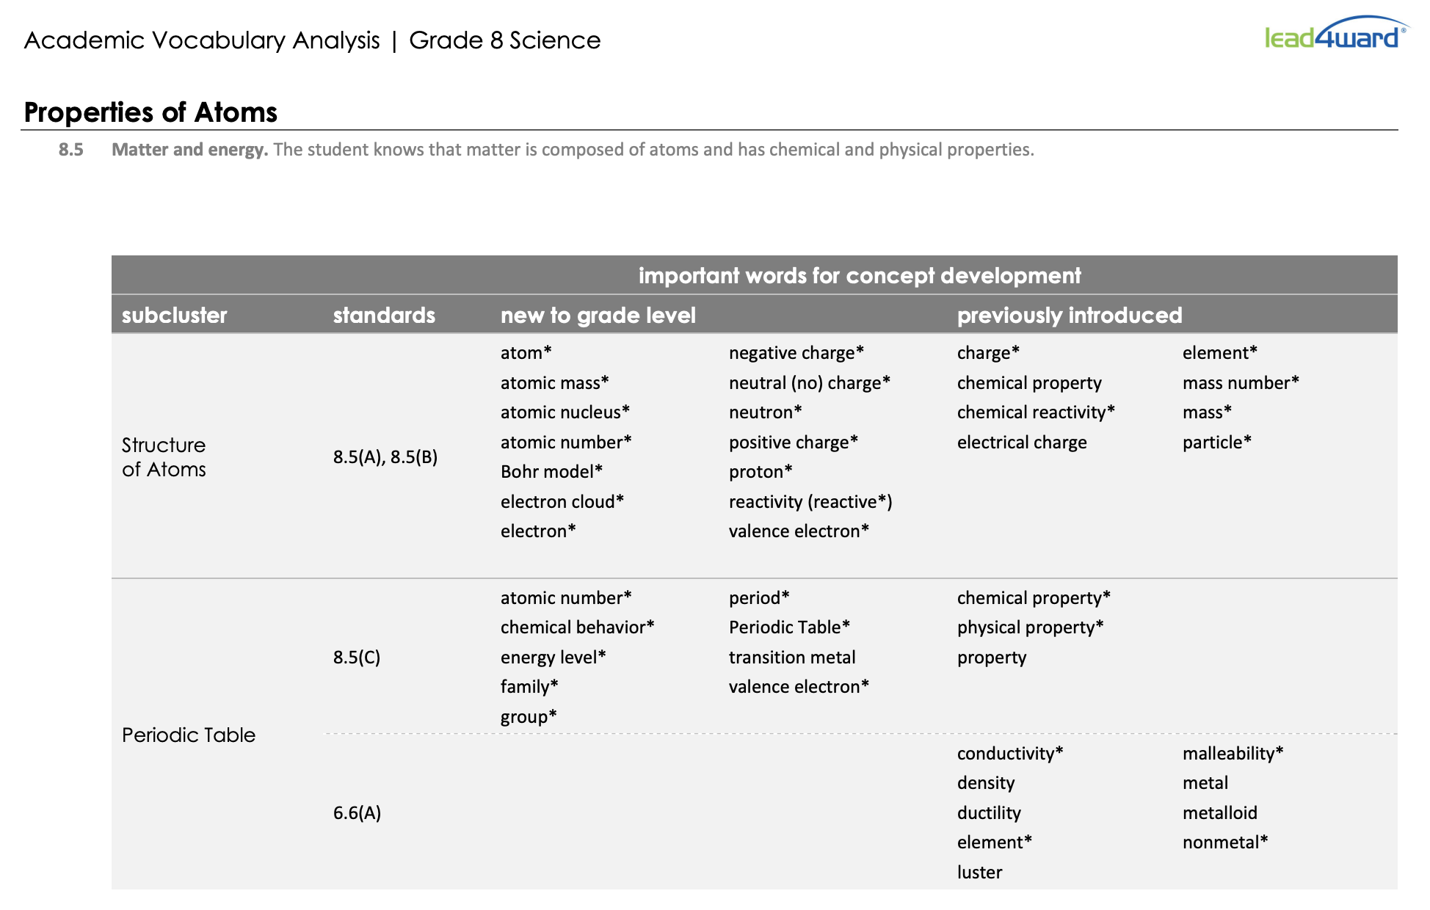
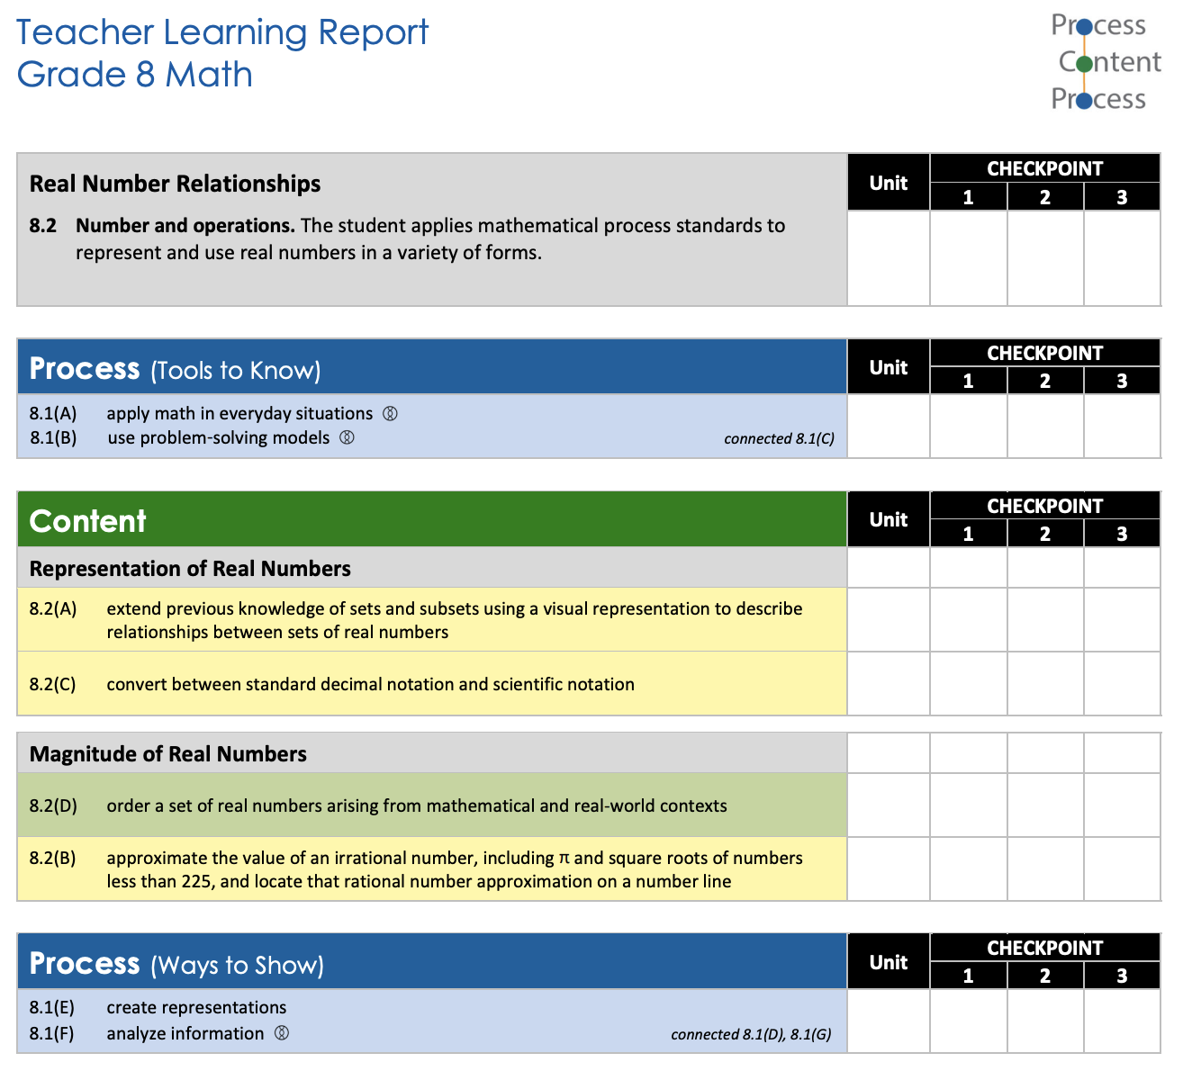
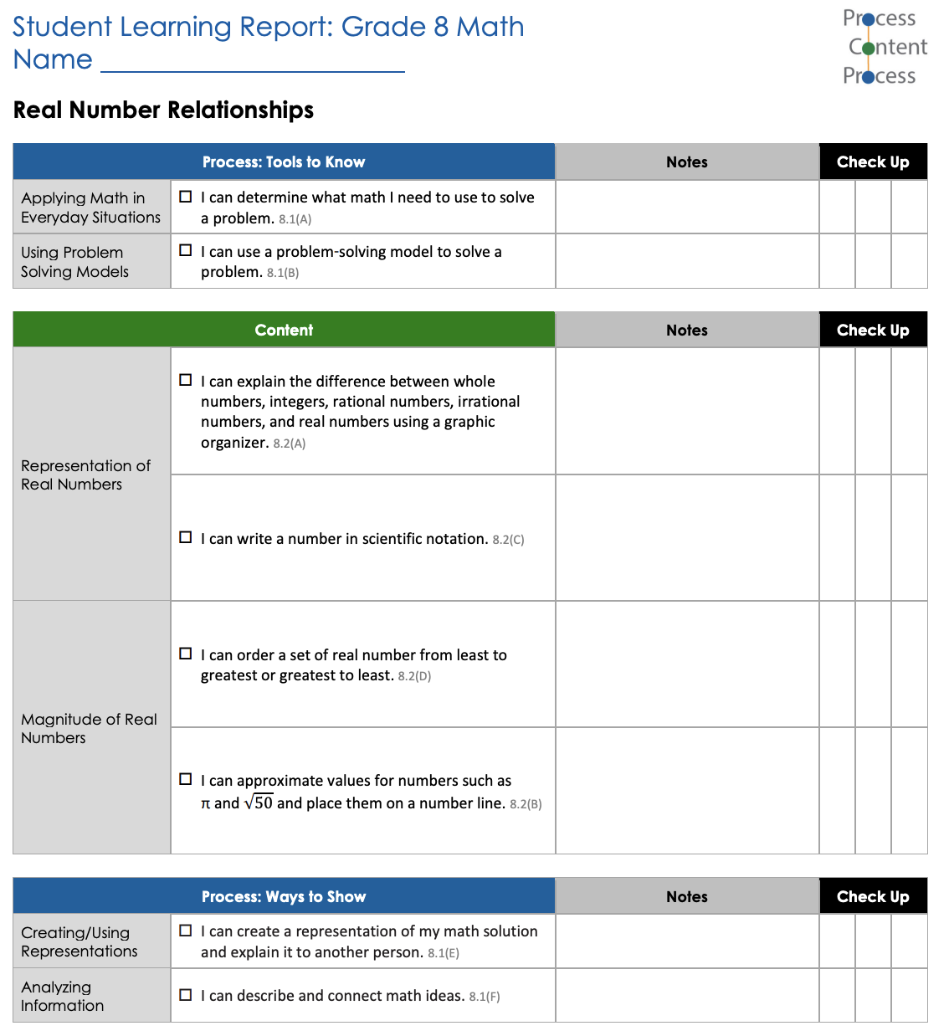
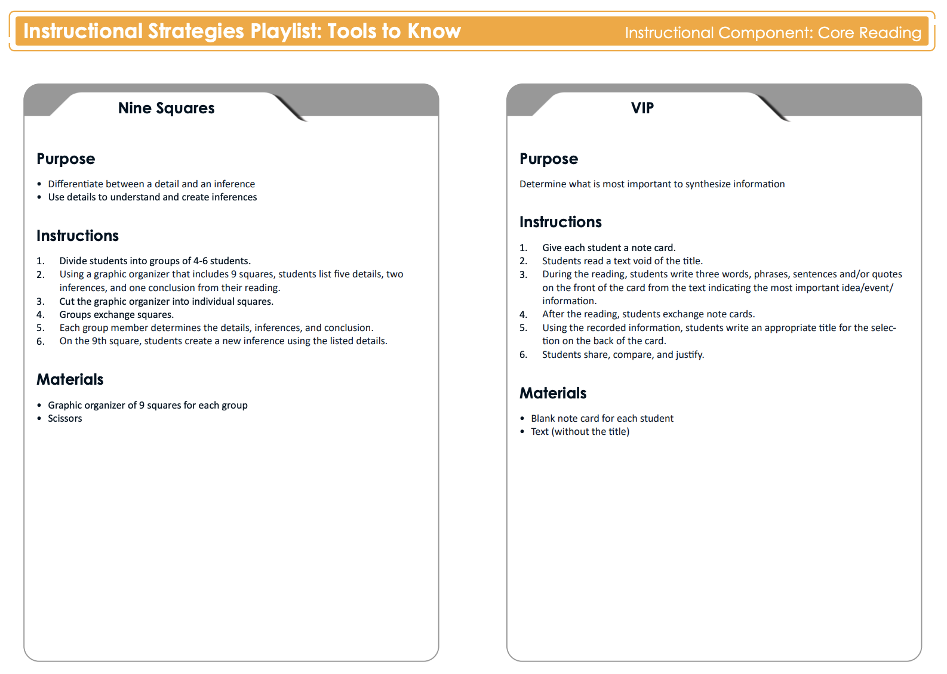

Slide 21
teach4learning

Slide 22
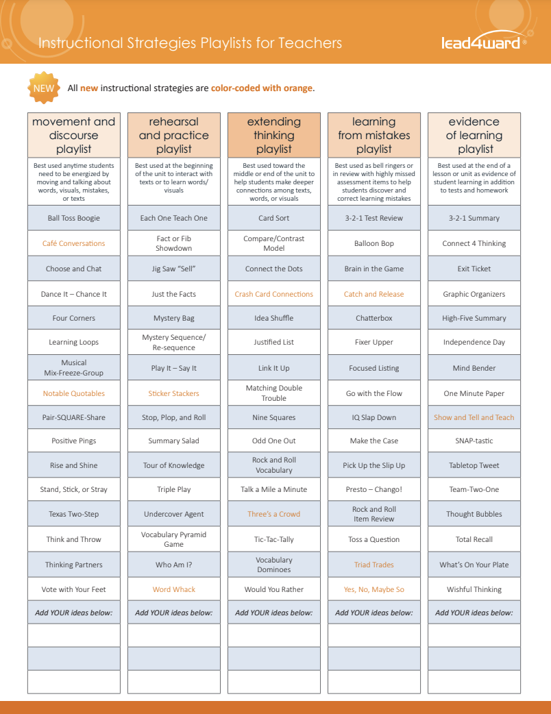
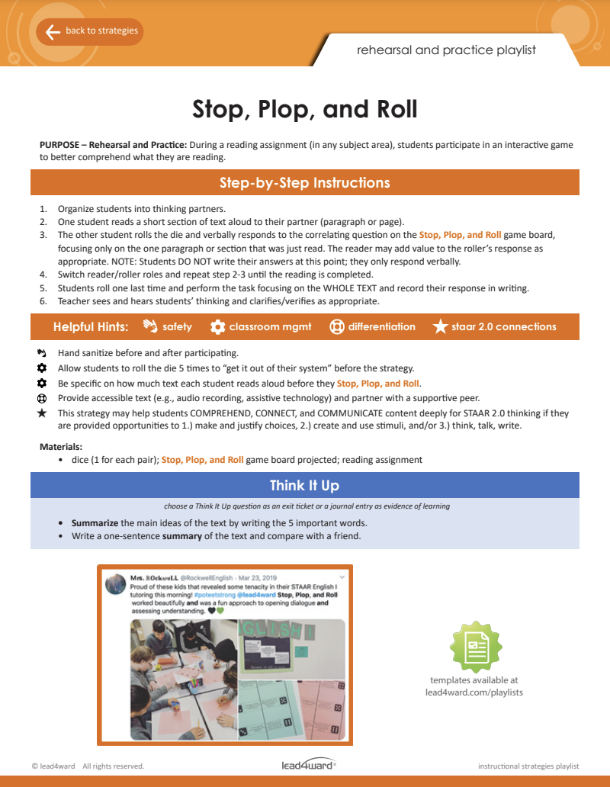
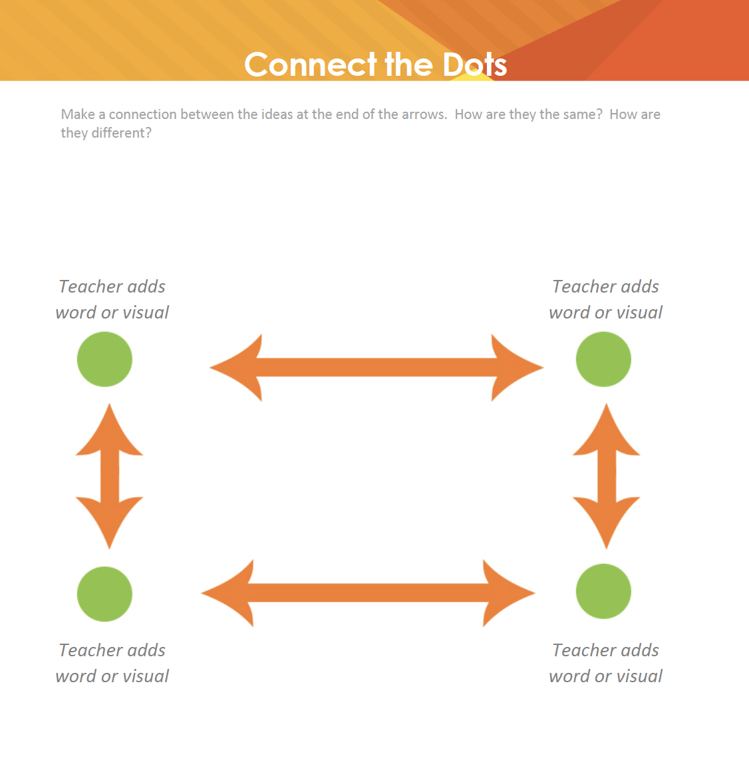
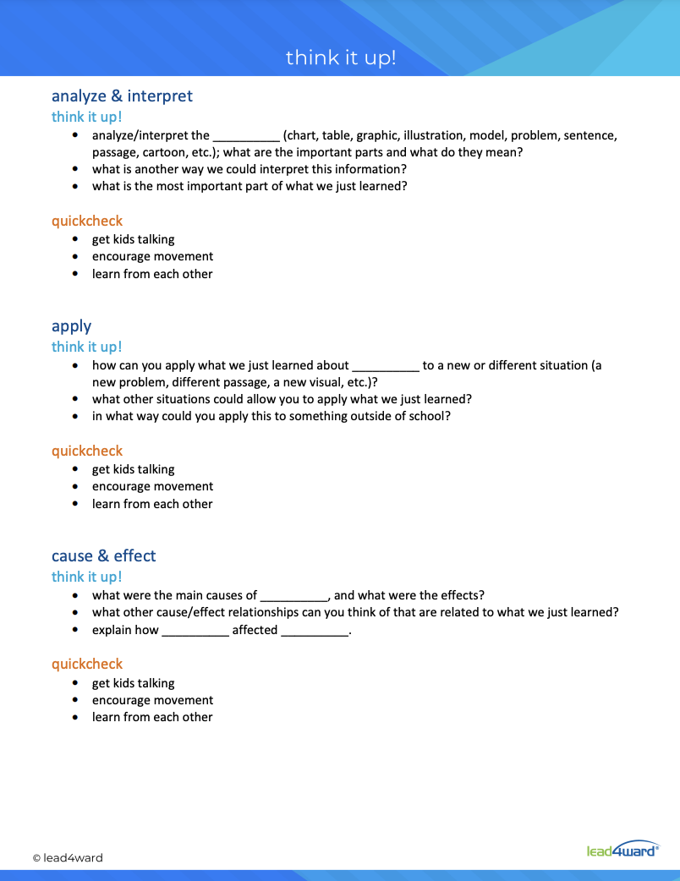
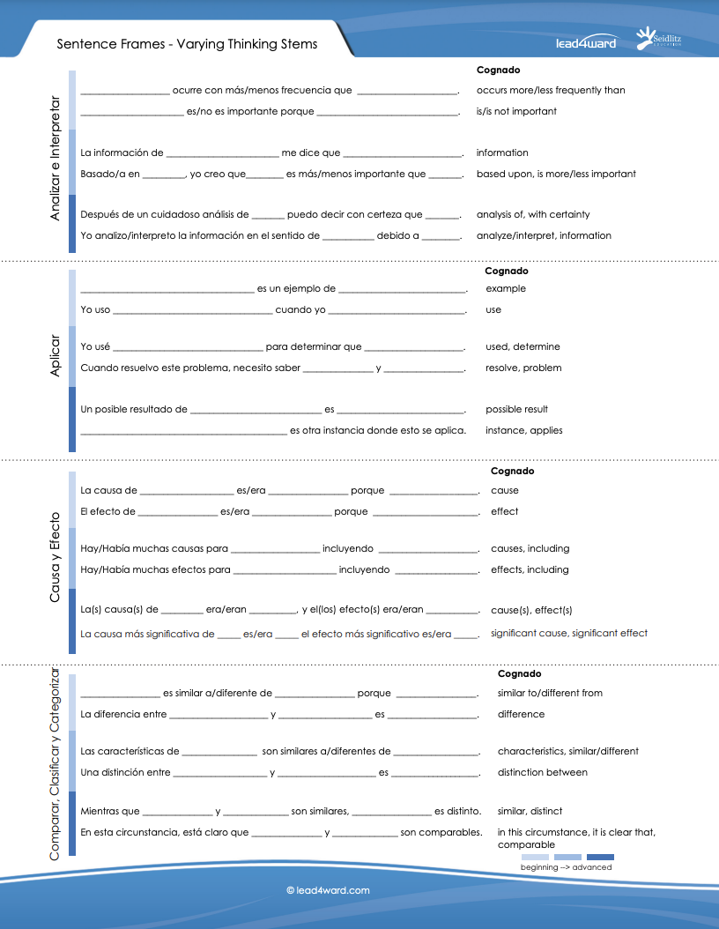
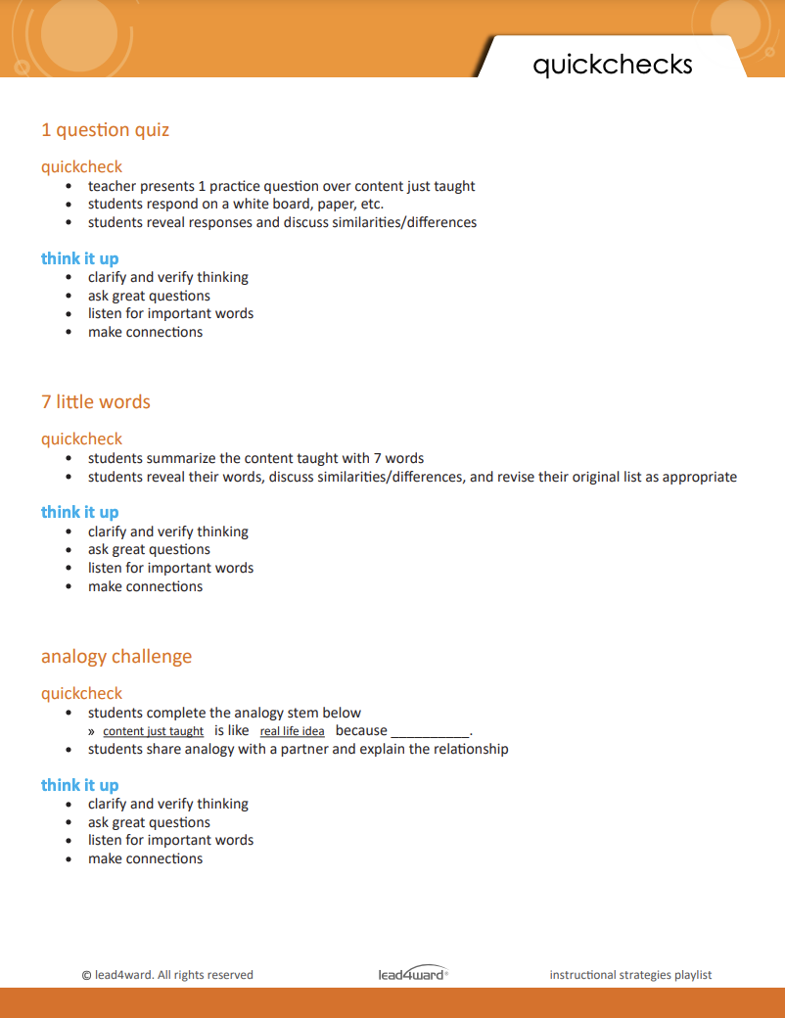

Slide 23
intentional intervention

Slide 24
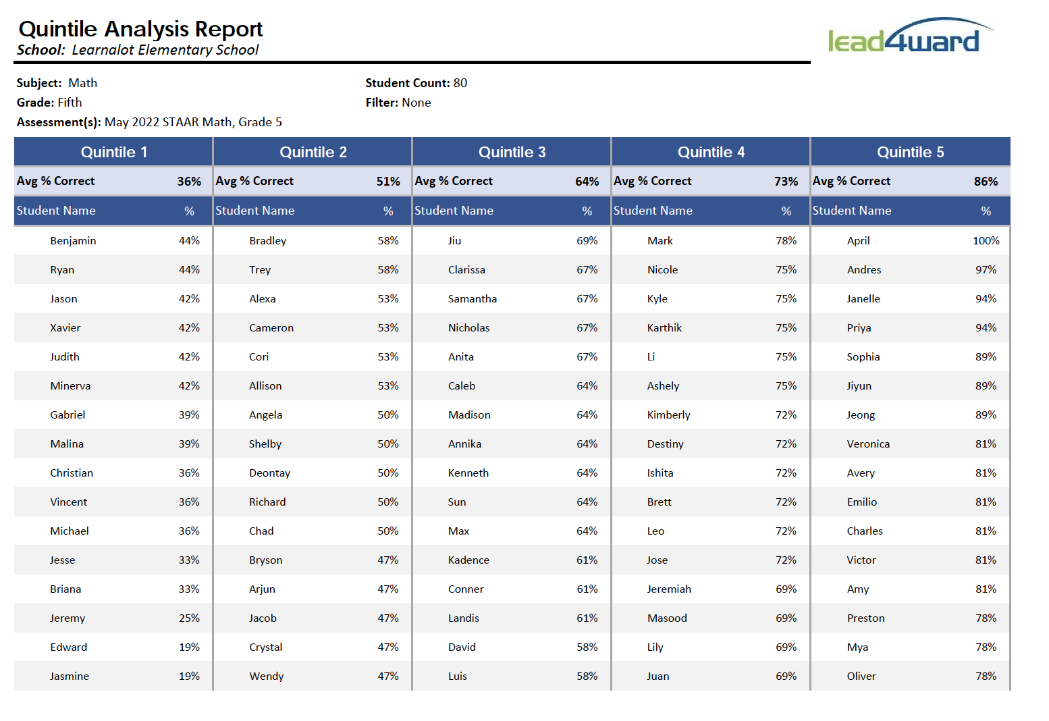
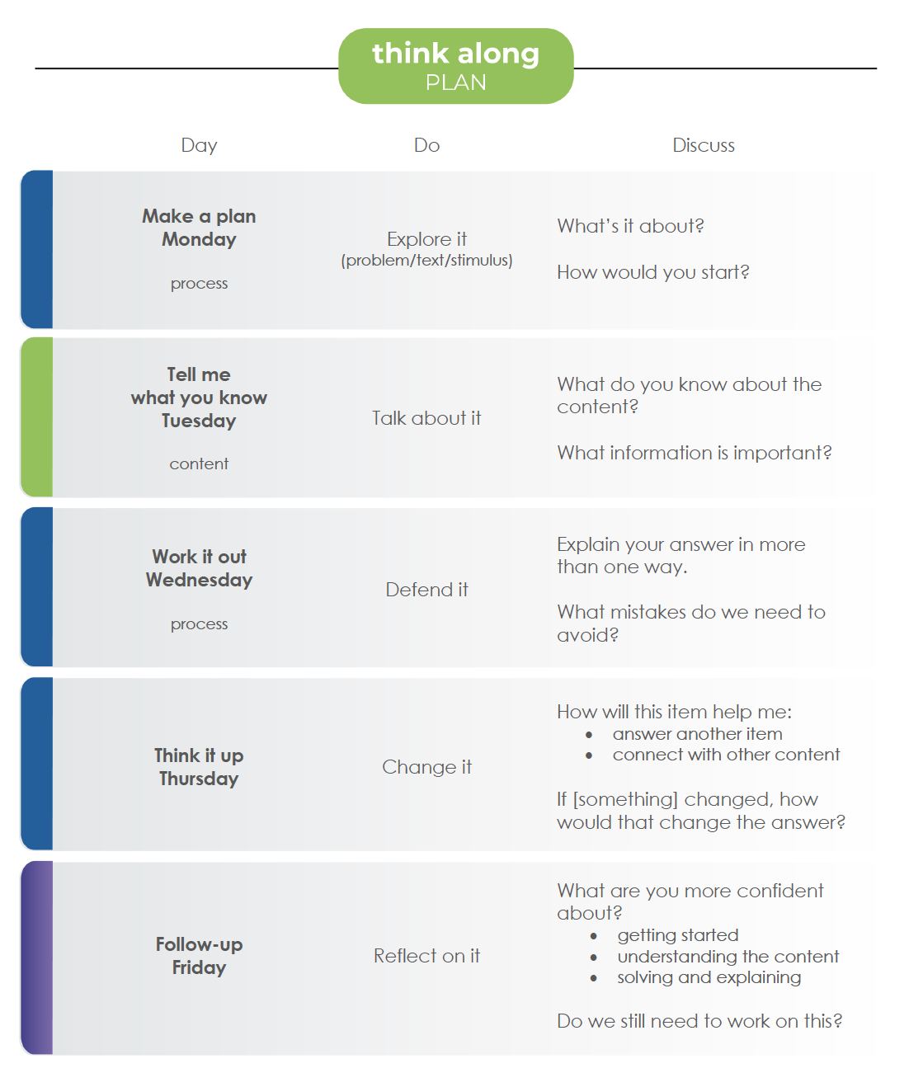
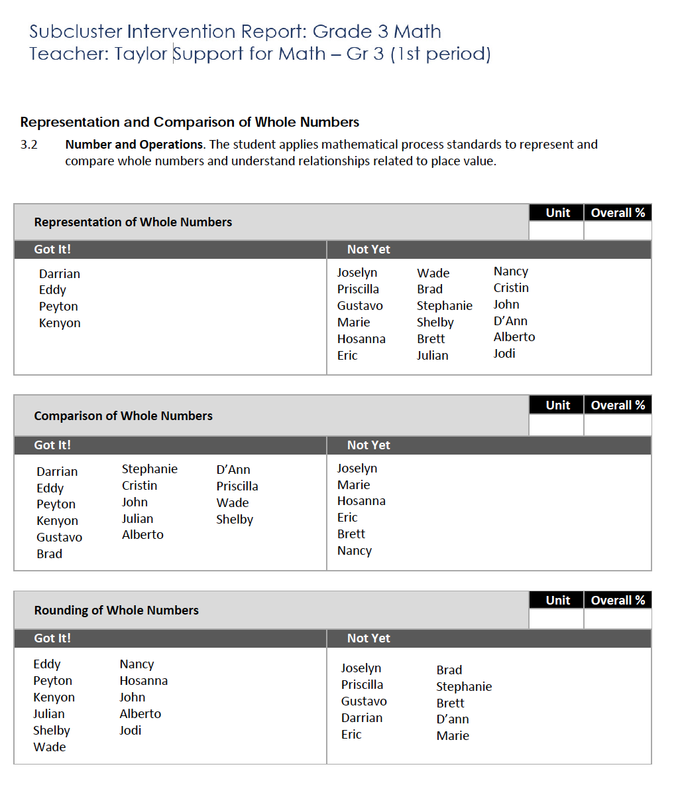
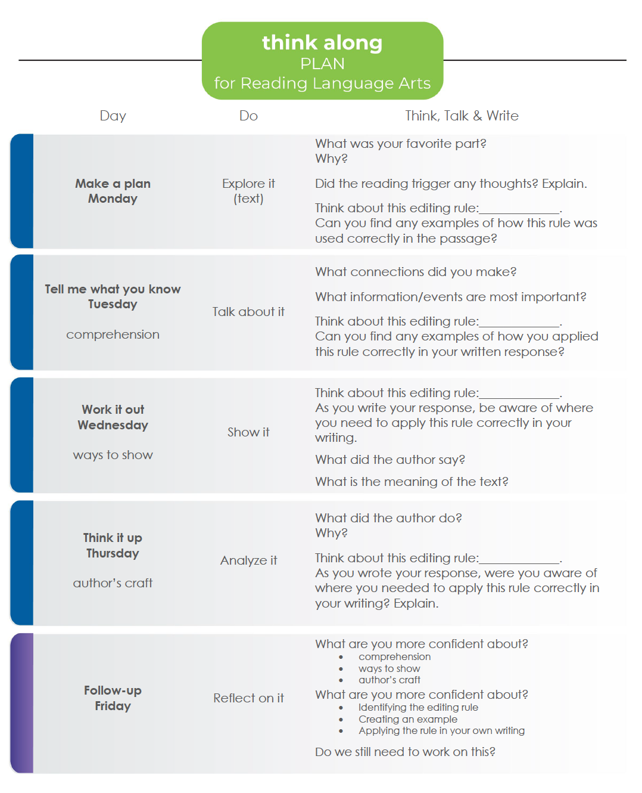
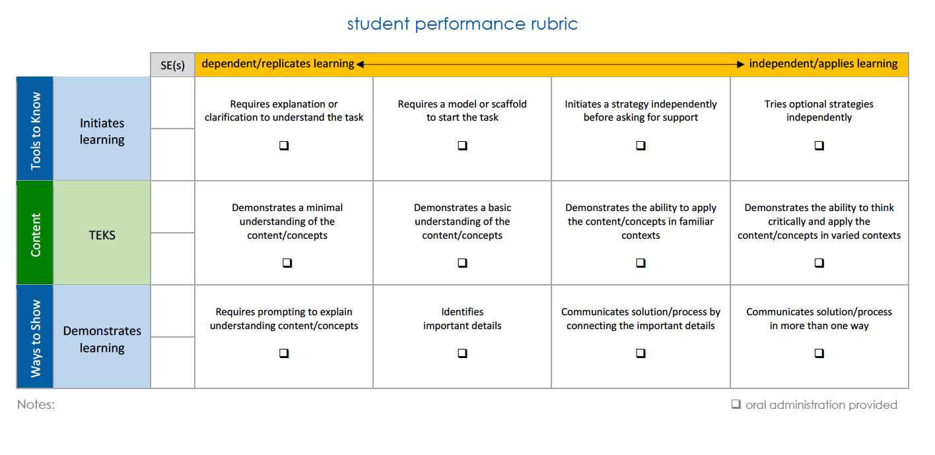

Slide 27
#growthwins

Slide 28
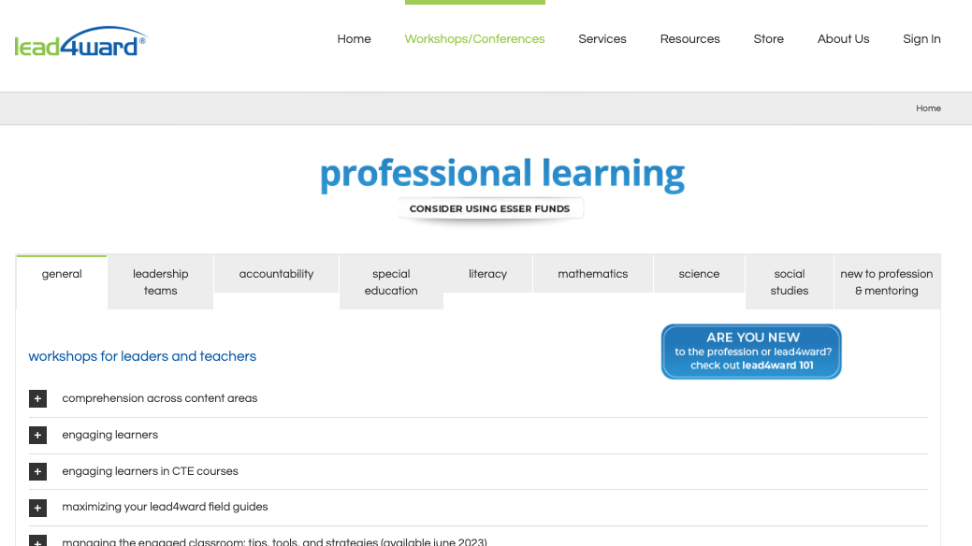

Slide 29
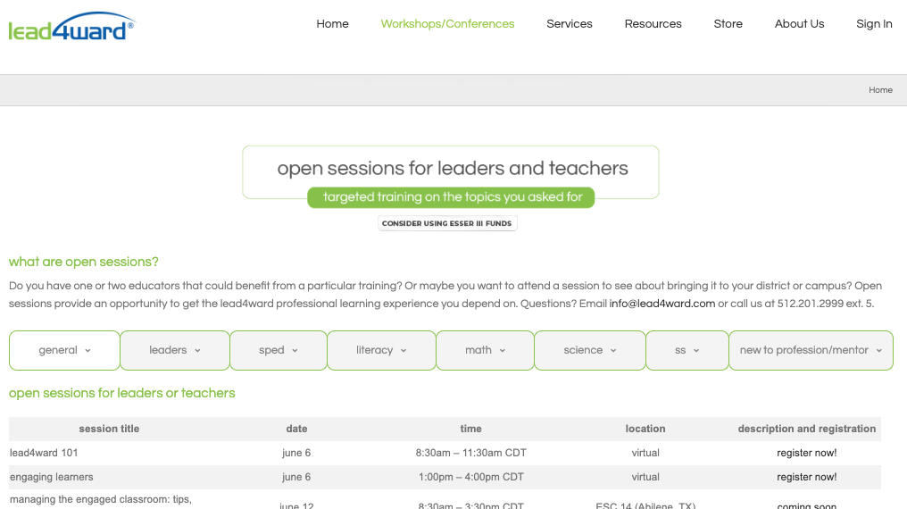

Slide 30
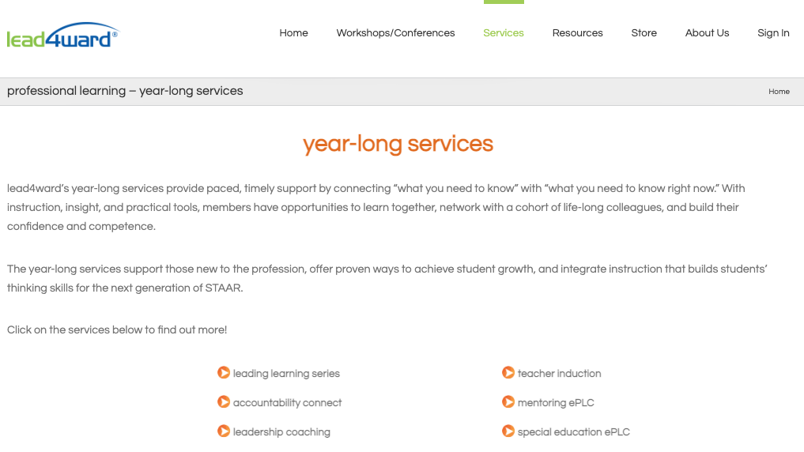

Slide 33
info@lead4ward.com

