Slide 1
2022-23
School Year
Update
Webinar 16
February 2, 2023
accountabilityconnect22-23

Slide 2

2022-23
School Year
Update
recording will be posted on
ac22-23 users page
Webinar 16
February 2, 2023
accountabilityconnect22-23

Slide 3

to webinar 16

Slide 4
previously… in
Webinar 15

Slide 5

So … what is your favorite “unusual” word
  You just like the sound of it
  You learned it years ago, and it just sort of stuck with you
Penultimate – next to last
Draconian – excessively harsh or severe

Slide 6
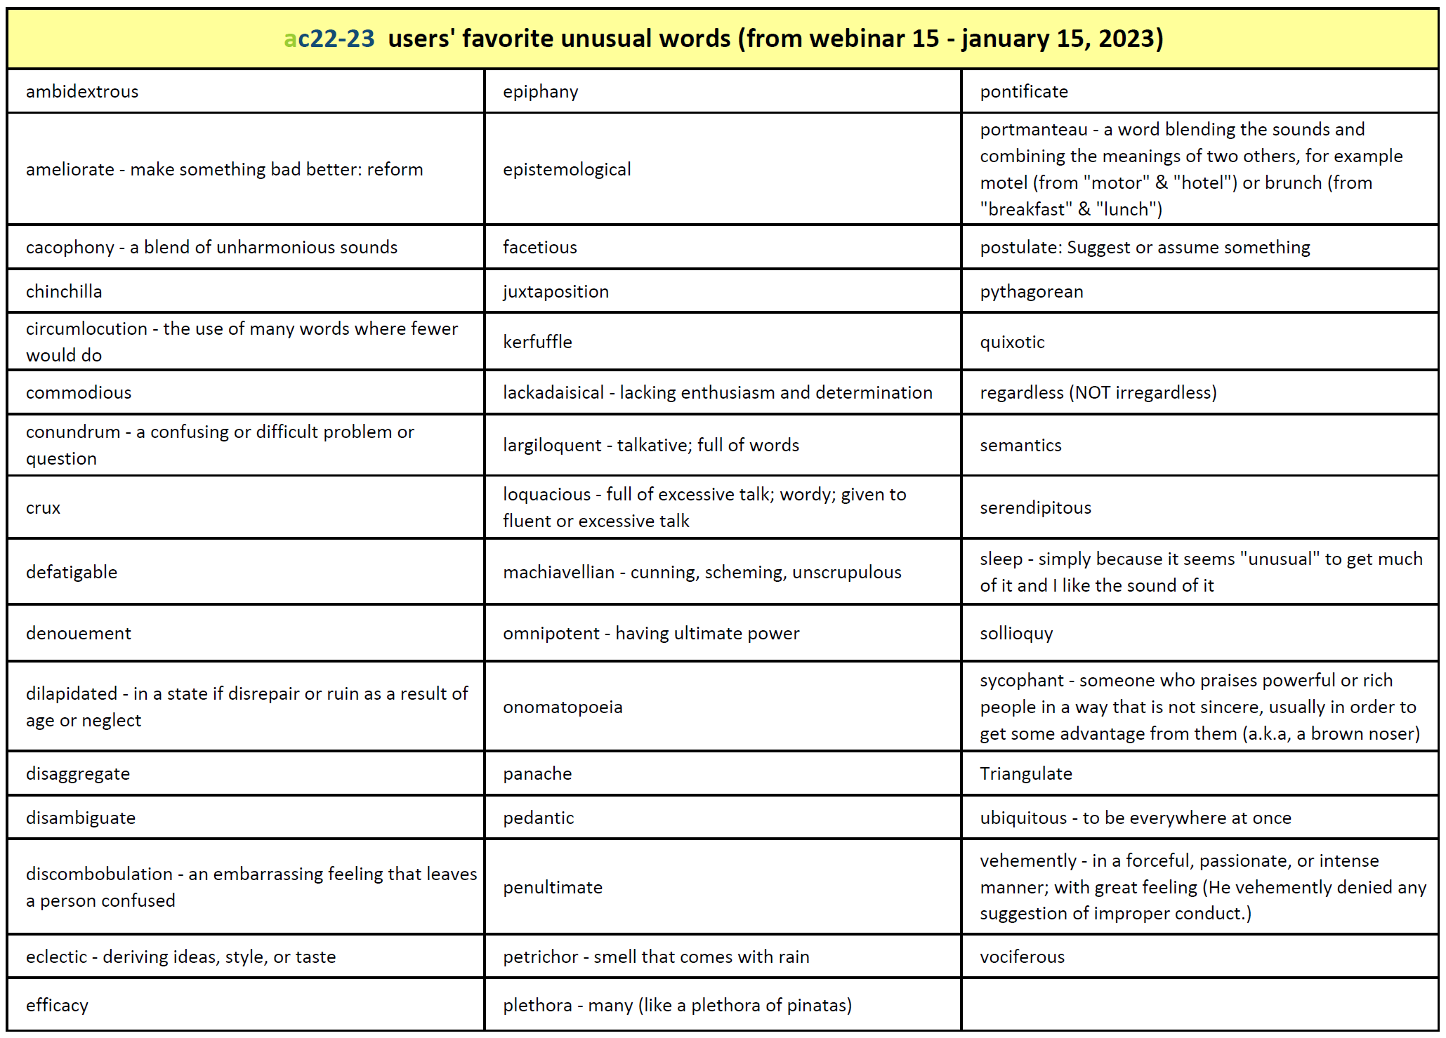

Slide 7
today is …

Slide 8


Slide 9

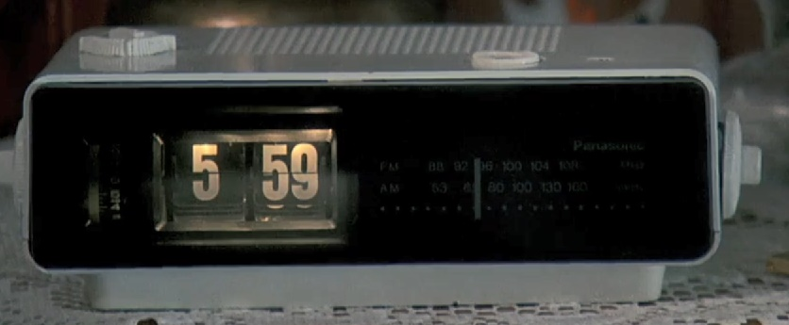
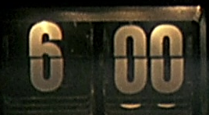
What show/movie/book is your “go to” for comfort or relaxation?
You can read or watch it over and over and over again …
and it keeps getting better each time?

Slide 10

agenda – webinar 16
ac22-23 users page
2023 accountability refresh update
  Where are we now?
2022-23 school year update
  2021-22 Federal Report Cards
  2021-22 School Report Cards

Slide 11
ac22-23
users page

Slide 12


Slide 13



Slide 14


Slide 16
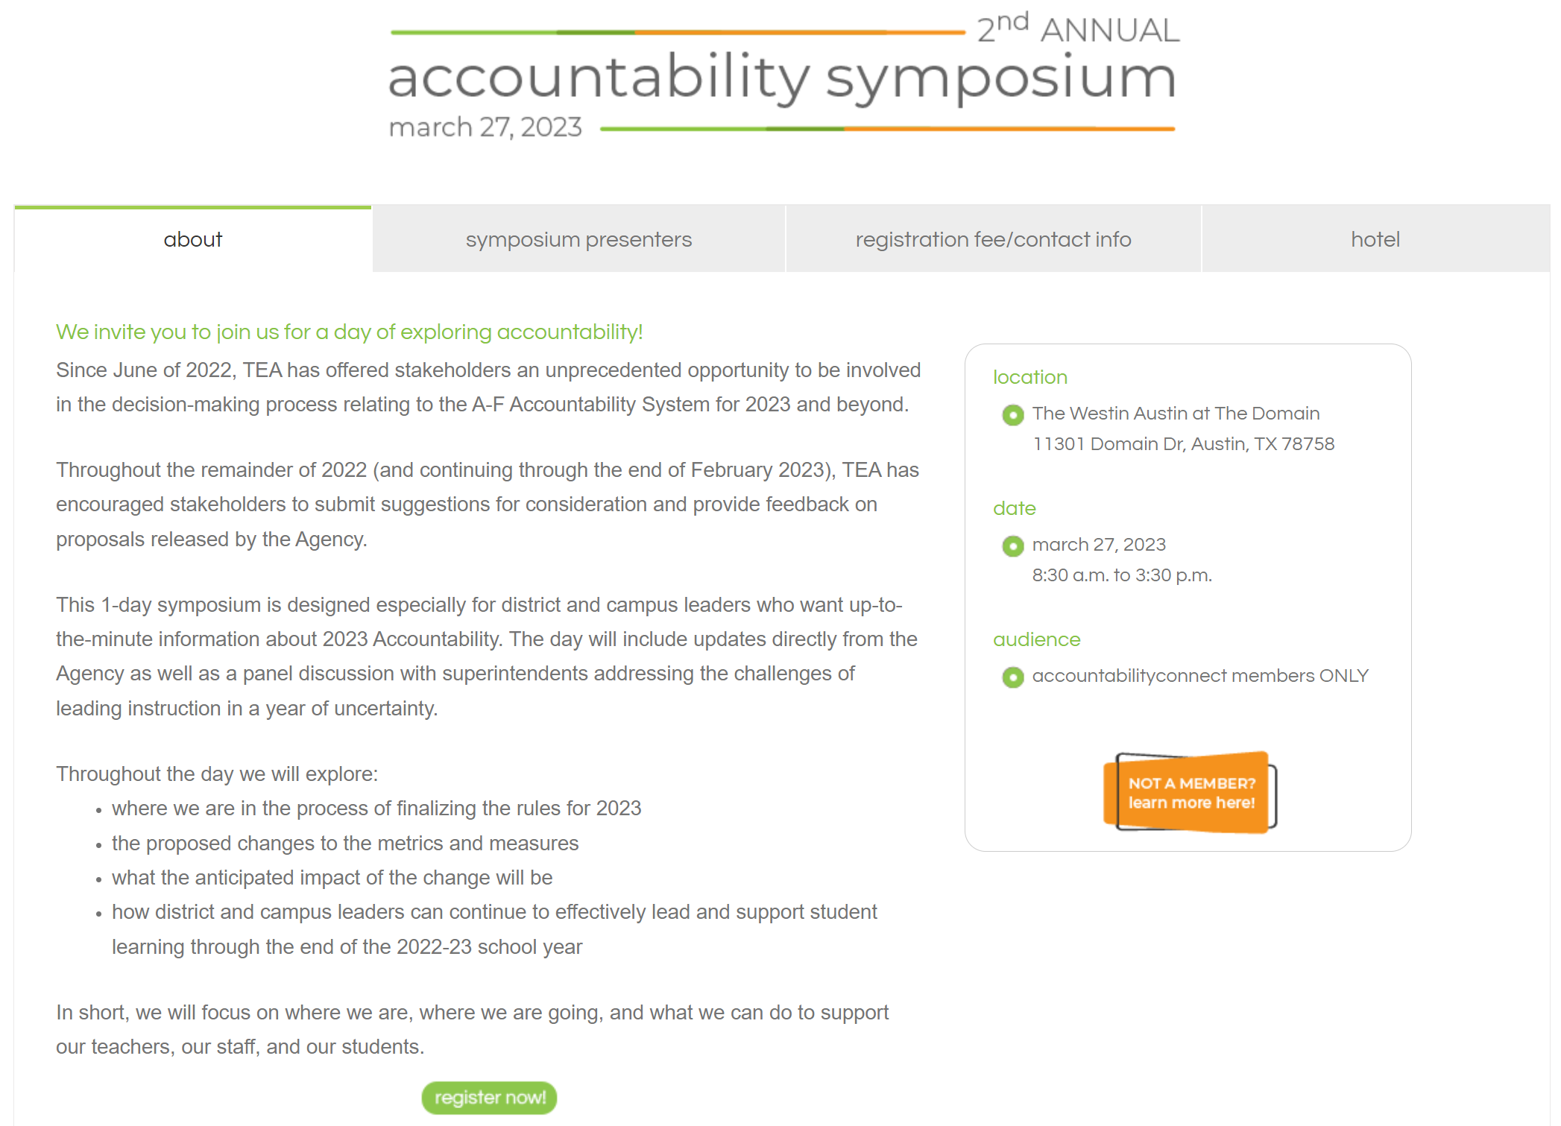
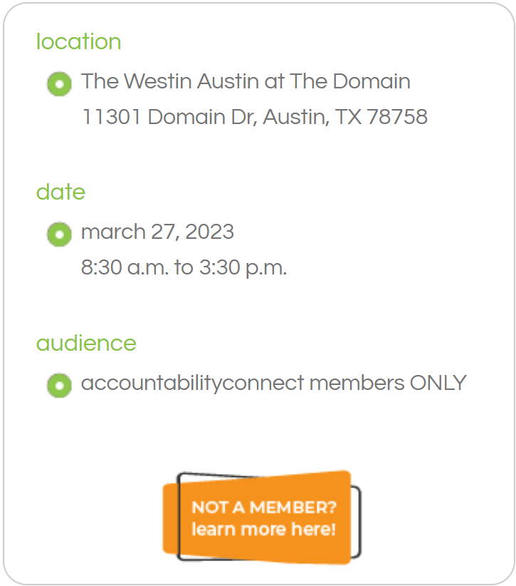

Slide 17
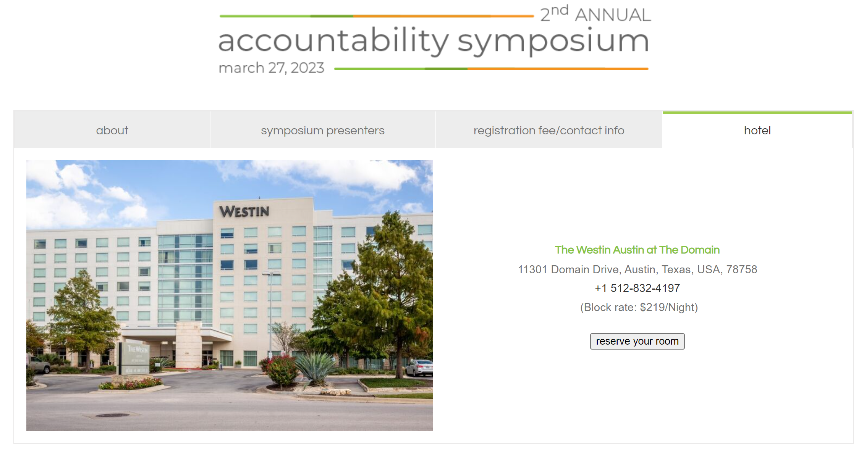
30 additional rooms were added to the block rate on January 31st!

Slide 19
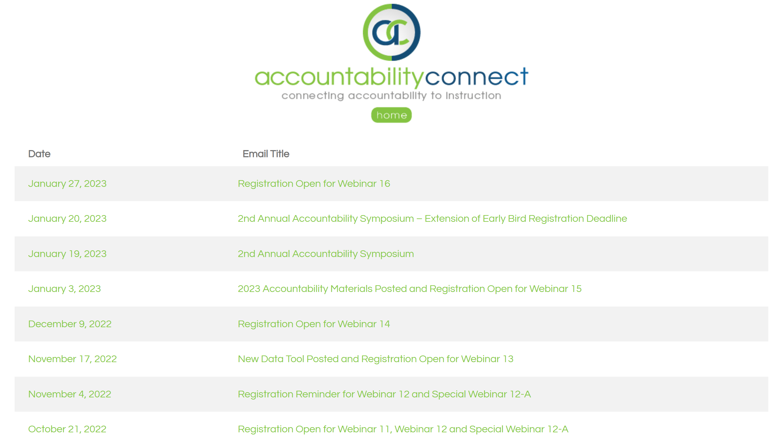
All ac22-23 emails are posted here for review or reference

Slide 21
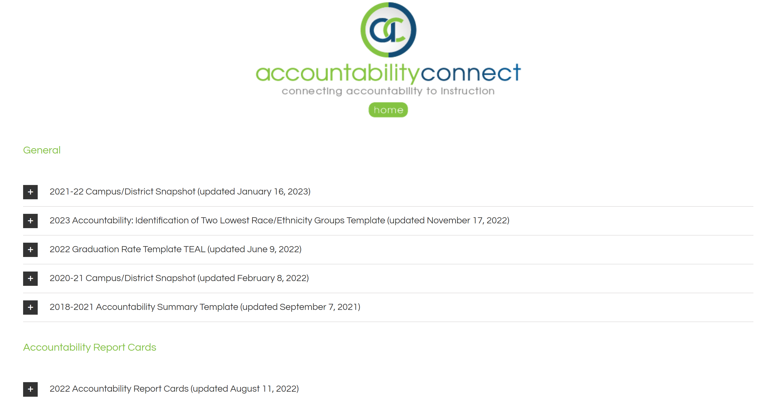

Slide 22
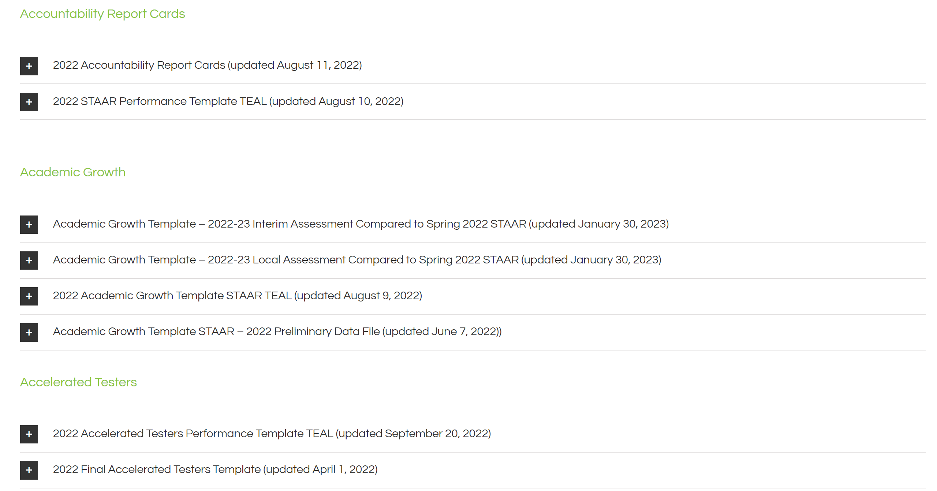
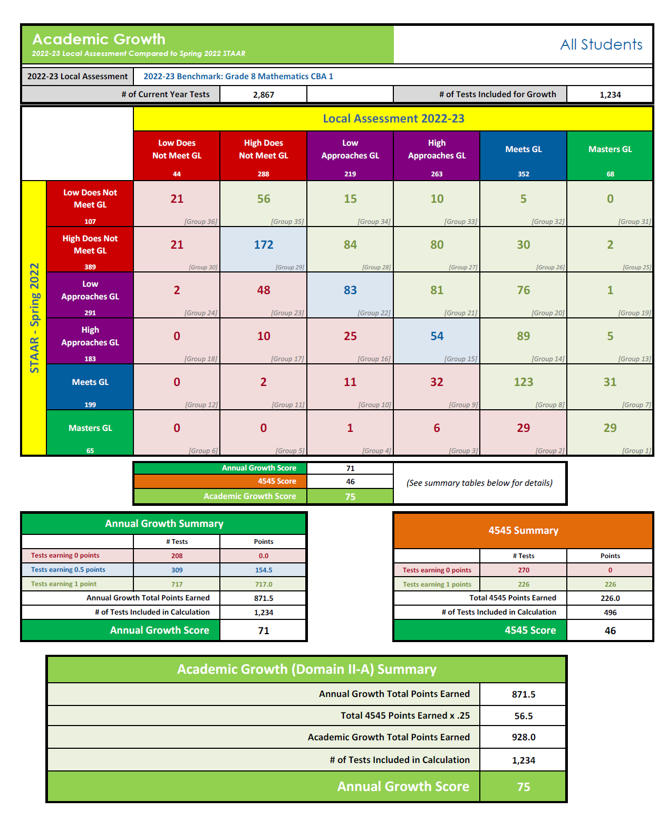
Annual Growth
4545
Academic Growth

Slide 24
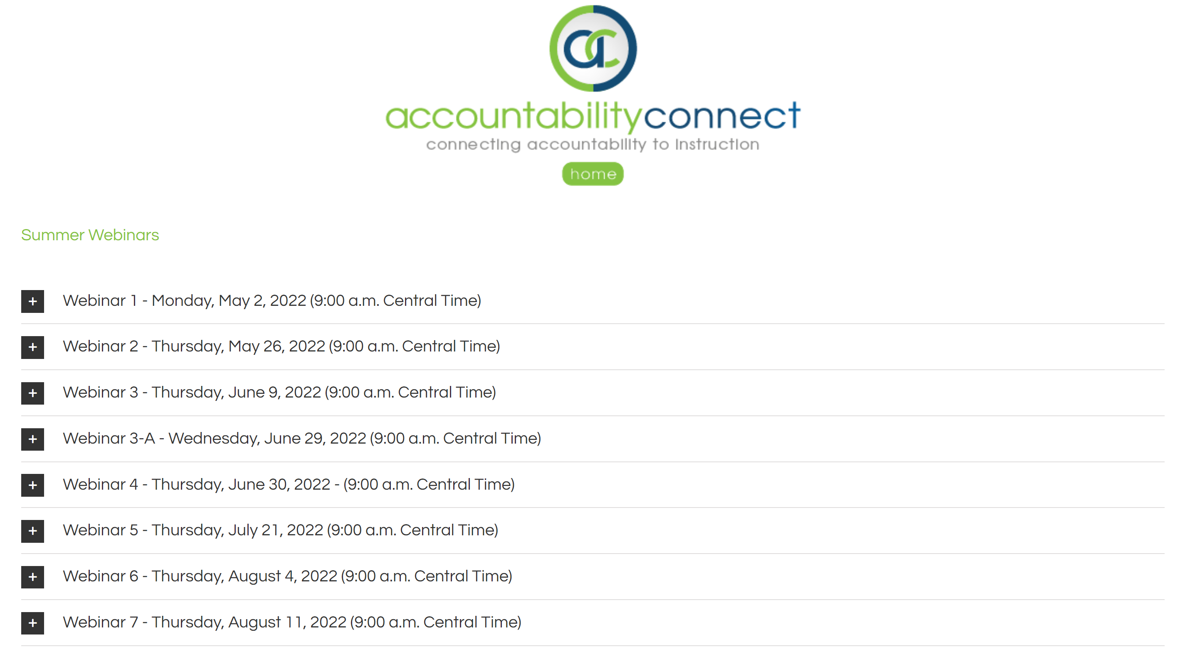

Slide 25
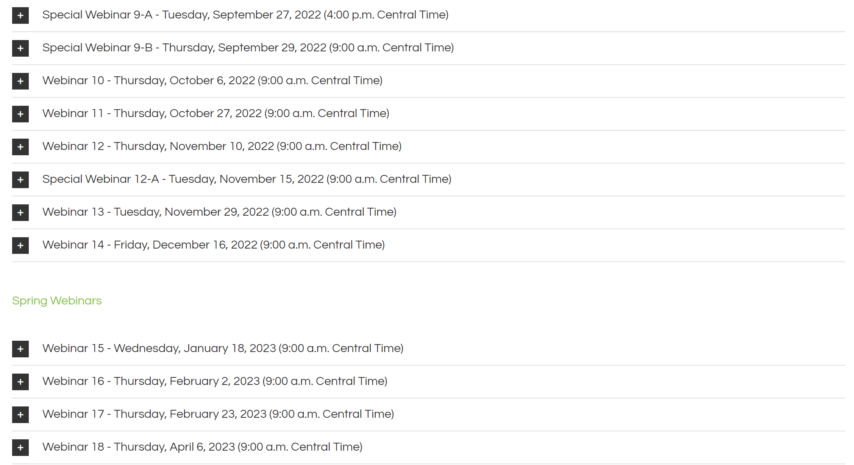

Slide 26
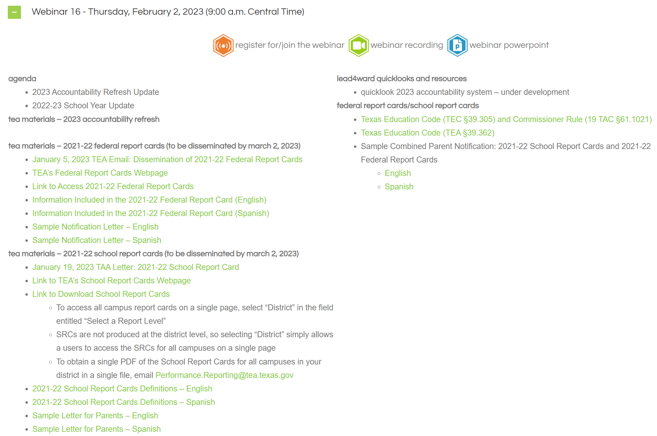


Slide 27
2023 accountability refresh update
As of February 2, 2023

Slide 28

As an instructional leader:
What %age of
students
should make
1 year of growth
for
1 year of instruction?

Slide 29

3 r’s for 2023 …
redesign
rethink
refresh
#betternotharder

Slide 30
refresh
(2023 accountability)
Growth
We still don’t know everything …
But what we
DO KNOW is …
is the word
is the word
is the word

Slide 31

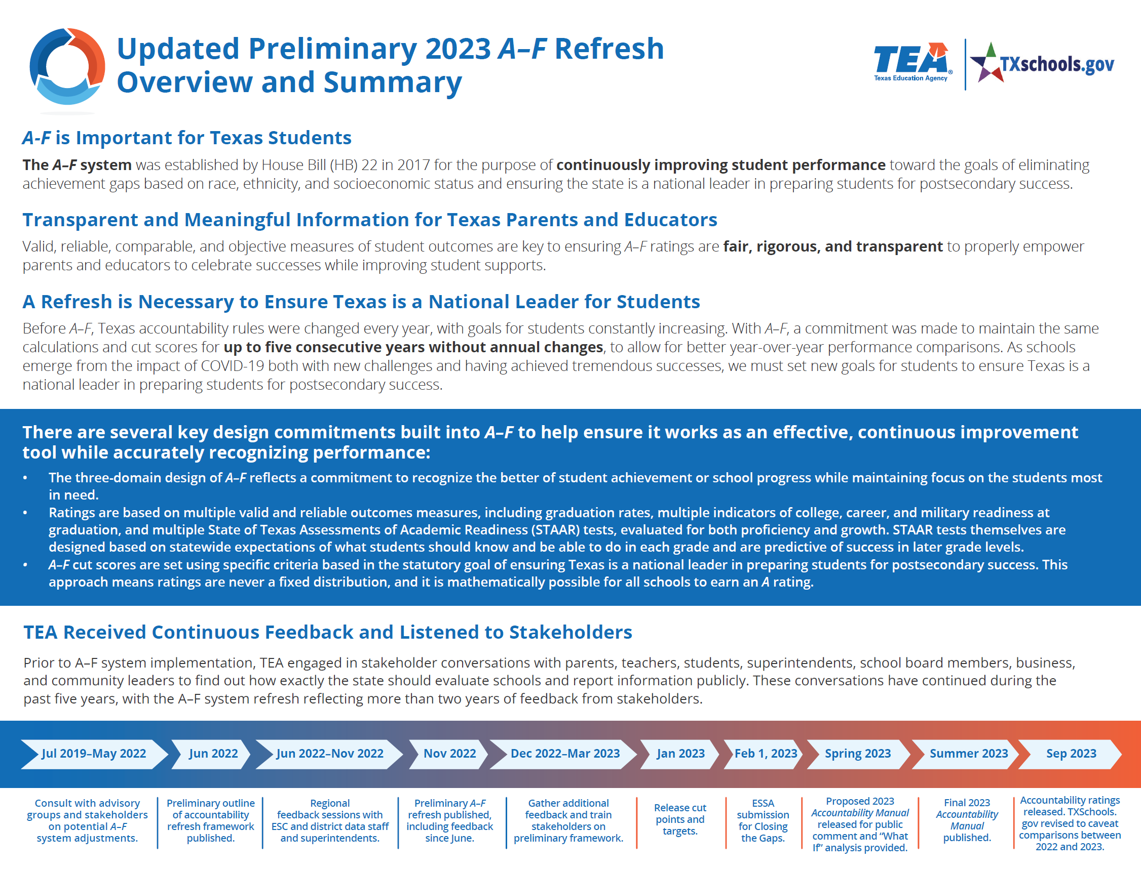
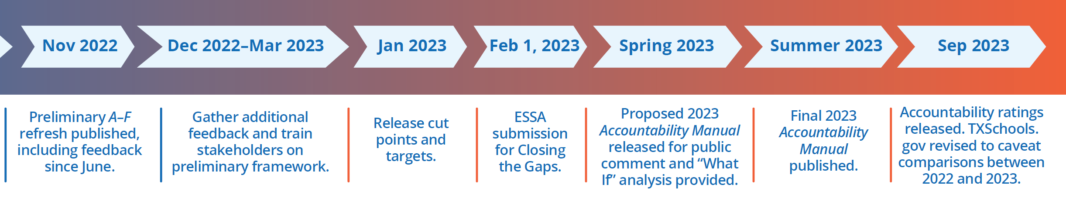

2023 Accountability Refresh Overview and
Summary
(Nov 2022)

Slide 32

so when will we know the FINAL, FINAL, FINAL rules for 2023?
Answer: Late Summer 2023

Slide 33
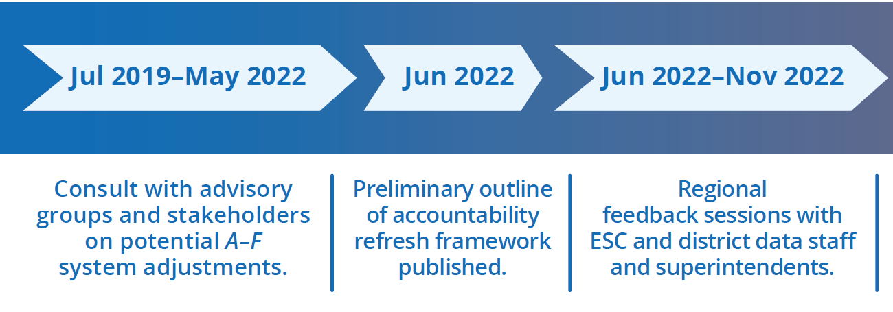
2023 Accountability Refresh Overview and
Summary
(Nov 2022)
2023 A-F Ratings not scheduled to be released until September 2023
It is important that we start preparing school boards for:
STAAR performance results for grades 3-8 will not be available until mid August
A-F accountability ratings will not be released until September
At the Accountability Symposium on March 27th, we will host a panel of superintendents to discuss these issues as well as other topics relating to moving forward to 2023-24

Slide 34
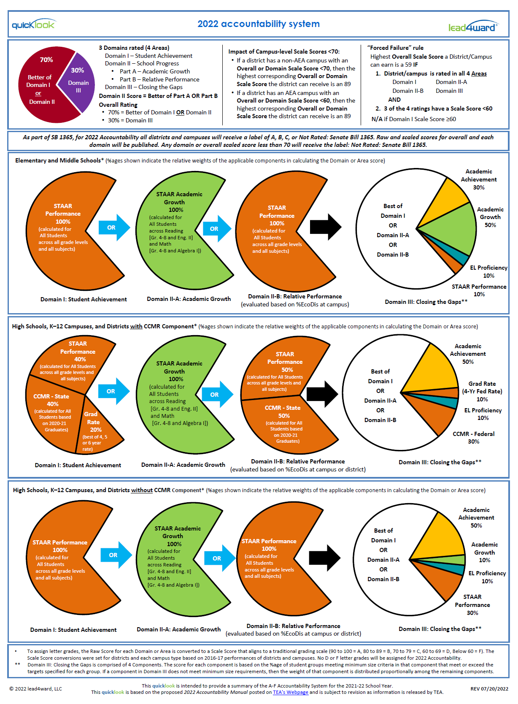
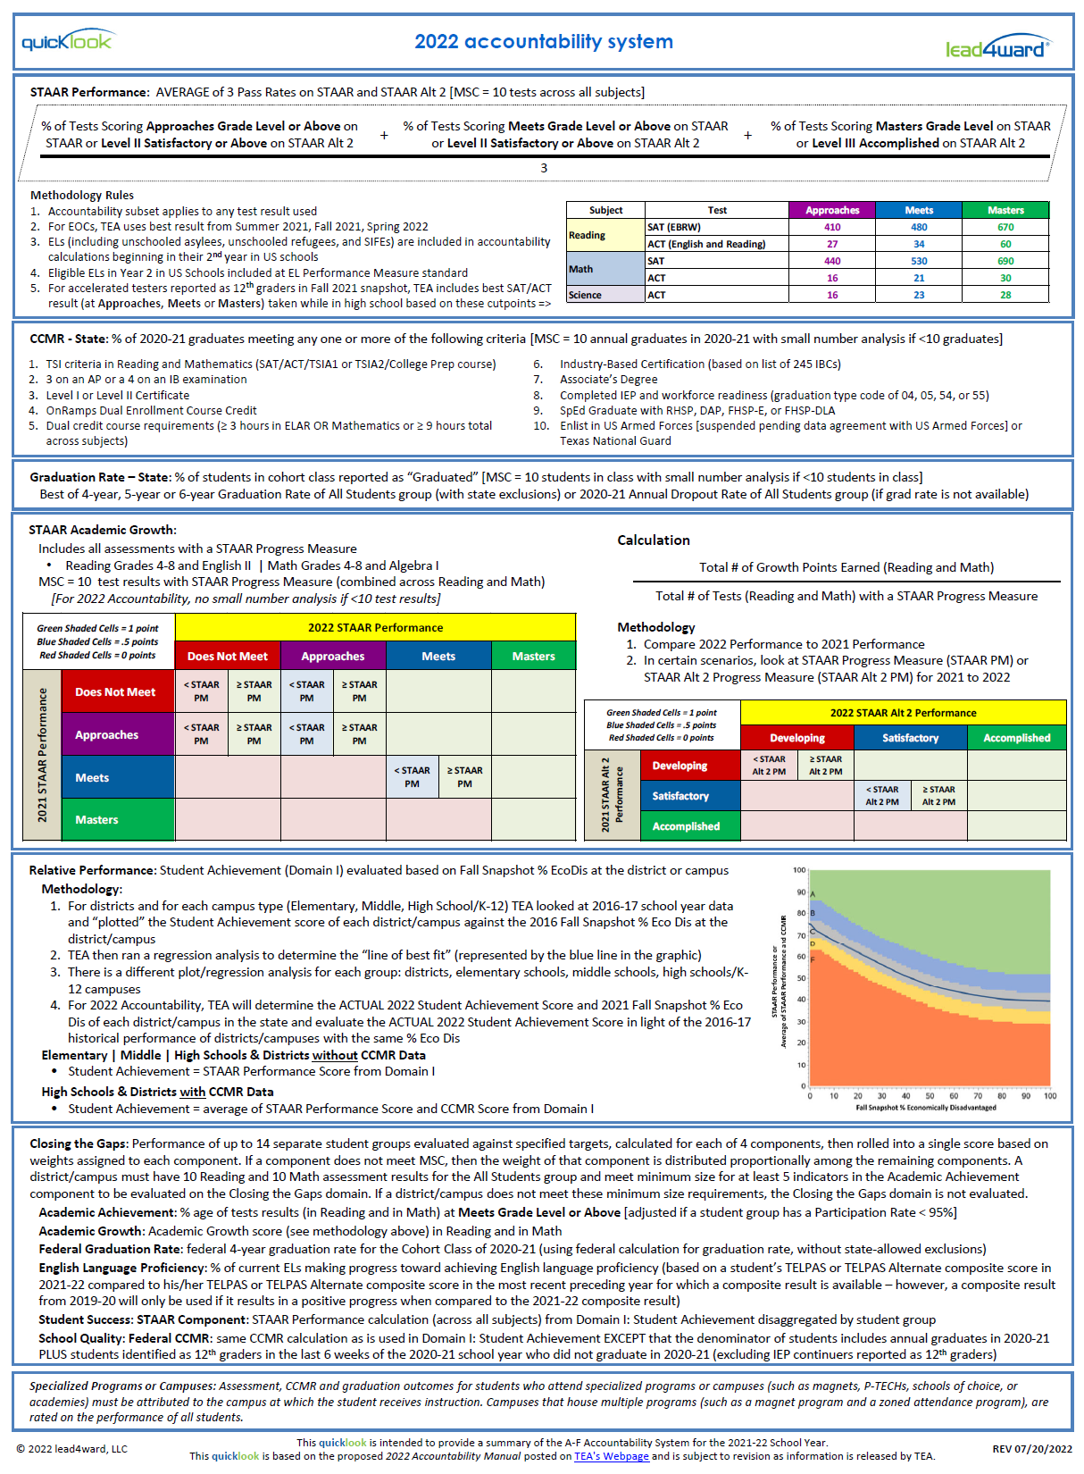
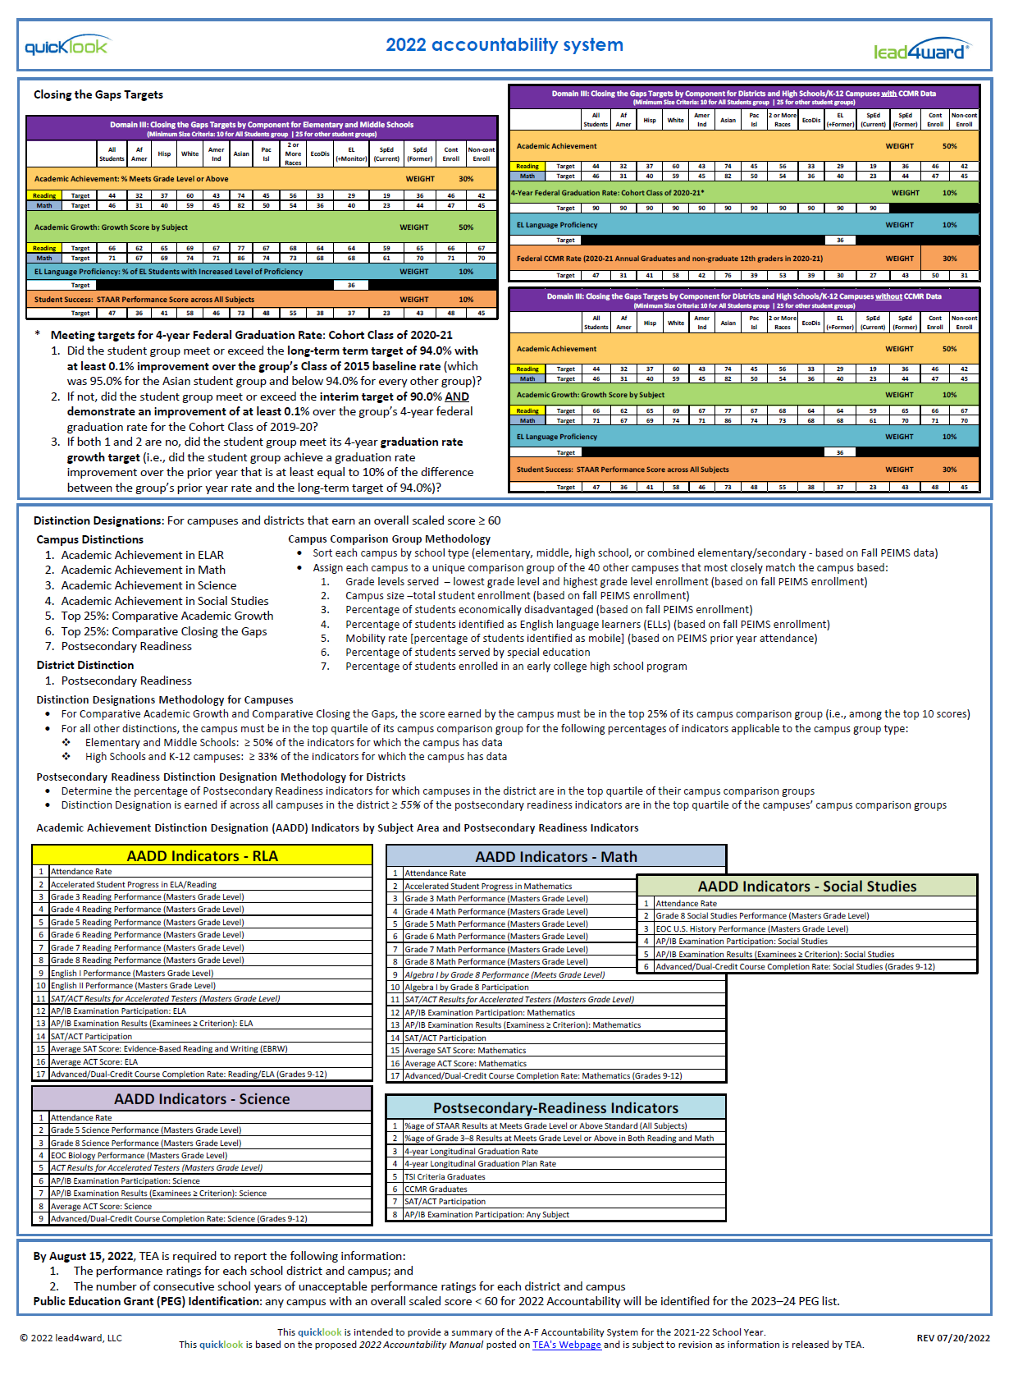
using the
2022 accountability quicklook to envision
2023 accountability

Slide 35
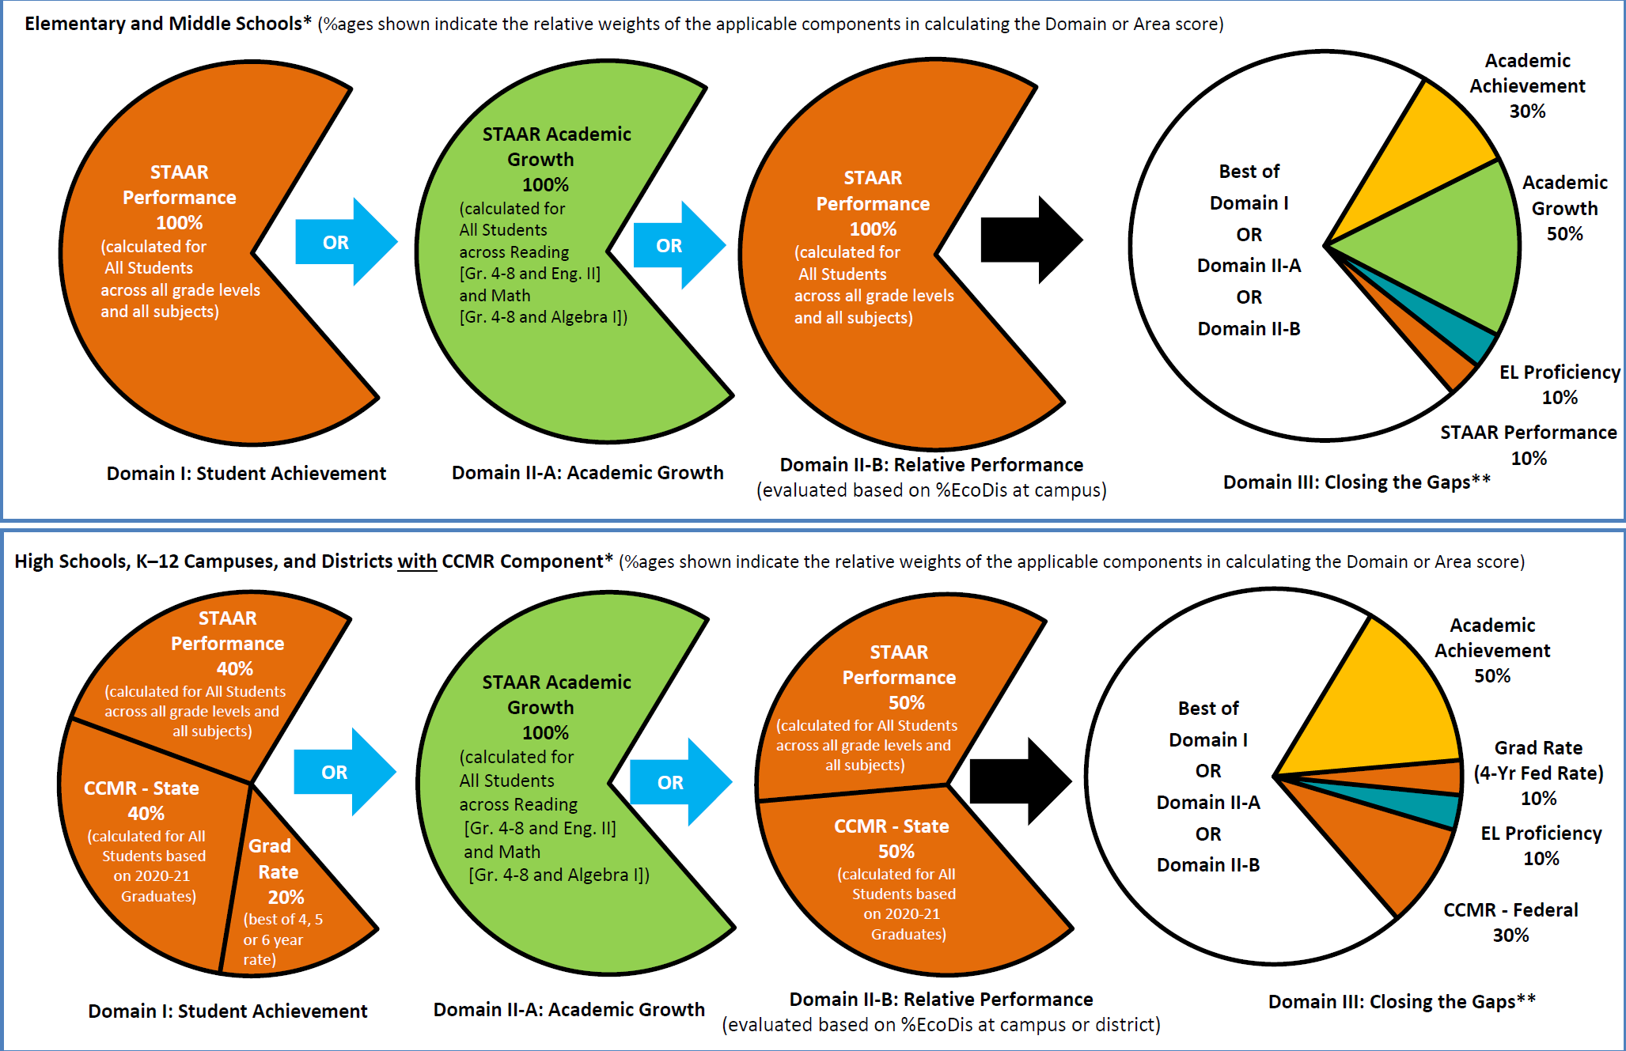
elementary and middle schools
Domain I
(Performance)
Domain II-A
(Growth)
Domain II-B
(Performance)
Domain III
high schools (NOT districts)

Slide 36
elementary and middle schools
GROWTH
70% of the overall rating is based on whichever is best:
Growth
OR
Performance
OR
For campuses, there are no proposed changes to
THE BIG PICTURE
PERFORMANCE
Domain
III
(30%)
Domain I
(Performance)
Domain II-A
(Growth)
Domain II-B
(Performance)
Domain III
high schools (NOT districts)
GROWTH
OR
PERFORMANCE

Slide 37
A-F in 2023 is still a STRENGTHS-BASED system …
Example: if GROWTH is what we do best …
85%
Academic
Achievement
Academic
Achievement
Growth
Growth
70%
(best of Domains
I, II-A or II-B)
30%
(Domain III)
70%
(best of Domains
I, II-A or II-B)
30%
(Domain III)
Growth
70%
Fed 4-Year Grad Rate
EL Proficiency
EL Proficiency
For High Schools, based on 1st time takers of:
English I
English II
Algebra I
Fed CCMR
STAAR Performance
Growth
RLA (Gr. 4 through Eng. II) Math (Gr. 4 through Algebra I)
elementary and middle schools
high schools

Slide 38
2023?
2023?
elementary and middle schools
Domain I
(Performance)
Domain II-A
(Growth)
Domain II-B
(Performance)
Domain III
2023?
2023?
high schools (NOT districts)

Slide 39
elementary and middle schools
2023:
No changes to calculation or scaling
2023:
No changes to calculation or scaling
Domain I
(Performance)
Domain II-A
(Growth)
Domain II-B
(Performance)
Domain III
high schools (NOT districts)
2023?
2023:
No changes to calculation or scaling
2023:
No changes to calculation or scaling
2023?

Slide 40
2023?
elementary and middle schools
2023:
No changes to calculation or scaling
2023:
No changes to calculation or scaling
Domain I
(Performance)
Domain II-A
(Growth)
Domain II-B
(Performance)
Domain III
2023?
high schools (NOT districts)
2023:
No changes to calculation or scaling
2023:
No changes to calculation or scaling
2023?
2023:
Minor change to calculation
Major changes to scaling
2023:
Minor change to calculation
Major changes to scaling
2023:
No change to calculation
Minor changes to scaling

Slide 41
2023?
elementary and middle schools
2023:
No changes to calculation or scaling
2023:
No changes to calculation or scaling
2023:
MAJOR changes to calculation
and scaling
Domain I
(Performance)
Domain II-A
(Growth)
Domain II-B
(Performance)
Domain III
2023?
high schools (NOT districts)
2023:
No changes to calculation or scaling
2023:
No changes to calculation or scaling
2023:
MAJOR changes to calculation
and scaling
2023:
Minor change to calculation
Major changes to scaling
2023:
Minor change to calculation
Major changes to scaling
2023:
No change to calculation
Minor changes to scaling

Slide 42
academic growth 2023: what tea has proposed
Academic Growth (Domain II-A) will be based on:
  Annual Growth
  4545 Performance
The overall Academic Growth score will then be scaled very similarly to how Academic Growth was scaled in 2022

Slide 43
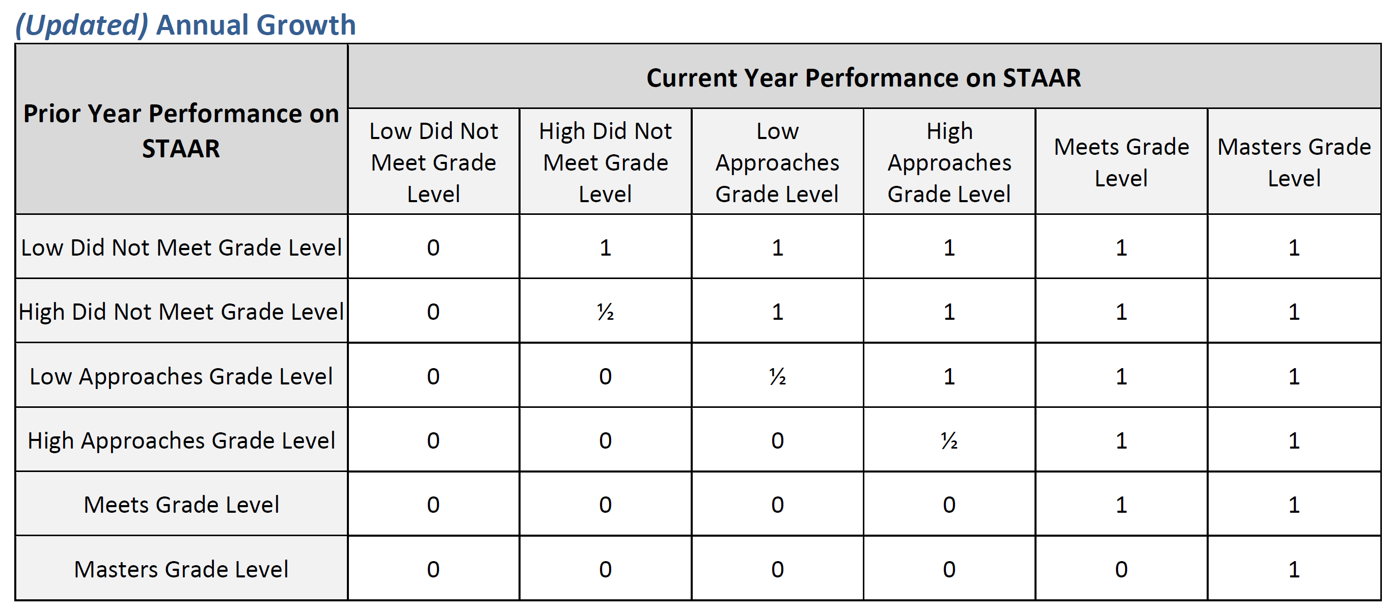

Annual Growth – Transition Table Model
Meets to Meets or Masters = Good
Meets to anything else (Performance Dropper) = Bad
Masters to Masters = Good
Masters to anything else (Performance Dropper) = Bad

Slide 44
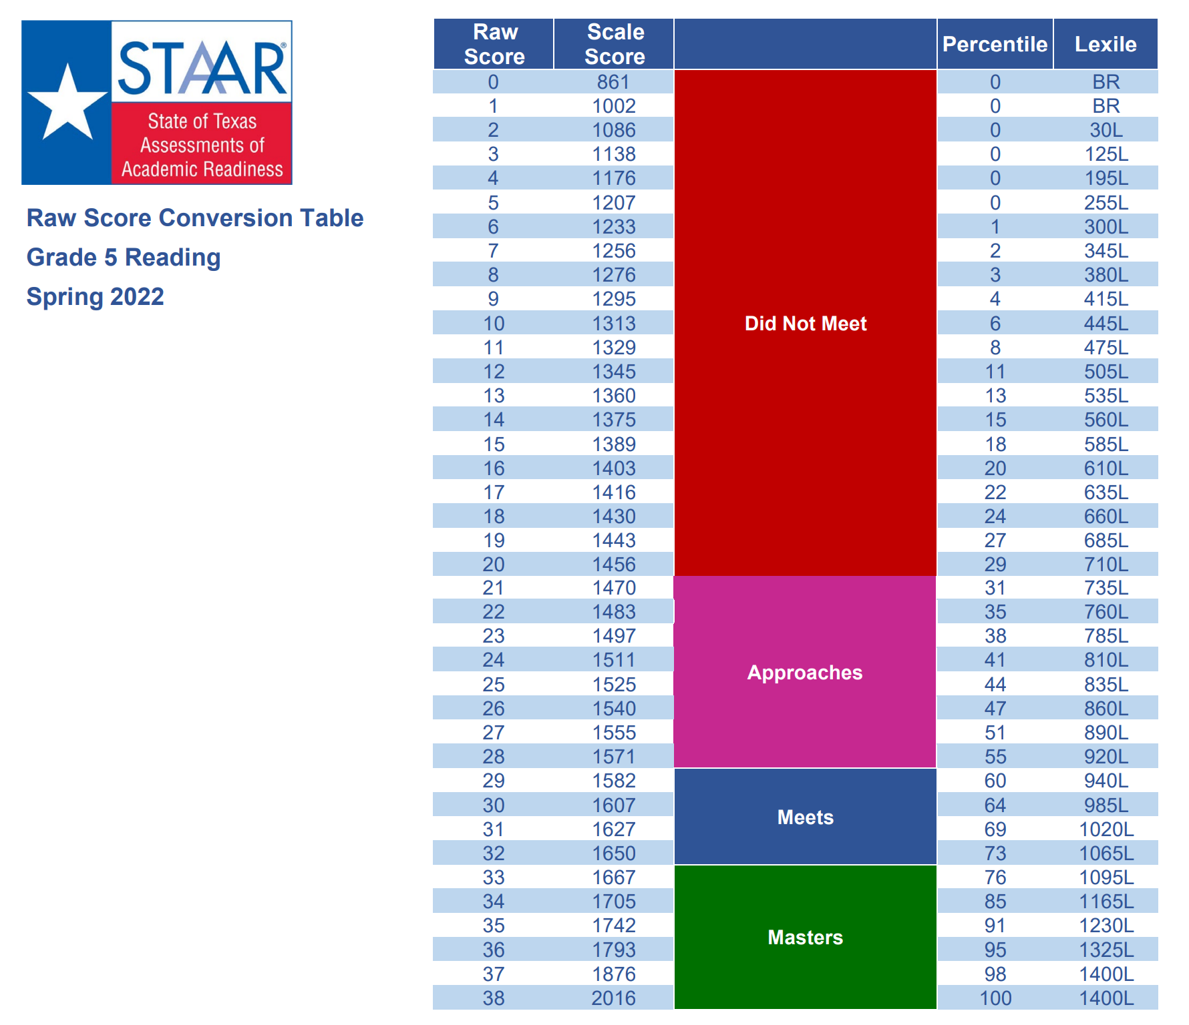
Making Sense of “High” vs. “Low”
Where would YOU draw the line to create
  High Approaches vs. Low Approaches
  High Does Not Meet vs. Low Does Not Meet
Only 4 questions
Only 6 questions

Slide 45
Academic Growth – Transition Table Model
Annual Growth = No Performance Droppers
ANY STUDENT who maintains OR improves
contributes positively to GROWTH
(the only exception is students who go from Low Did Not Meet to Low Did Not Meet)

Slide 46
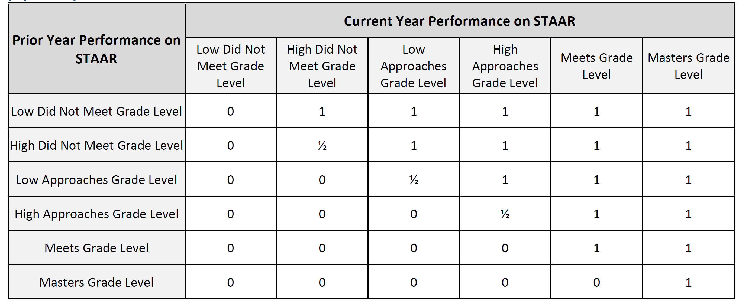
4545 Performance – Using the Transition Table Model
0 | 0
0 | 0
1 | 1 | 1 | 1
1 | 1 | 1 | 1

Slide 47
so … how do
Annual Growth
and
4545 Performance
work together to determine
ACADEMIC GROWTH?

Slide 48
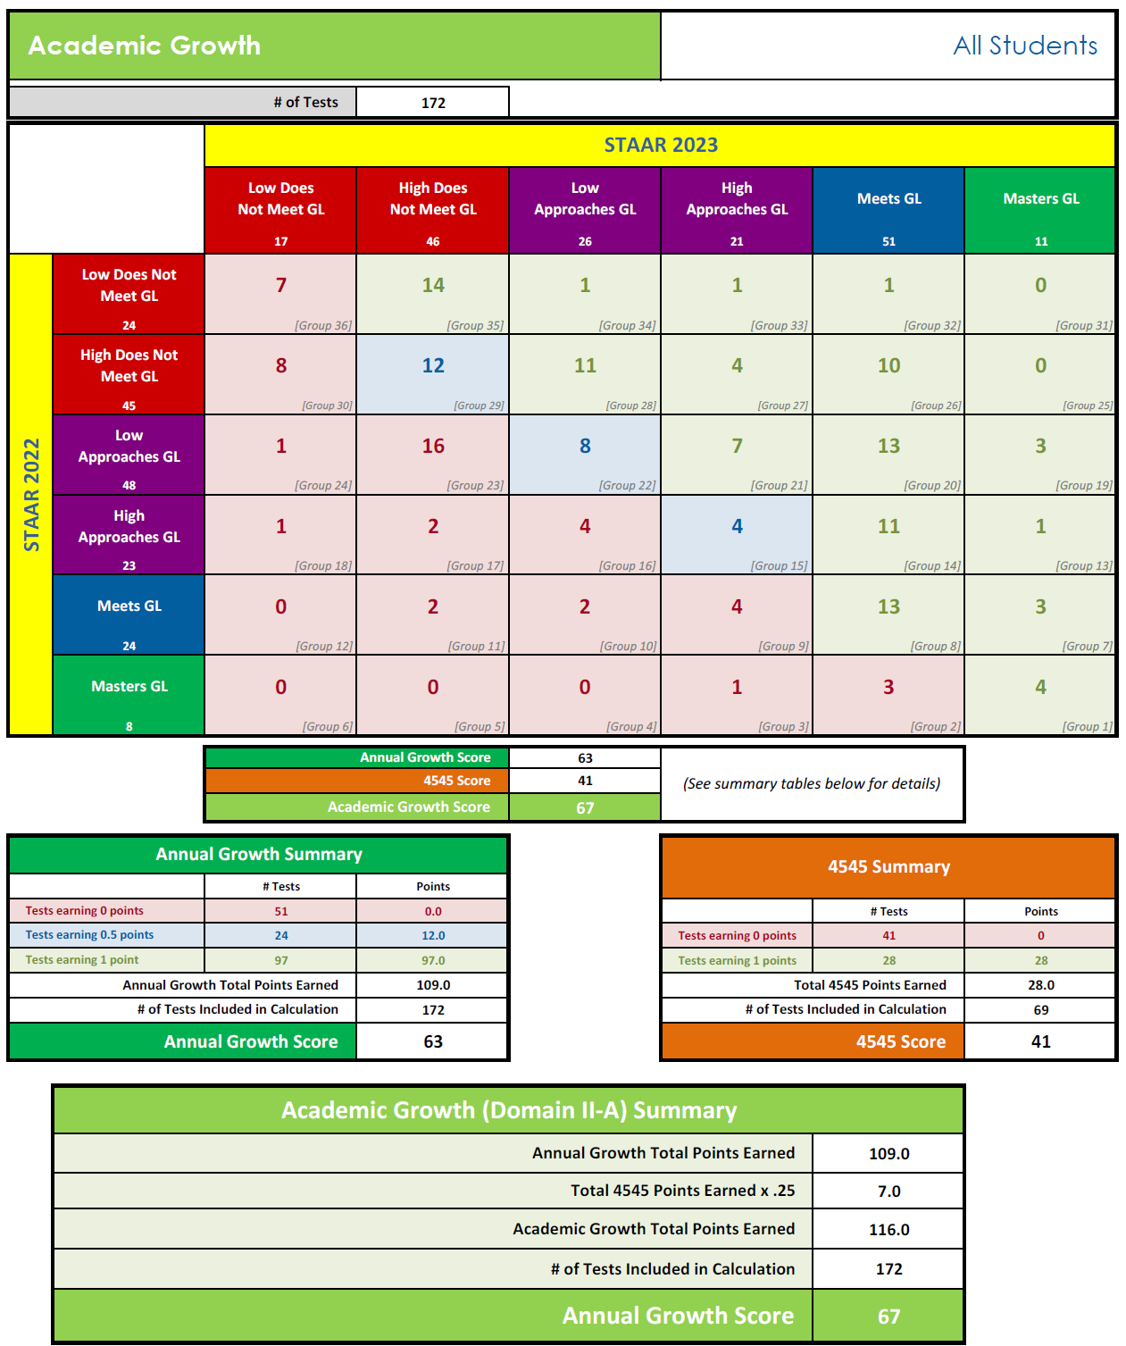
Transition Table Model
Test results that meet the following:
  Valid score in 2023 on 1st time attempt at a test in Reading or Math
  Valid score in 2022 on 1st time attempt at a test in the same subject area but lower grade/course
EOC retests are NOT included
BUT 1st time attempts are, so SOME 4545 student test results are included:
  Alg I compared to Gr 8 Math
  Eng I compared to Gr 8 Rdg
  Eng II compared to Eng I
Annual Growth
4545 Performance
Academic Growth
(Domain II-A)

Slide 49
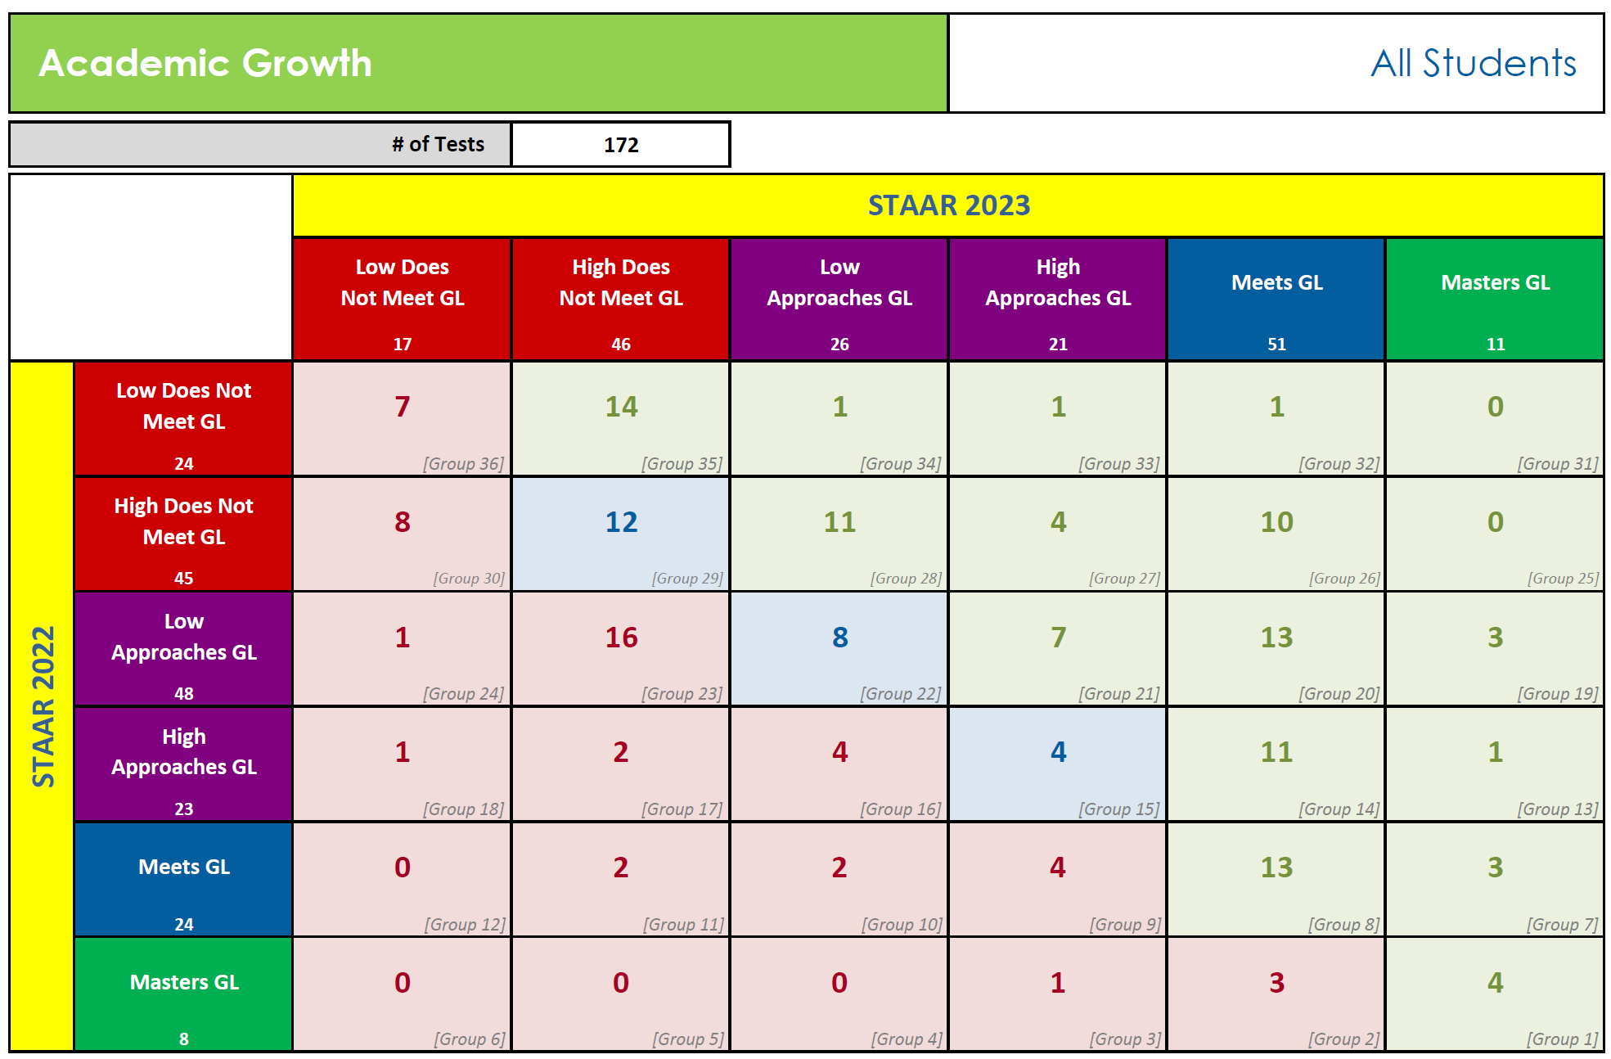
2023
Performance
Annual Growth
is the
%age of students
who made
1 year of growth
for
1 year of instruction
Annual Growth = 63
2022
Performance

Slide 50
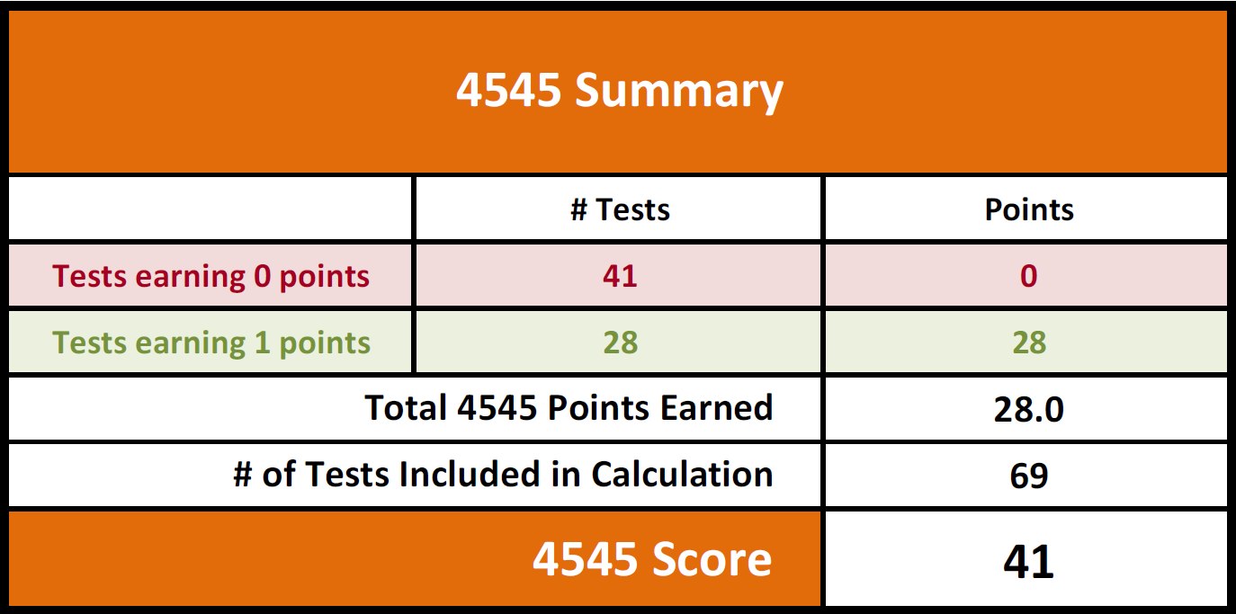
This is a KEY number for campus principals
It is the %age of passing tests in 2023 taken by students who failed Reading or Math in 2022
It reflects the effectiveness of the 4545 services provided on campus
4545 Score = 41

Slide 51
So … now that we have calculated
Annual Growth
and
4545 Performance
we can calculate
ACADEMIC GROWTH

Slide 52
Overall Academic Growth Score

Slide 53

4545 Performance
icing on the Annual Growth cake
(it can help, but it cannot hurt Annual Growth)
Academic Growth
  Annual Growth
  4545 Performance
Annual Growth

Slide 54
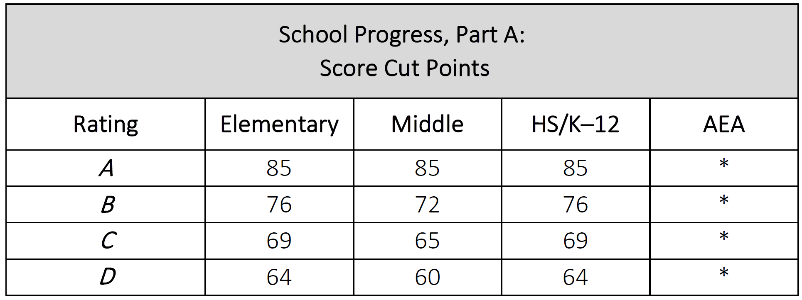
What will it take to get an A for Academic Growth?

Slide 55

academic growth
what
is STILL
our
GOAL?

Slide 56


DRIVE FOR

Slide 57

4545 Performance
icing on the Annual Growth cake
(it can help, but it cannot hurt Annual Growth)
Academic Growth
  Annual Growth
  4545 Performance
Annual Growth is a measure of the %age of students maintaining or improving their performance level as they move up to a much harder curriculum level
Annual Growth

Slide 58
2023?
elementary and middle schools
2023:
No changes to calculation or scaling
2023:
Good changes to calculation
Minor changes to scaling
2023:
No changes to calculation or scaling
2023:
MAJOR changes to calculation
and scaling
Domain I
(Performance)
Domain II-A
(Growth)
Domain II-B
(Performance)
Domain III
2023?
high schools (NOT districts)
2023:
No changes to calculation or scaling
2023:
No changes to calculation or scaling
2023:
MAJOR changes to calculation
and scaling
2023:
Good changes to calculation
Minor changes to scaling
2023:
Minor change to calculation
Major changes to scaling
2023:
Minor change to calculation
Major changes to scaling
2023:
No change to calculation
Minor changes to scaling

Slide 59

Let’s Play!
Would you rather …
Invisible

Slide 60
Let’s Play!
(particularly high school folks)
Would you rather …
CCMR
Academic Growth

Slide 61
the power of growth in 2023
this is what accountability looked like for Learnalot High School in 2022
What would it look like applying the proposed 2023 system?

Slide 62
The same thing is true for Domain III
A campus that earned a 100 in Domain III in 2022 (because all groups met the current target) will earn a 75 in 2023 (unless any of the groups meet the 2038 target)
At the low end, some campuses that earned a 0 for Domain III in 2022 may earn a higher score due to being able to earn a 1 or 2
The 2022 Domain III raw score is not an accurate score to use
One of the challenges of doing “what if” reports now is that scores like Academic Growth are not accurate
The Growth score that a campus earned in 2022 is LOWER than the Growth score the campus WOULD have earned using the proposed 2023 methodology because:
  Many results that earned ½ point in the old methodology will earn 1 point under the Transition Table Model
  4545 Performance (icing on the cake) was not included
  So if we use the Growth score from 2022, it will scale downward
  Just remember that the Growth score reported for 2022 is NOT the Growth score the campus would have earned using the 2023 methodology

Slide 63
Academic Growth of 65 means that 1 out of 3 students went backwards
What if ACADEMIC GROWTH = 85
(i.e., 85% of students make 1 year growth for 1 year of instruction PLUS a little 4545 icing on the cake)

Slide 65
that’s the power of
Growth

Slide 66

FACT or FIB?
THE PROBLEM WITH GROWTH
IS THAT IT CANNOT BE SUSTAINED!
FIB

Slide 67

For a student who achieved low Approaches GL in 2022 to maintain his/her performance in 2022-23, the teacher needs to teach this year’s curriculum AND fill in learning gaps from prior years
For a student who achieved Masters GL in 2022 to maintain his/her performance in 2022-23, the teacher “only” needs to teach this year’s curriculum
making sense of growth …
2023
Did Not Meet GL
Approaches GL
Meets GL
Masters GL
? | ? | ? | ?
student is unlikely to succeed in the next grade or course without significant, ongoing academic intervention
student has a high likelihood of success in the next grade or course but may still need some short-term, targeted academic intervention
student is expected to succeed in the next grade or course with little or no academic intervention
If you are the classroom teacher and you had to bet your life savings on only ONE of these students making Academic Growth as a result of your classroom instruction in 2022-23 … which would you choose?
student is likely to succeed in the next grade or course with targeted academic intervention
Did Not Meet GL
Approaches GL
Meets GL
Masters GL
2022
let’s suppose this is how students PERFORMED in 2022

Slide 68
The keys to Growth?
Recognize that ACADEMIC GROWTH applies to ALL students
  all means all
Recognize that a student who MAINTAINS his/her performance as he/she manages a much more rigorous level of curriculum has made ACADEMIC GROWTH
  4th grade is a LOT harder than 3rd grade, 5th grade is a LOT harder than 4th grade, etc.
Emphasize, evaluate and engage in ACADEMIC GROWTH throughout the school year

Slide 69
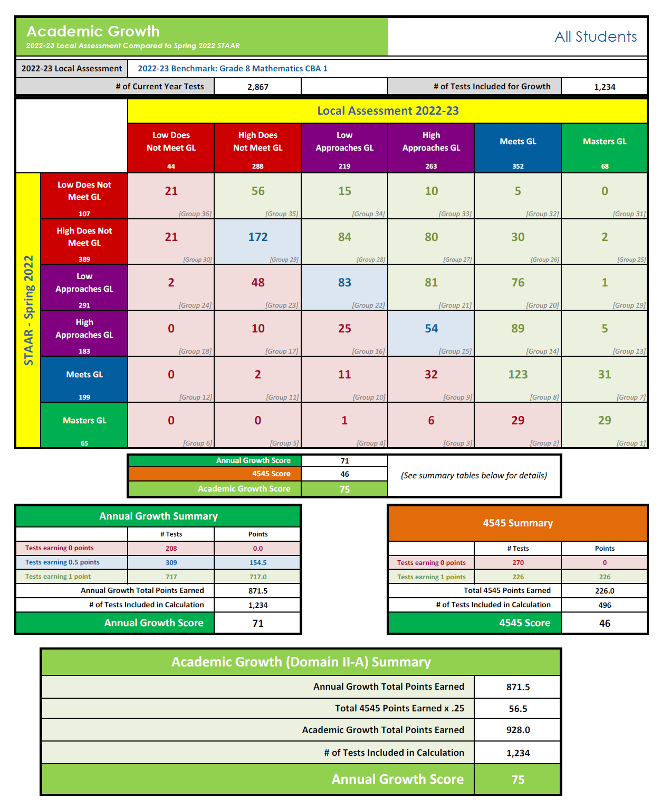
ac22-23 data tool
Academic Growth Template (2022-23 Local Assessment or Interim Assessment)
“Maps” performance on 2022-23 Local Assessment compared to Performance on Spring 2022 STAAR
Annual Growth
4545
Academic Growth

Slide 70
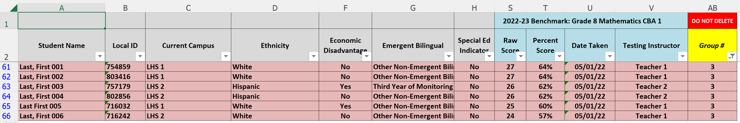
ac22-23 data tool
Academic Growth Template (2022-23 Local Assessment or Interim Assessment)
This Template is designed PRIMARILY to help with identifying INDIVIDUAL students who may need intervention

Slide 71
reality check:
as of today, do we know everything we want to know about 2023 Accountability?
No

Slide 72
do we know what we need to know to lead instruction for 2022-23?
Yes

Slide 73
#growthwins

Slide 74

2023 accountability refresh

Slide 75
2021-22
federal report cards

Slide 76
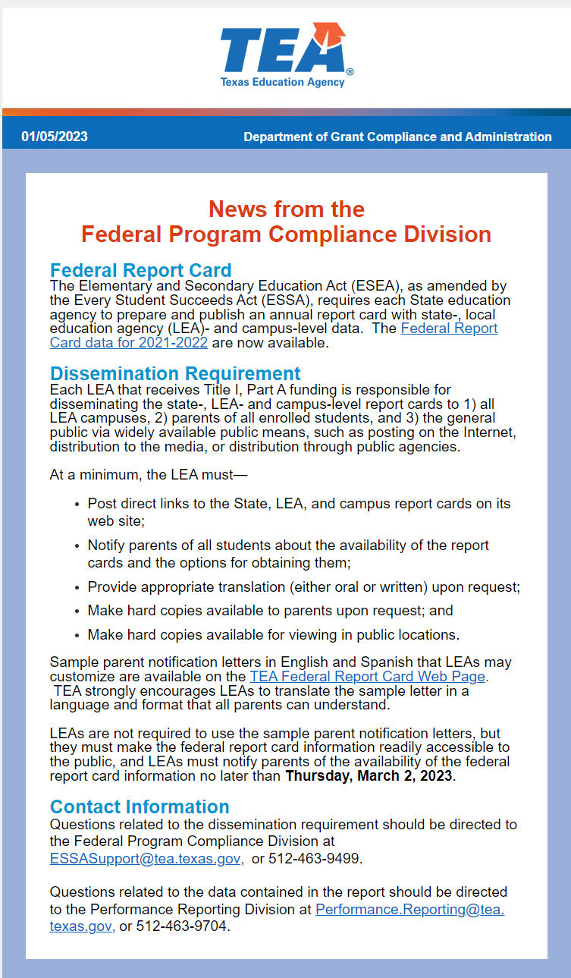
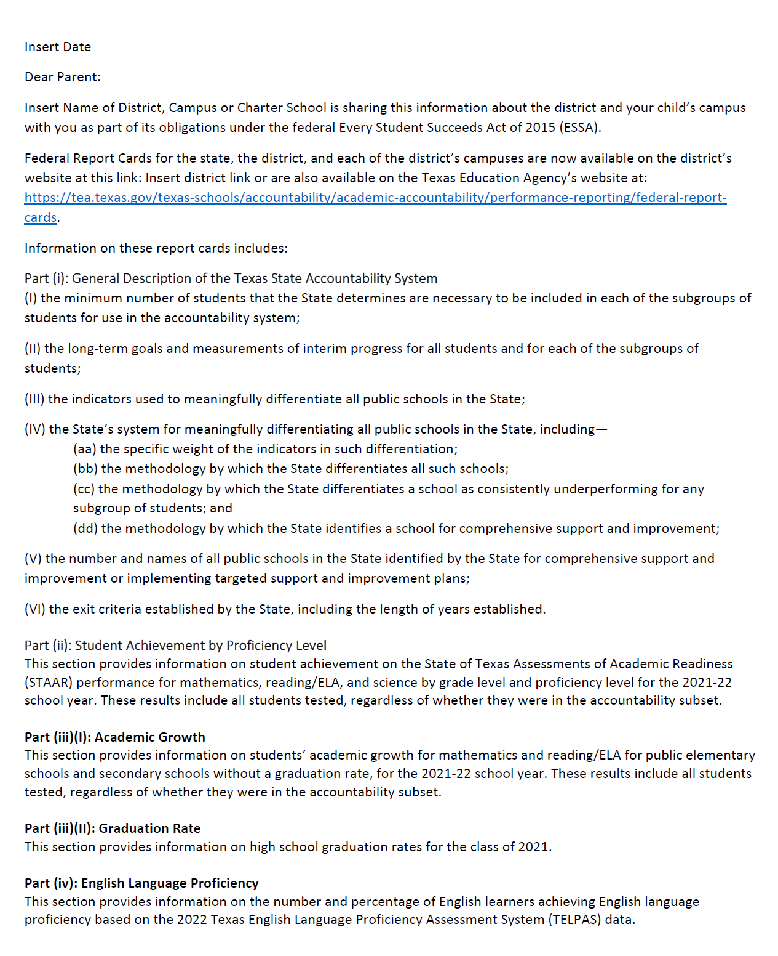
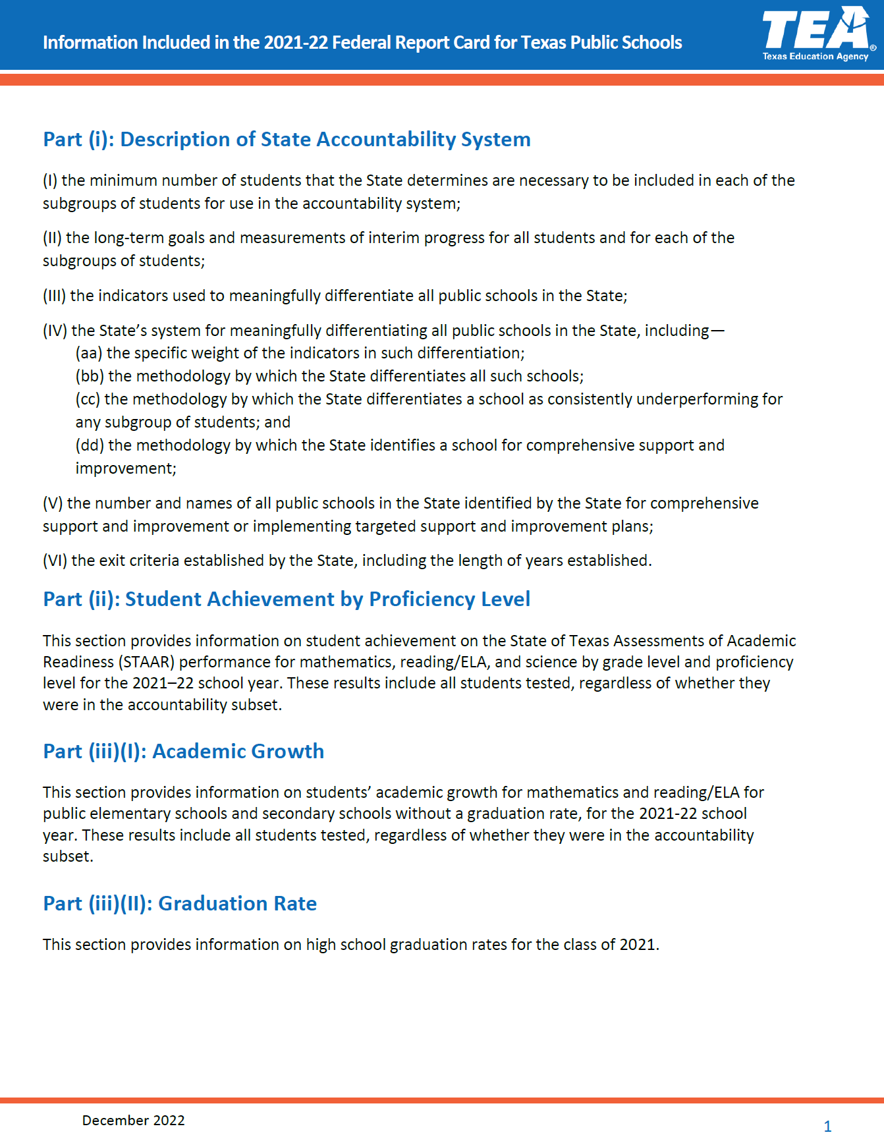
2021-22 Federal Report Cards (FRCs)
All are posted on the Webinar 16 page
TEA-provided Sample Parent Notification Letter
English/Spanish
Information Included
in FRC
English/Spanish
01/05/2023
Email

Slide 77
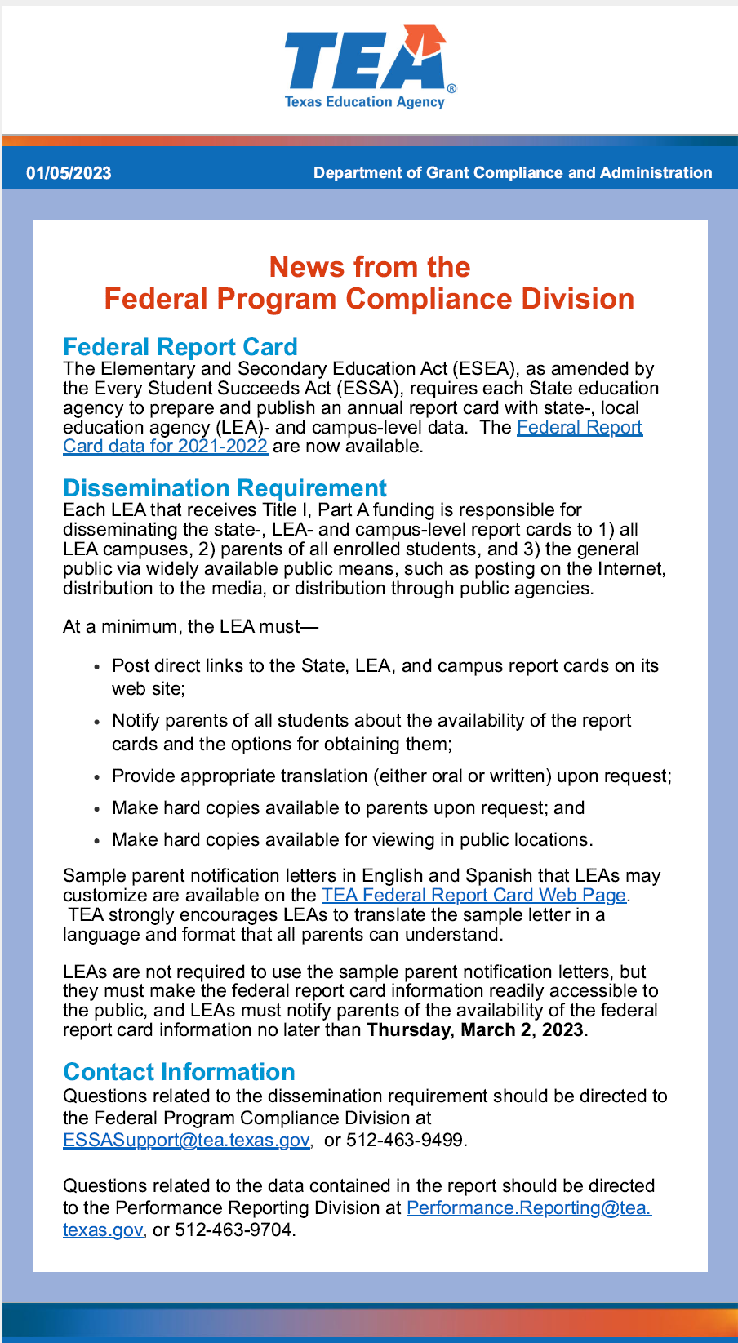
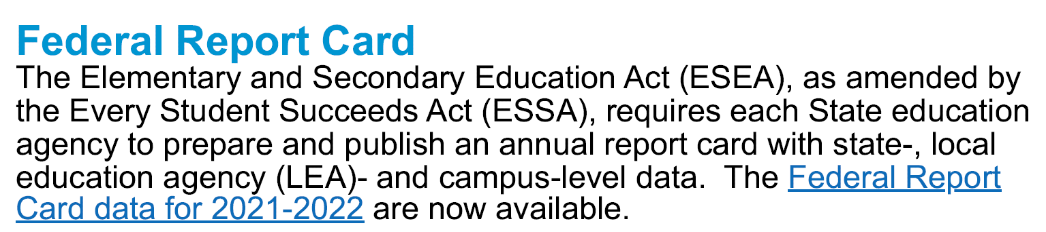
2021-22 Federal Report Cards (FRCs)
ESSA requires each State education agency to prepare and publish an annual report card with state-, district- and campus-level data
TEA has posted 2021-22 Federal Report Cards for
  the state
  each district and
  each campus
General requirements applicable to FRCs are set forth on TEA's Federal Report Card Webpage
The 2021-22 FRCs are posted at: Federal Report Cards
Links to both web sites are posted on the Webinar 16 page

Slide 78

2021-22 Federal Report Cards (FRCs)
Each FRC has 14 parts
  Part (i): Description of the State Accountability System
    This section includes a broad description of various aspects of the State Accountability System
    Each FRC contains links to the lists of CSI, TSI and ATS campuses for 2022-23
  Part (ii): Student Achievement by Proficiency Level
    This section provides information on student achievement on STAAR performance for Mathematics, Reading/ELA, and Science by grade level and proficiency level for the 2021-22 school year
    These results include all students tested, regardless of whether they were in the accountability subset
  Part (iii): Academic Growth and Graduation Rate
    Section (I) provides information on students’ academic growth for Math and RLA for the 2021-22 school year
      These results include all students tested, regardless of whether they were in the accountability subset
    Section (II) provides information on high school graduation rates for the cohort class of 2020-21

Slide 79
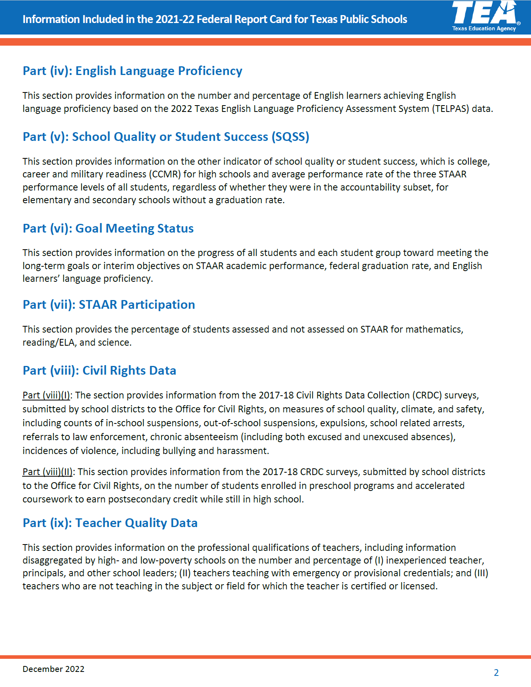
2021-22 Federal Report Cards (FRCs)
Each FRC has 14 parts
  Part (iv): English Language Proficiency
    This section provides information on the number and percentage of English learners achieving English language proficiency based on 2022 TELPAS data
  Part (v): School Quality or Student Success (SQSS)
    This section provides information on school quality or student success, which is:
      CCMR for high schools (for graduates in 2020-21) and
      average performance rate of the three STAAR performance levels of all students, regardless of whether they were in the accountability subset, for elementary and secondary schools without a graduation rate
  Part (vi): Goal Meeting Status
    This section provides information on the progress of all students and each student group toward meeting the long-term goals or interim objectives on:
      STAAR academic performance
      federal graduation rate
      English learners' language proficiency
  Part (vii): STAAR Participation
    This section provides the percentage of students assessed and not assessed on STAAR for Math, RLA and Science

Slide 80
2021-22 Federal Report Cards (FRCs)
Each FRC has 14 parts
  Part (viii): Civil Rights Data (same data as was reported in the 2020-21 FRCs)
    Section (I) provides information from the 2017-18 Civil Rights Data Collection (CRDC) surveys, submitted by school districts to the Office for Civil Rights, on measures of school quality, climate, and safety, including counts of in-school suspensions, out-of-school suspensions, expulsions, school related arrests, referrals to law enforcement, chronic absenteeism (including both excused and unexcused absences), incidences of violence, including bullying and harassment
    Section (II) provides information from the 2017-18 CRDC surveys, submitted by school districts to the Office for Civil Rights, on the number of students enrolled in preschool programs and accelerated coursework to earn postsecondary credit while still in high school
  Part (ix): Teacher Quality Data
    This section provides information on the professional qualifications of teachers, including information disaggregated by high- and low-poverty schools on the number and percentage of
      inexperienced teacher, principals, and other school leaders;
      teachers teaching with emergency or provisional credentials; and
      teachers who are not teaching in the subject or field for which the teacher is certified or licensed

Slide 81
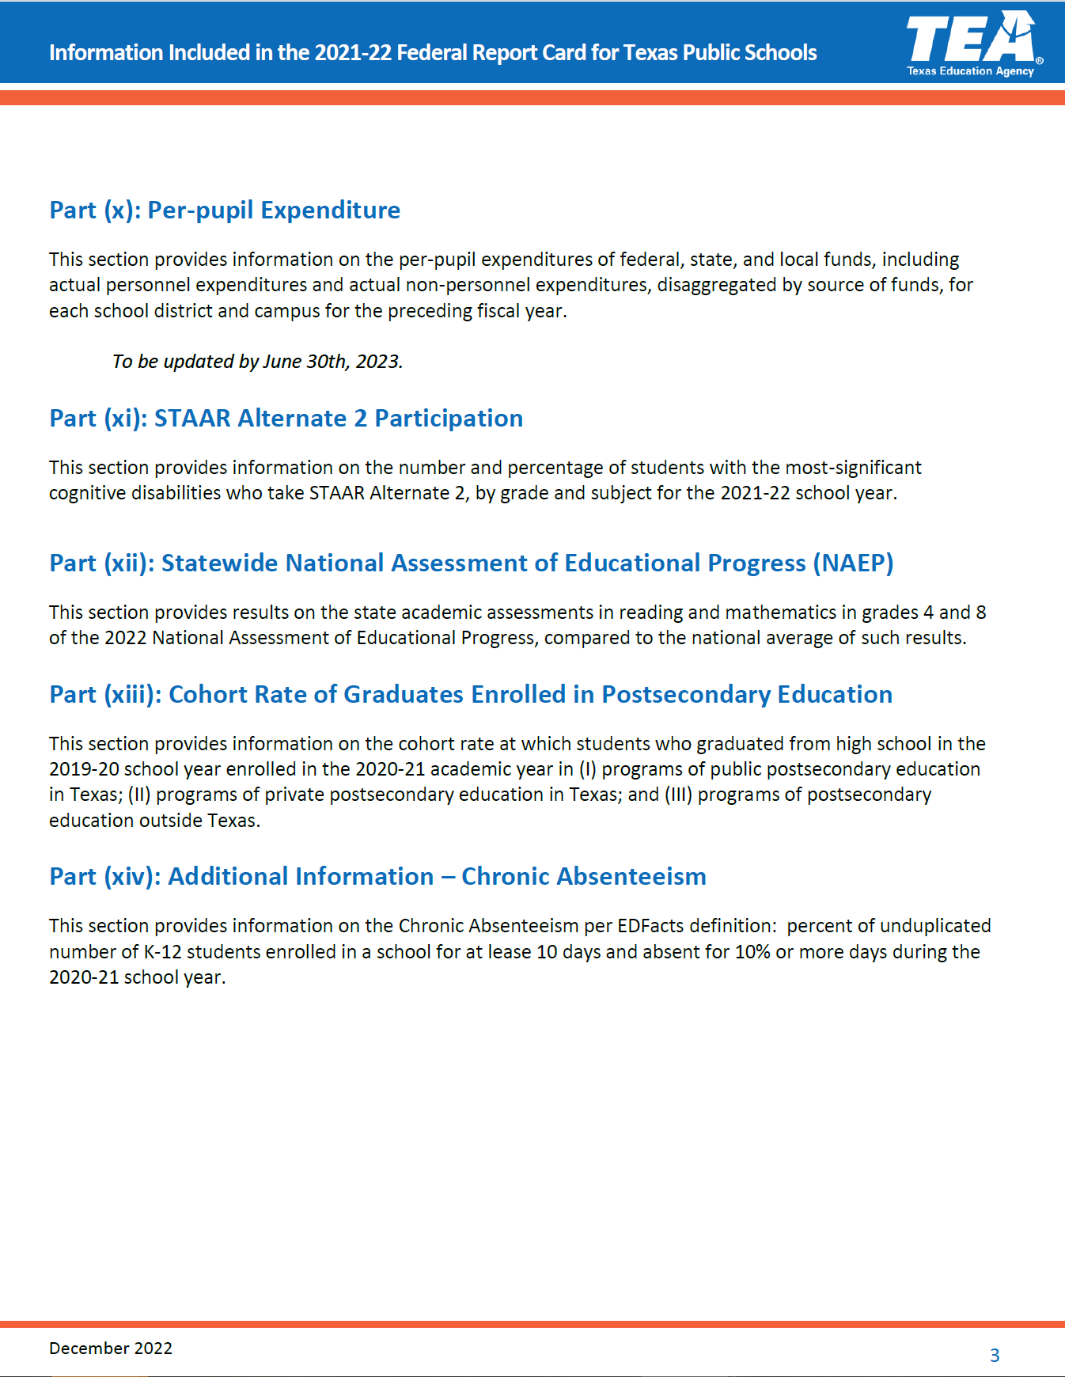
2021-22 Federal Report Cards (FRCs)
Each FRC has 14 parts
  Part (x): Per-pupil Expenditure
    This section provides information on the per-pupil expenditures of federal, state, and local funds, including actual personnel expenditures and actual non-personnel expenditures, disaggregated by source of funds, for each school district and campus for the preceding fiscal year
    To be updated by June 30, 2023
  Part (xi): STAAR Alternate 2 Participation
    This section provides information on the number and percentage of students with the most-significant cognitive disabilities who take STAAR Alternate 2, by grade and subject for the 2021-22 school year
  Part (xii): Statewide National Assessment of Educational Progress (NAEP)
    This section provides results on the state academic assessments in reading and mathematics in grades 4 and 8 of the 2022 National Assessment of Educational Progress, compared to the national average of such results

Slide 82
2021-22 Federal Report Cards (FRCs)
Each FRC has 14 parts
  Part (xiii): Cohort Rate of Graduates Enrolled in Postsecondary Education
    This section provides information on the cohort rate at which students who graduated from high school in the 2019-20 school year enrolled in the 2020-21 academic year in
      programs of public postsecondary education in Texas;
      programs of private postsecondary education in Texas; and
      programs of postsecondary education outside Texas.
  Part (xiv): Additional Information – Chronic Absenteeism (new in last year’s FRC)
    This section provides information on the Chronic Absenteeism per EDFacts definition: percent of unduplicated number of K-12 students enrolled in a school for at least 10 days and absent for 10% or more days during the 2020-21 school year

Slide 83
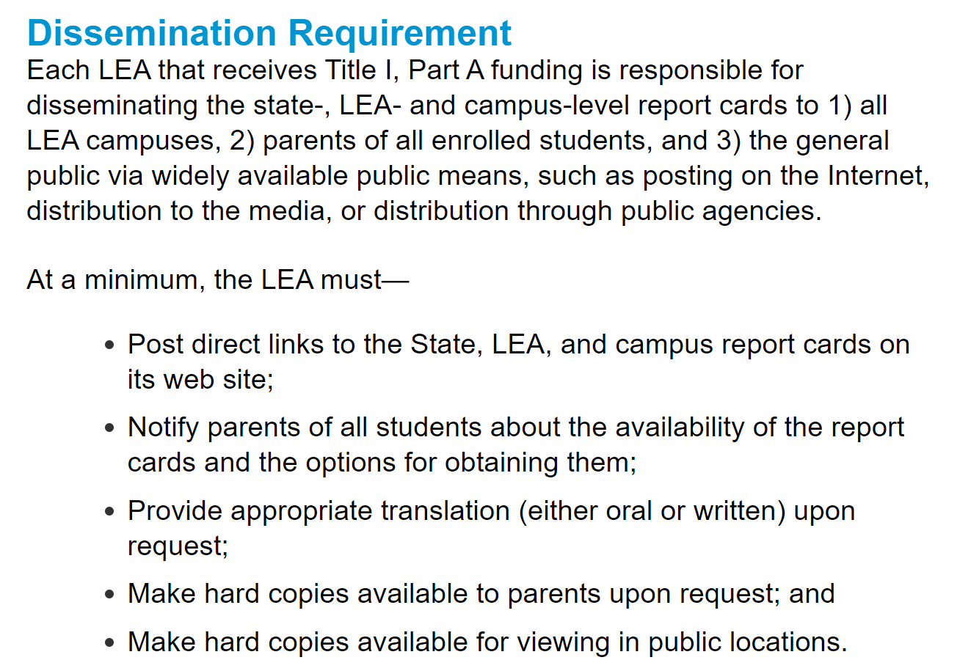
2021-22 Federal Report Cards (FRCs)
Dissemination Requirement
  Each LEA that receives Title I, Part A funding is responsible for disseminating the State, LEA and campus-level report cards to
    all LEA campuses
    parents of all enrolled students, and
    the general public via widely available public means such as posting on the Internet, distribution to the media, or distribution through public agencies
  At a minimum, the LEA must—
    Post direct links to the State, LEA, and campus report cards on its web site
    Notify parents of all students about the availability of the report cards and the options for obtaining them
    Provide appropriate translation (either oral or written) upon request
    Make hard copies available to parents upon request; and
    Make hard copies available for viewing in public locations

Slide 84
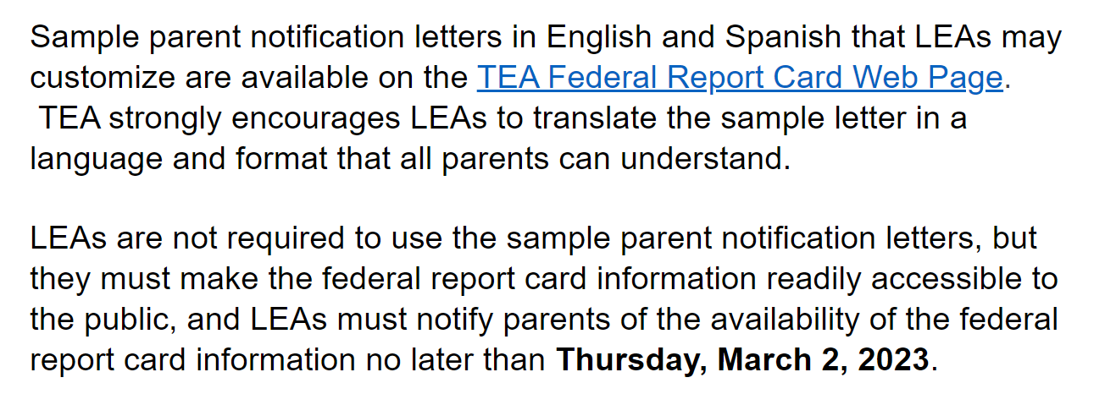
2021-22 Federal Report Cards (FRCs)
Parent Notification
  TEA has provided a sample parent notification letter (in English and in Spanish) that LEAs may customize as needed
    Both letters are posted on TEA’s Federal Report Card page
    Both letters are also posted as resources on the Webinar 15 page
  TEA strongly encourages LEAs to translate the sample letter in a language and format that all parents can understand
  LEAs are not required to use TEA’s letter, but they must make the FRC information readily accessible to the public
  LEAs must notify parents of the availability of the FRC information no later than Wednesday, March 2, 2023

Slide 85
2021-22 Federal Report Cards (FRCs)
TEA’s parent letter restates all of the information contained in the TEA document summarizing the information included in the FRC
Districts might consider
including TEA’s summary document with the parent letter or
including a hyperlink to TEA’s information document in the parent letter
(both of which would reduce the length of the parent letter)

Slide 86
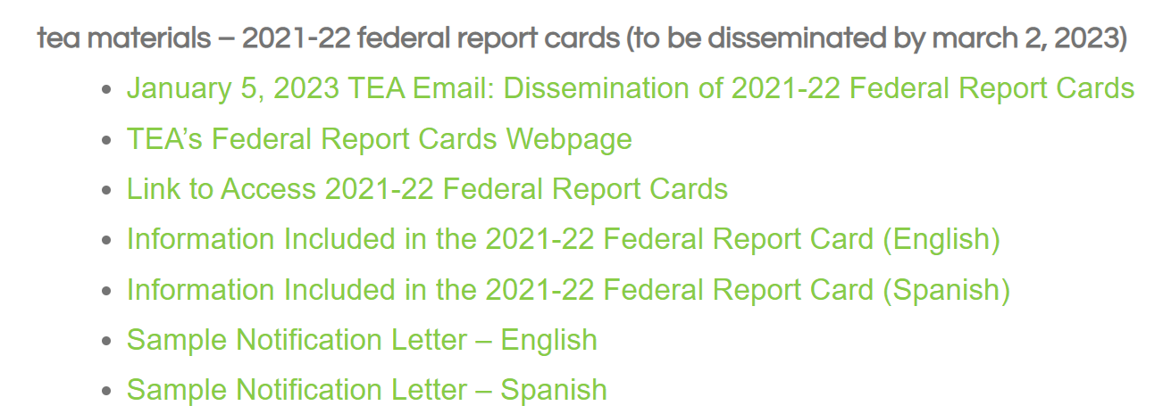

Slide 87
2021-22
school report cards

Slide 88
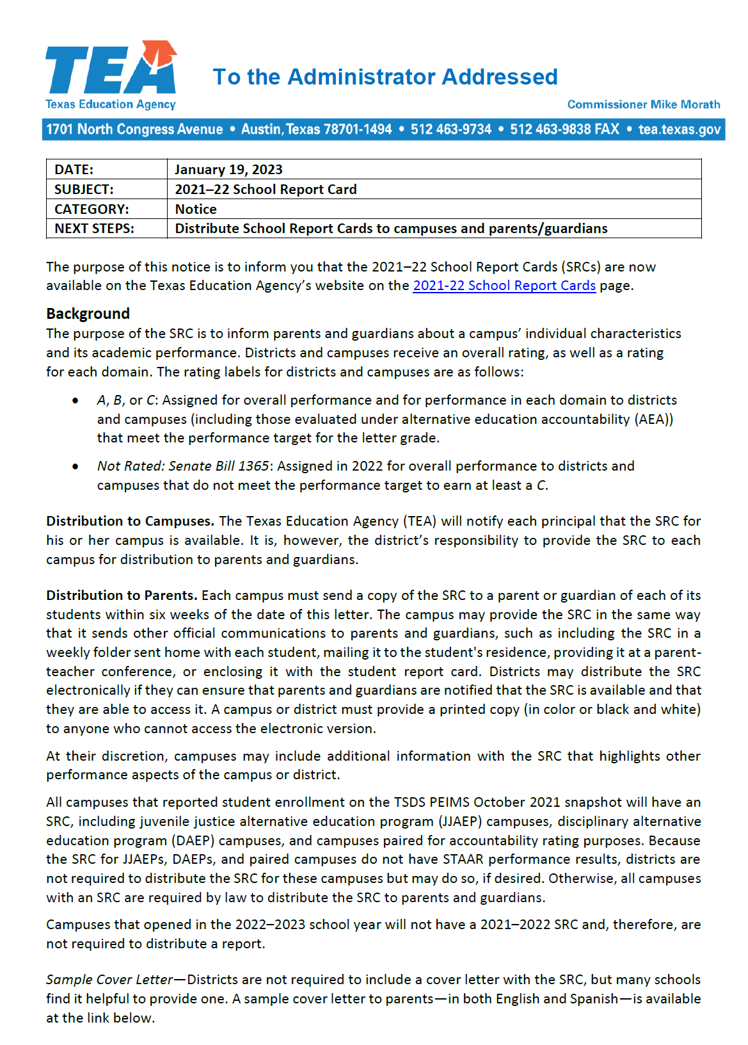
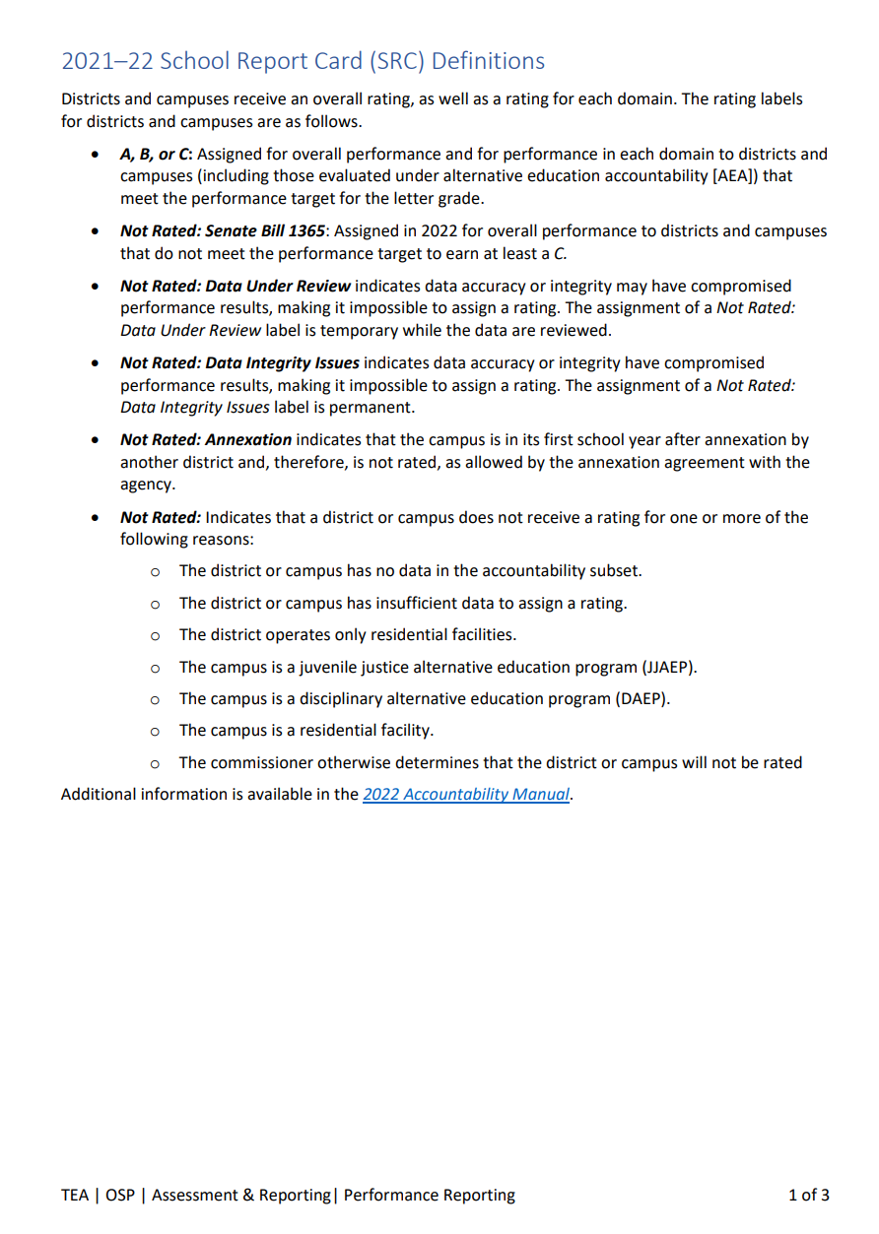
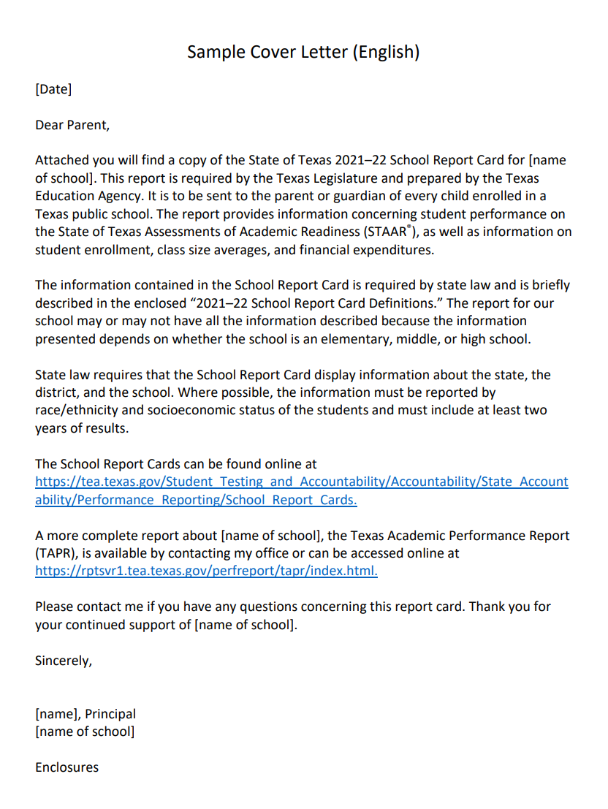
2021-22 School Report Cards (SRCs)
01/19/2023
TAA Letter
(2 pages)
2021-22 SRC Definitions
English/Spanish
(3 pages)
TEA-provided Sample Parent Notification Letter
English/Spanish
(1 page)

Slide 89
2021-22 School Report Cards (SRCs)
TEC §39.305 requires TEA to publish an SRC for each campus each year
  2021-22 SRCS were posted on TEA’s website on January 19, 2023
  2020-21 SRCs were posted on TEA’s website on February 3, 2022
  2019-20 SRCs were posted on TEA’s website on December 3, 2020
The SRC provides a broad view of campus performance by combining:
  accountability ratings
  data from the Texas Academic Performance Reports (TAPR), and
  financial information
The SRC is intended specifically to inform parents and guardians about a school’s individual characteristics and its academic performance

Slide 90
2021-22 School Report Cards (SRCs)
TAA Letter – January 19, 2023
  Each campus must send a copy of the SRC to a parent or guardian of each of its students within six weeks of the date of the TAA letter
    So the deadline for disseminating the SRC is March 3, 2023
  A school may provide the SRC in the same way it sends other official communications to parents and guardians, such as:
    including the SRC in a weekly folder sent home with each student
    mailing it to the student's residence
    providing it at a teacher-parent conference or
    enclosing it with the student report card
  Districts may distribute the SRC electronically if they can ensure that parents and guardians are notified that the SRC is available and that they are able to access it
  A campus or district must provide a printed copy (in color or black and white) of the SRC to anyone who cannot access the electronic version

Slide 91
2021-22 School Report Cards (SRCs)
TAA Letter – January 19, 2023
  A campus may not alter the SRC
    However, a campus may include additional information with the SRC that highlights other performance aspects of the campus or district
  All campuses that reported student enrollment on the Fall 2021 PEIMS Snapshot date will have a 2021-22 SRC, including
    JJAEP campuses
    DAEP campuses, and
    Campuses paired for accountability rating purposes
  HOWEVER, because SRCs for JJAEPs, DAEPs, and paired campuses do not have STAAR performance results, districts are not required to distribute the SRC for these campuses
  Campuses that opened in 2022-23 will not have a 2021-22 SRC

Slide 92
2021-22 School Report Cards (SRCs)
TAA Letter – January 19, 2023
  Sample Cover Letter
    Districts are not required to include a cover letter with the SRC
    Many schools find it helpful to provide one
    A sample cover letter to parents (in English and in Spanish) is available
      On TEA’s webpage
      On the Webinar 16 page
  Definitions
    Districts are not required to provide definitions to parents
    Many schools find that it helps parents and guardians understand the SRC
    A document with brief definitions of the items included in the SRC (in English and in Spanish) is available
      On TEA’s webpage
      On the Webinar 16 page

Slide 93
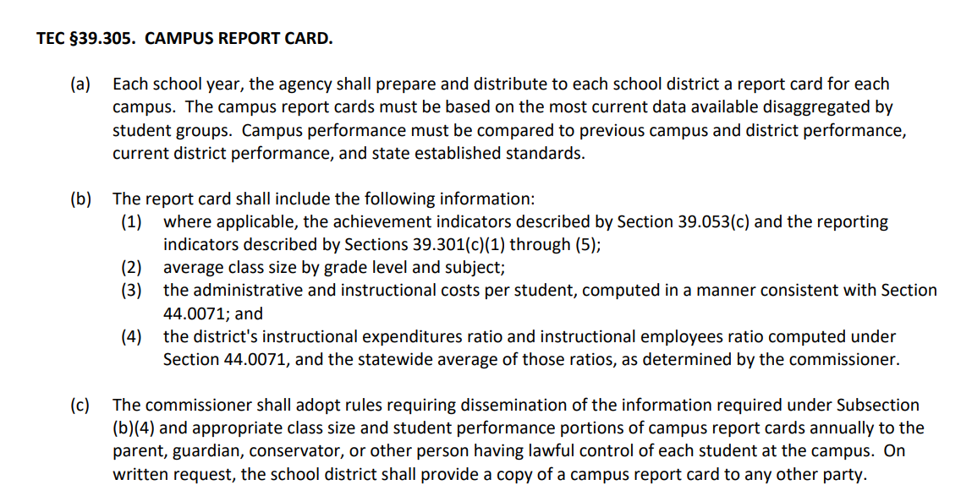
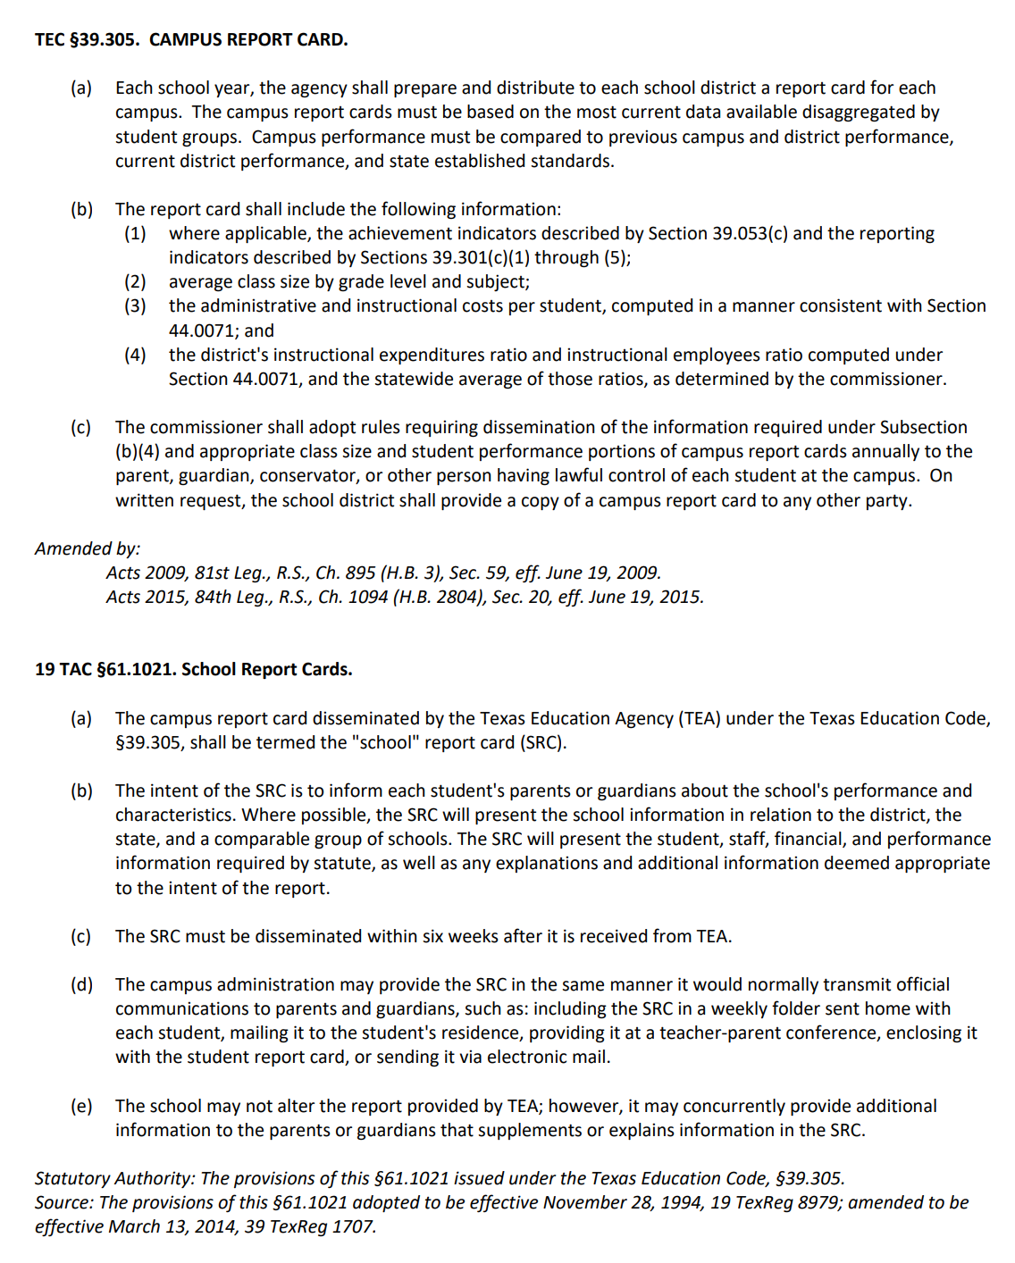
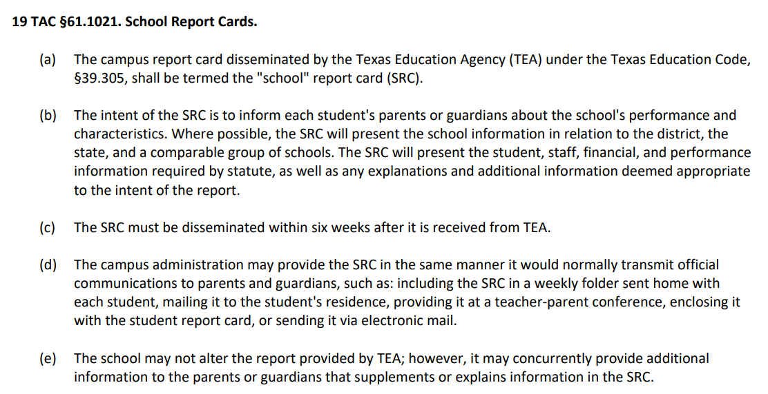
2021-22 School Report Cards (SRCs)
Statutory and rule requirements relating to SRCs
  Texas Education Code Sec. 39.305
  Commissioner Rule Sec. 89.1021

Slide 94
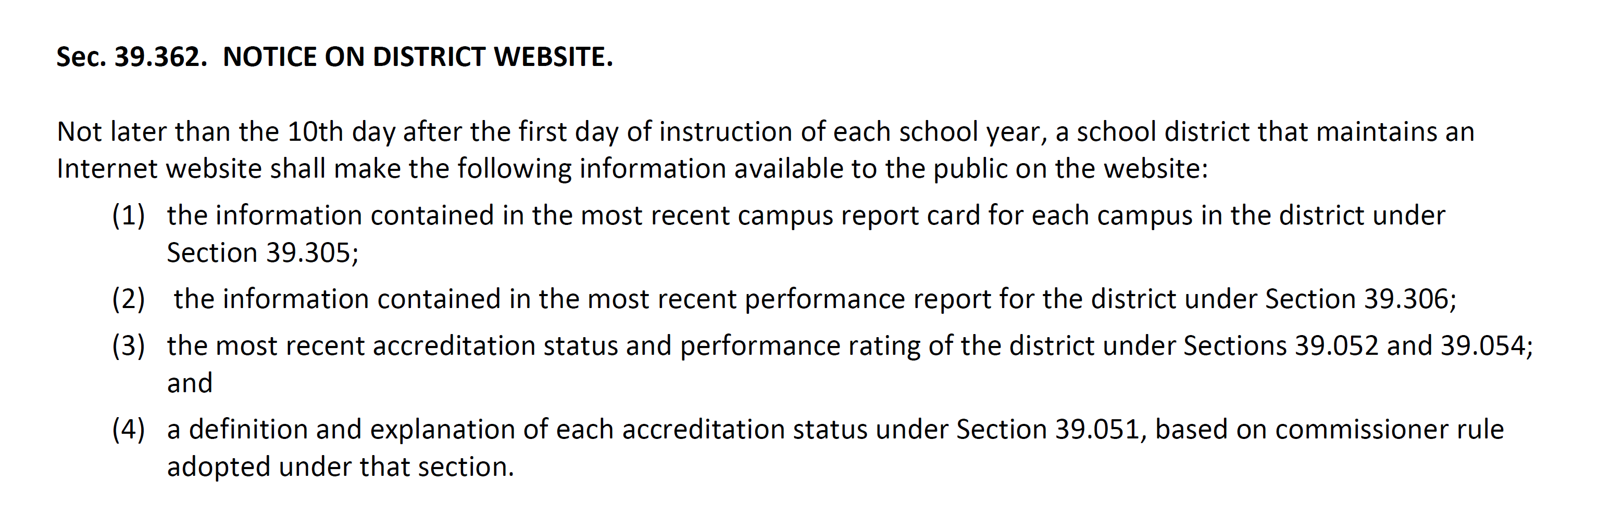
2021-22 School Report Cards (SRCs)
Posting to District’s Website – TEC §39.362
  Each district that maintains an internet website must post the most recent SRC for each campus to the district’s website by the 10th instructional day of the school year
    The 2021-22 SRCs must be posted by the 10th instructional day of the 2023-24 school year
    Statute does not require a district to update its website now with the 2021-22 SRCs
    BUT … posting the 2021-22 SRCs now will mean that the district will have satisfied the requirement to post the “most recent” SRCs by the 10th instructional day of the 2023-24 school year

Slide 95
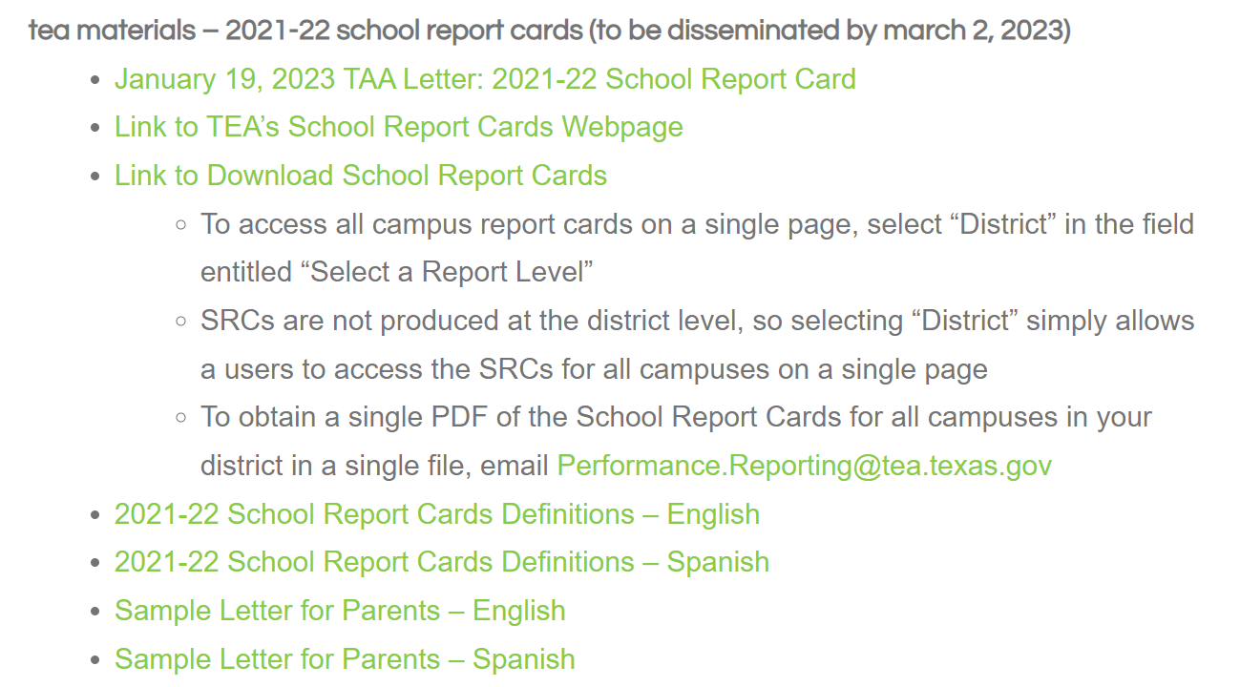

Slide 96

2021-22 Federal Report Cards
Could I just handle them with one notice???
2021-22 School Report Cards

Slide 97
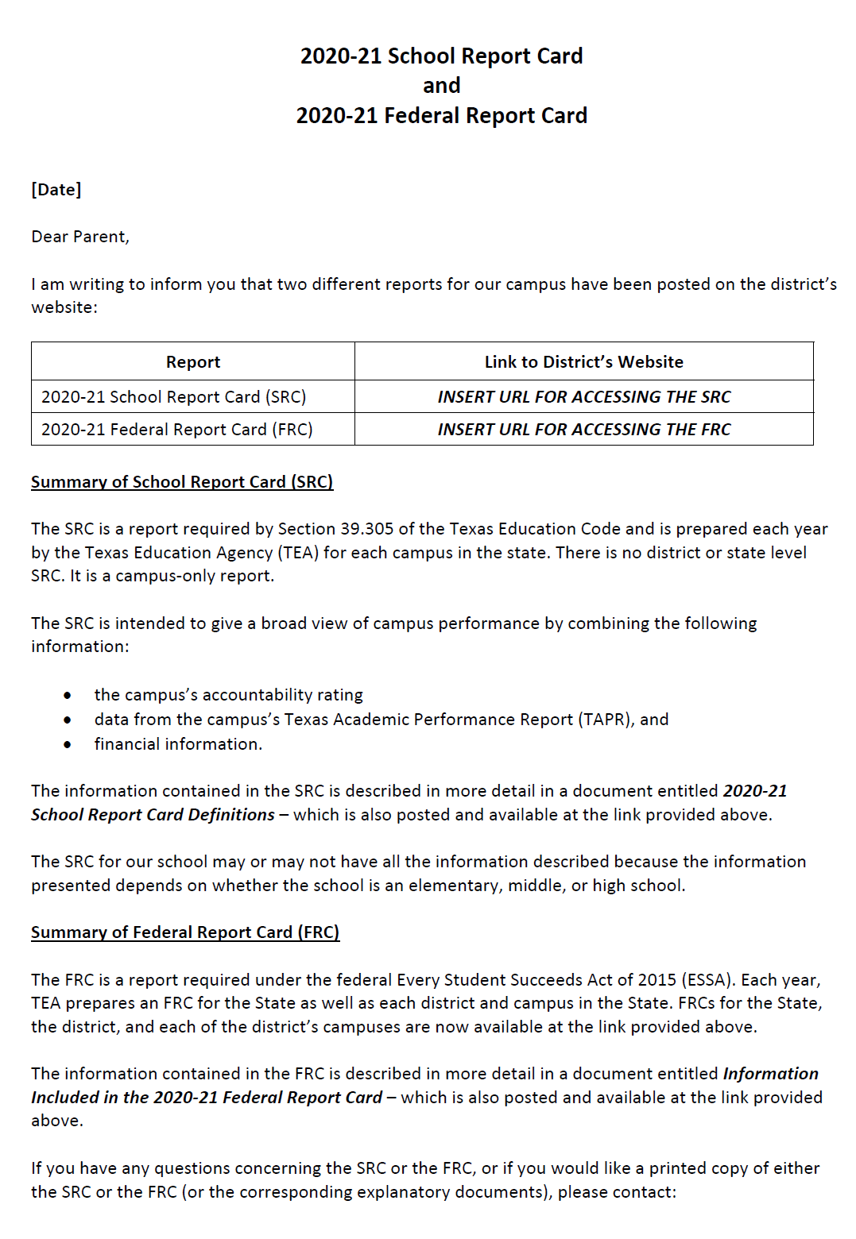
2021-22 School Report Cards (SRCs)
2021-22 Federal Report Cards (FRCs)
Sample Communication for notifying parents of BOTH the FRC and the SRC
  Posted as a resource under Webinar 16
  Not drafted by TEA – but might be used by districts to facilitate dissemination requirements for both the FRC and the SRC
  The sample communication would provide parents with direct links to the district’s website to access
    State, District and Campus FRCs (as well as the TEA document describing the information contained in the FRC – in English and Spanish)
    Campus SRCs (as well as the TEA document providing SRC definitions – in English and Spanish)
  Parents interested in more information about either the FRC or the SRC – or who would like to obtain a printed copy of either report – may contact the person designated in the notice
  Dissemination dates
    FRCs: March 2, 2023
    SRCs: March 2, 2023

Slide 98
2021-22 federal report cards
2021-22 school report cards

Slide 99
what’s next?
Date | Activity
February | Updated 2023 A–F System Framework Release
March 2, 2023 | Deadline for disseminating 2021-22 Federal Report Cards and 2021-22 School Report Cards
Late March/early April | Deadline for holding Public Hearing to review the 2021-22 District Annual Report [see Webinar 14]
March 27, 2023 | 2nd Annual Accountability Symposium
April – May 2023 | What If Report (TEAL and Public Web) Release
April – May 2023 | Preliminary 2023 Accountability Manual release
August 2023 | Final 2023 Accountability Manual (all Chapters and Appendices) release
September 2023 | 2023 A-F Accountability Ratings release

Slide 100


Slide 101
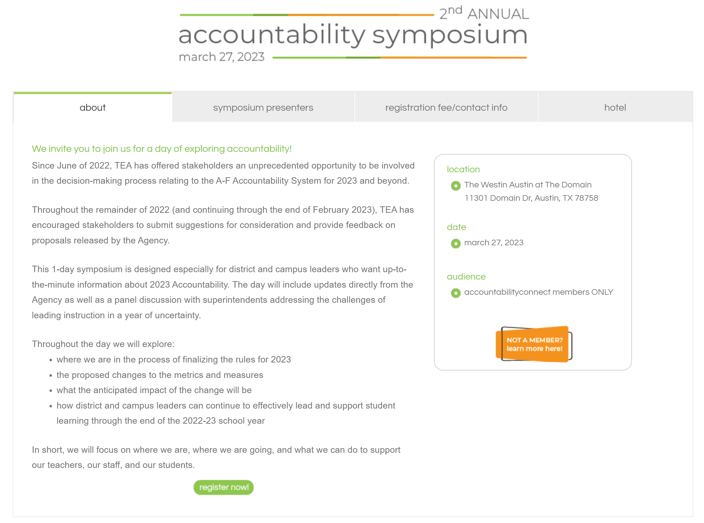

Slide 102


next 2 webinars
accountabilityconnect22-23 | Webinars
  Webinar #17: 2022-23 School Year Update
    Thursday, February 23, 2023
    9:00 a.m. Central Time
    Special Guest: Heather Smalley, Texas Education Agency
  Webinar #18: 2022-23 School Year Update
    NEW DATE: Thursday, April 6, 2023
    9:00 a.m. Central Time

Slide 103

THANK YOU!
johnfessenden
email: john@lead4ward.com
telephone: 512-560-7784
leannfisher
email: leann@lead4ward.com
telephone: 806-535-5509

